Slide 1
Be a Professional
Bart Sturzl, MPM®, RMP®

Slide 2
Definition
pro·fes·sion·al adjective
following an occupation as a means of livelihood or for gain
pro·fes·sion·al·ism noun
1. Professional character, spirit, or methods.
2. the standing, practice, or methods of a professional, as distinguished from an amateur.

Slide 3
The 3 Keys
Know the Owner
Know the Property
Know the Tenant

Slide 4

Know the Owner
Competition
Contracts
ROI
Insurance & Risk Management
Communication
Is There a Fit

Slide 5
Competition
Who are They
What do they Charge
What are their Strengths & Weaknesses
What’s in Their Contract
How are you Different

Slide 6

Contracts
When is the Last Time You Read It
Will it Stand Up

Slide 7

ROI
((Return - Capital) / Capital) × 100% = Rate of Return

Slide 8
Insurance & Risk Management
Does the Owner Have the Correct Policy
Are you Listed as Additionally Insured
Additionally Insured / Additional Interest

Slide 9

Communication
Try to Find Out What Generation
Email / Phone / Text / Fax

Slide 10
Is There a Fit
Have They Been Managed Before?
Can You Communicate With Them?
Will They Maintain The Property?
Are They Current On Payments?

Slide 11
Know the Property
Laws & Ordinances
Market
Area
Statistics

Slide 12
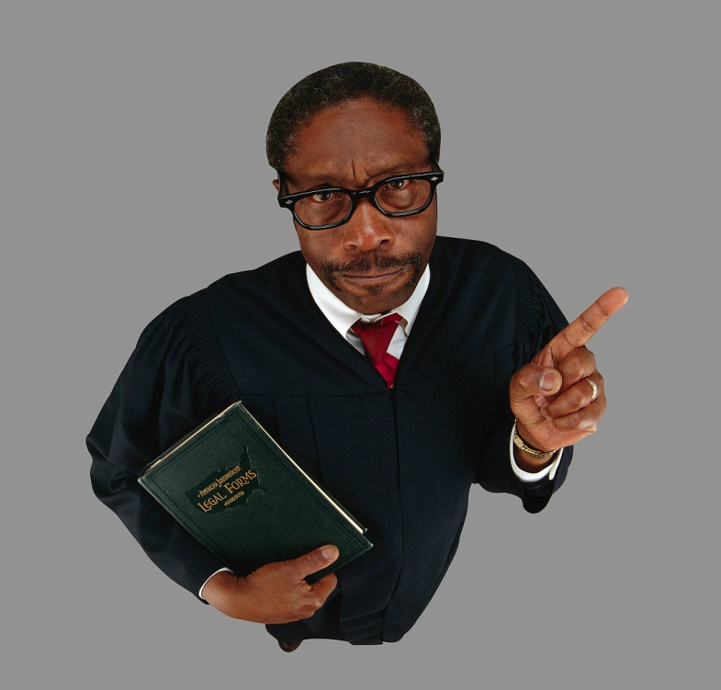
Laws & Ordinances
National
State
Local

Slide 13

Market
You Need To Know Your Market

Slide 14

Area
Set Boundaries
Types Of Properties You Manage

Slide 15

Statistics
Vacancy Rate
Days on Market
Renewal Rate
Average Rent

Slide 16
Know the Tenant
Application
Screening
Lease
Eviction
Deposit Itemization & Collection

Slide 17

Application
Authorization to Collect Information
Ask the Right Questions
Follows Fair Housing
Is it Complete?

Slide 18
Screening
Credit
Criminal
Sex Offender Data
Evictions
Employment
Rental History

Slide 19
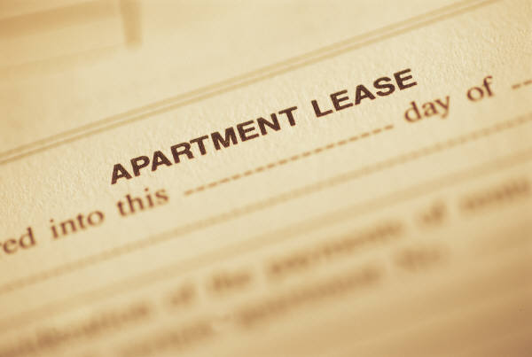
Lease
When is the Last Time You Read It
Will it Stand Up

Slide 20
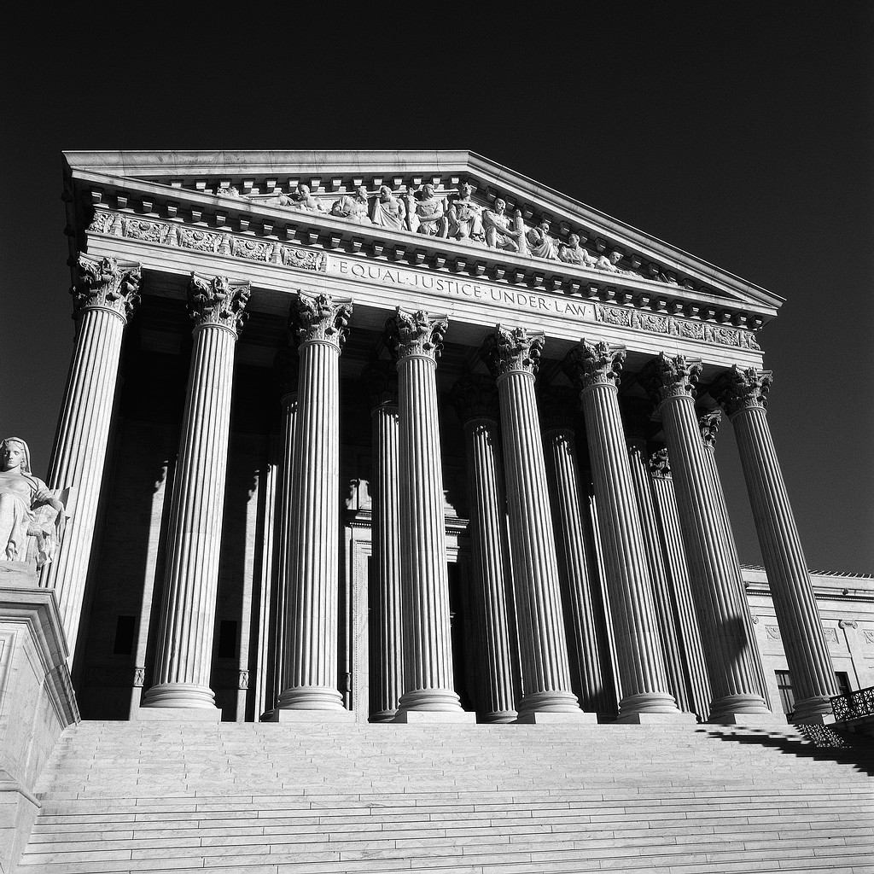
Eviction
Every State is Different, Know Yours
Court
Writ
Treat Tenant Fairly and with Respect

Slide 21

Deposit Itemization & Collections
Photos
Documentation / Inventories
Ask Yourself, What would the Judge Say
Fair Collections Act

Slide 22
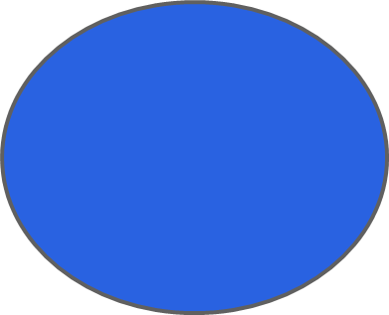


The Professional Property Manager
Owner
Tenant
Property

Slide 23
Be a Professional
Bart Sturzl, MPM®, RMP®

