Slide 1
“ONE IN A MILLION”
MAKE YOUR
COUNT

Slide 2


WHY
CAN I TALK ABOUT
THIS?
Jason Doyle,
President, Propertware
Notes:
Credentials about Jason’s background, current responsibilities

Slide 3

AGENDA
WHY THIS TOPIC?
#1 RULE
BEST PRACTICES
GOOD AND BAD
EXAMPLES
Notes:
Yes, we know it’s basic, but time and again we see listings (even our own clients) with poor pictures, bad addresses – details (really, fundamental information) that prevent prospective tenants from moving forward on the property in some way

Slide 4

#1 RULE:
MAKE IT ALL ABOUT
THE TENANT

Slide 5

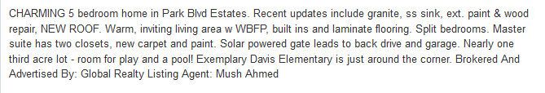
PROPERTY DESCRIPTION
Keep the description to the point and highlight the selling features

Slide 6
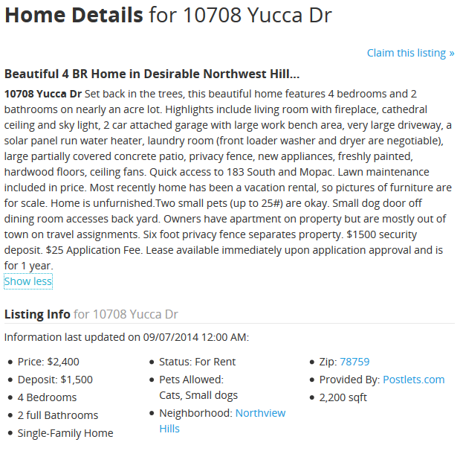
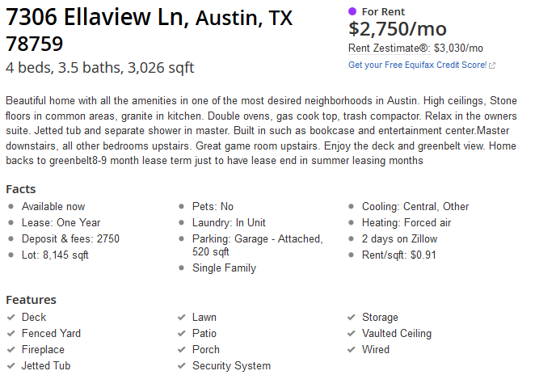
AMENITIES
Include all amenities to attract more visitors.
Customize based on ILS
Notes:
Make sure to include all amenities, such as parking, pets, A/C, etc. This is very important because sites will use filters to narrow down the search results. When you don’t list a particular amenity you’re missing out.

Slide 7


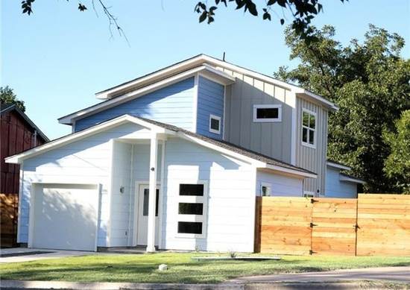
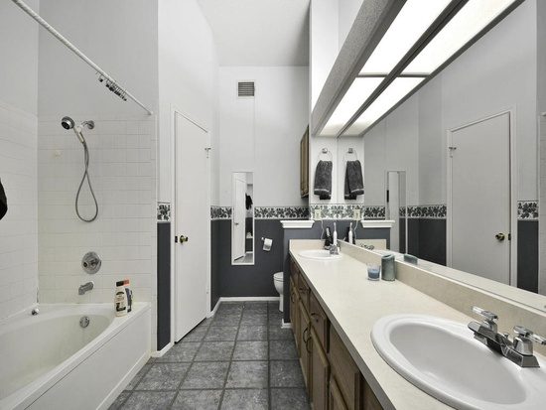
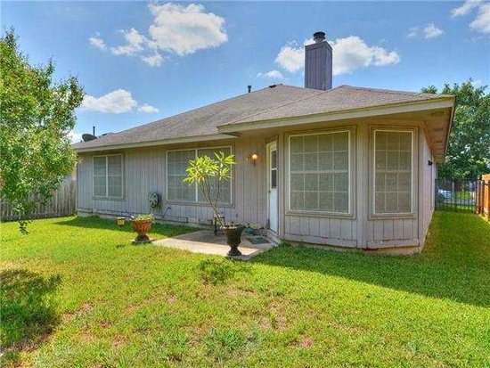
PHOTOS
Include between 5-10 photos
High-quality, properly sized, watermarked
Remove timestamps
Lead photo should be your best
Notes:
Every listing should have between 5 to 10 photos. Each needs to be properly sized (pixel dimensions and DPI) to correctly populate the sites. Photos should be high quality and watermarked, but they should Not have a timestamp. Use a naming convention that includes the pixel dimensions so you can use for multiple sites and readily access (Example: 121_Main-MasterBd-350w_x_180h.jpg or OwnerLast_ButterflyLn_Master-250w_x_125h.png)
You don’t want to be showing a photo that says it’s from 2007, when its 2014. It’s also important to make sure your lead photo is the best one. This lead photo will be the 1st impression of the property. Below is a list of photos to include on a listing. – recent, including best seasonal images (winter wonderland, spring blooms, striking views, etc)
Front of the property
Living room
Dining area
Kitchen
Bathroom
Backyard / patio
Bedroom / closet space

Slide 8
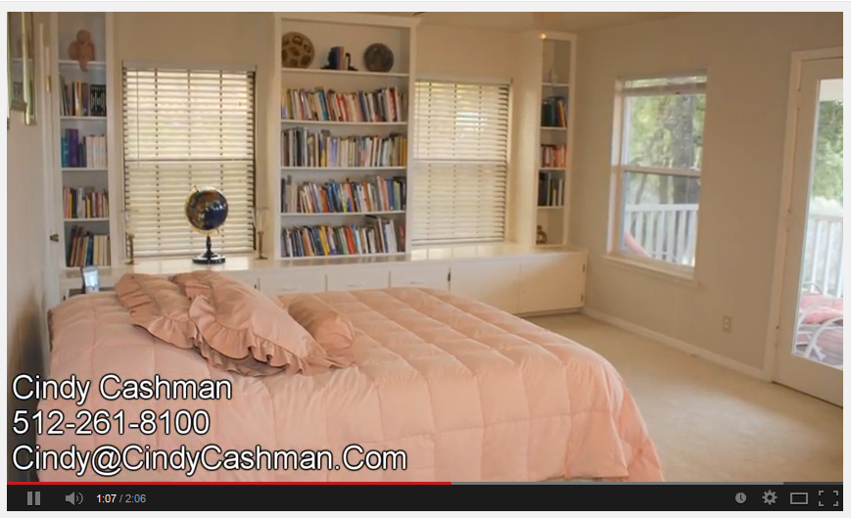
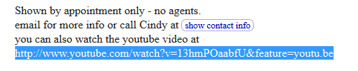
INCLUDE FLOOR PLANS AND VIRTUAL TOURS
Notes:
Including a floor plan is a great way to display the flow of the home. In recent years we’ve seen an increase in the use of virtual tours and video to display the properties. This is a nice to have, but not a must have. Ideally the user just needs to see the layout of the home and that can be accomplished with a basic floor plan.

Slide 9
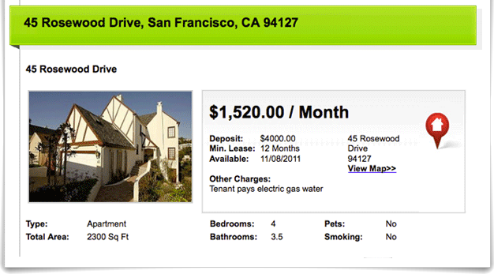
LIST A CLEAN ADDRESS FOR YOUR PROPERTY
Notes:
It is very important that you list a clean address for the property. Most websites now check the address against Google maps or the post office to make sure it’s a real property. If you have strange address and it can’t be verified the listing will not be displayed. (If there is a place to include true driving directions so you can include landmarks or mileage counts, be sure to include those, but verify first.)

Slide 10
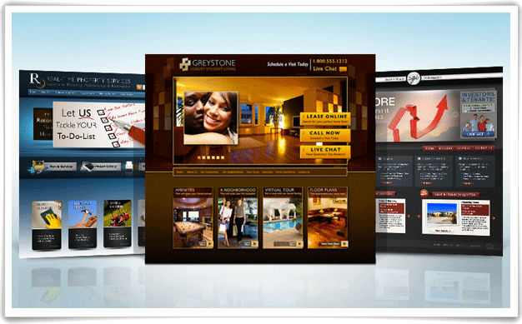
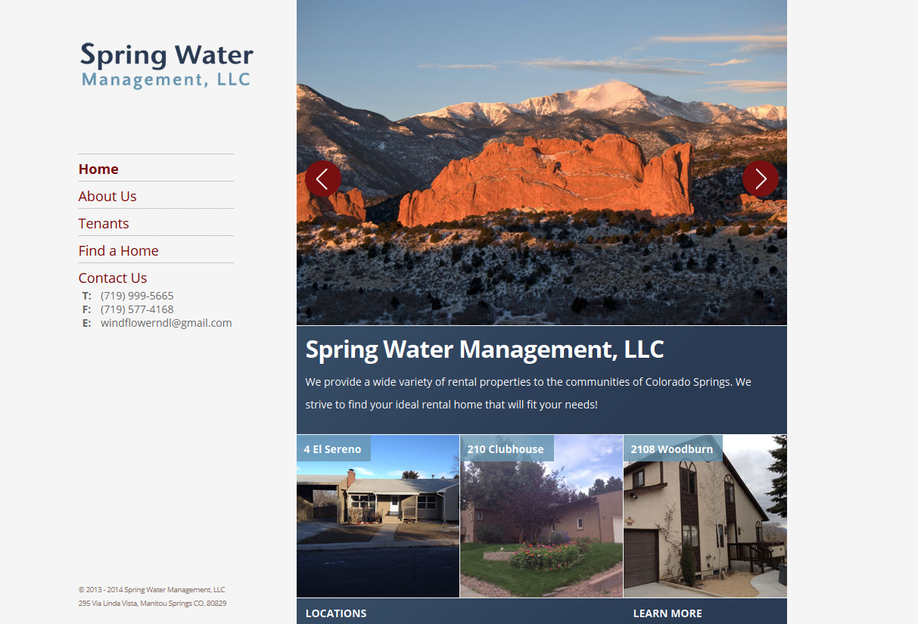
INCLUDE YOUR COMPANY WEBSITE
This validates your property management company.

Slide 11
USING LISTING SYNDICATION?
Keep these questions in mind
  What is the relationship the software or website has with the syndication sites?
  Are they just sending my listings in a free capacity?
  How are leads tracked and delivered?
Notes:
If you’re using property management software or utilizing a website to syndicate your listings ask yourself the following questions.
What is the relationship the software or website has with the syndication sites? You want to know if the software or website has a paying relation with the syndication site. If it does then your listing should be displayed more often and get more leads.
Are they just sending my listings in a free capacity? If your listing is only being sent in a free capacity then it’s probably just being used a filler data and will not receive exposure.
How are leads tracked and delivered? When your listing is being syndicated how does the software or website track leads. Does the website give created to the proper lead source? This very important when trying to determine your marketing ROI. It’s important to automatically track emails and phone calls. If you just tracking emails your missing out on about 50% of the traffic. It’s important to us a call tracking number on your listing and tracking email. Even when your staff is asking “where did you hear about us”, the prospect doesn’t always give the right answer nor does the staff drill down enough. This will lead to inaccurate marketing data, costing you time and money.

Slide 12
INTERNET LISTING SERVICES (ILS)
Focus on the user experience
Keep in mind the efficiencies for PMCs
Notes:
All the ILS’s work a little differently, but all try to focus on the user experience. The ILS wants the information to be relevant to the users search. Users are going to use filters and search on PRICE, SIZE, AMENITIES (usually pets). If your listing is lacking on one of the categories it might not even be shown on the ILS. Most ILS’s have featured or premium product that will give your listing maximum exposure and drive leads. If you pay for advertising make sure your tracking your leads and if the leads are converting.

Slide 13
BEST-IN-CLASS
EXAMPLES OF TOP PERFORMING LISTINGS
Notes:
Live link to examples

Slide 14
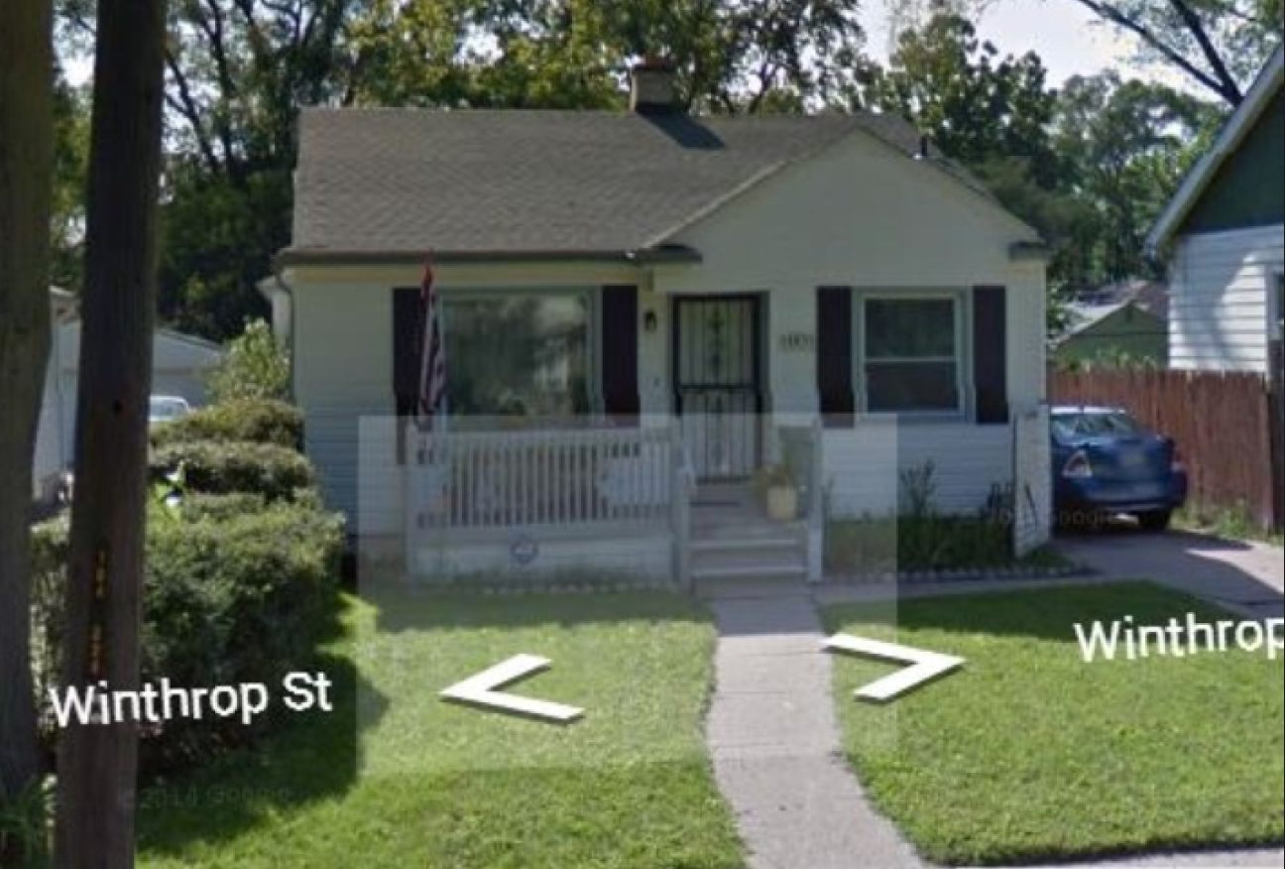
WHAT NOT TO DO
From: http://realestate.aol.com/blog/2014/08/23/real-estate-listing-photo-dos-and-donts/#!slide=2866612
Notes:
Google maps photo of your computer.

Slide 15
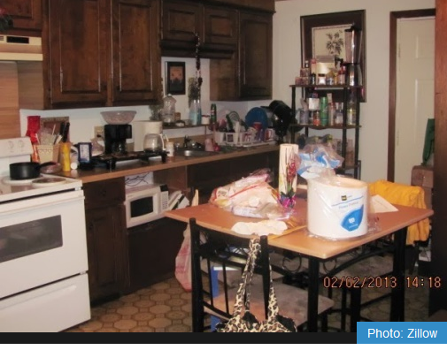
WHAT NOT TO DO
From: http://realestate.aol.com/blog/2014/08/23/real-estate-listing-photo-dos-and-donts/#!slide=2866612
Notes:
Messy picture and time stamp

Slide 16
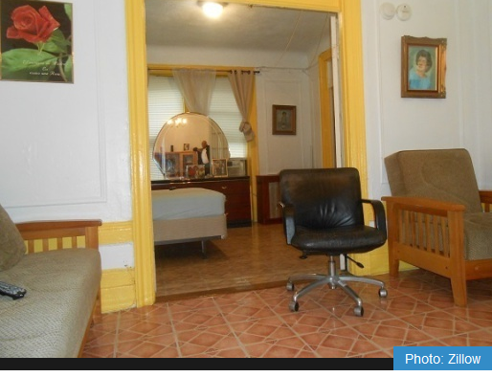
WHAT NOT TO DO
From: http://realestate.aol.com/blog/2014/08/23/real-estate-listing-photo-dos-and-donts/#!slide=2866612
Notes:
Photo of yourself in the mirror is creepy.

Slide 17
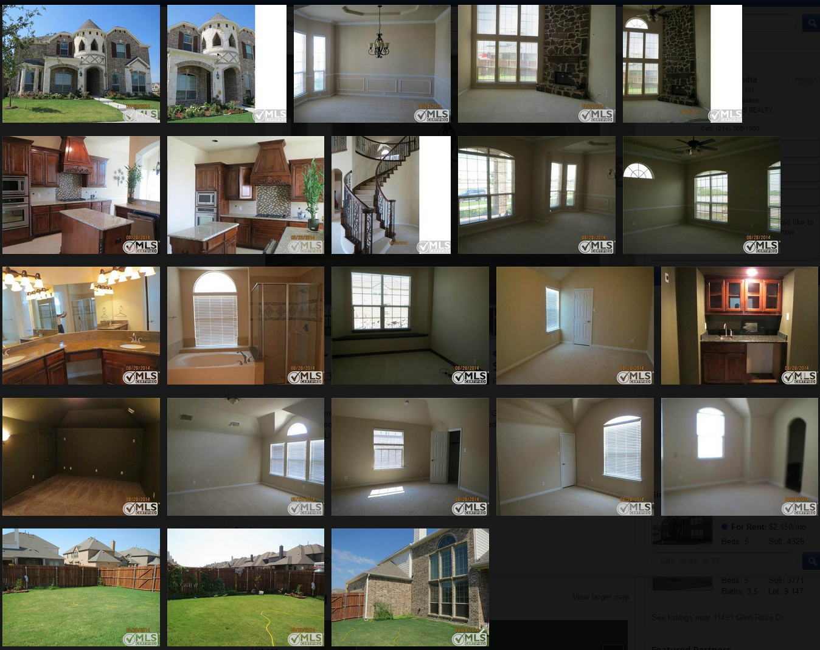
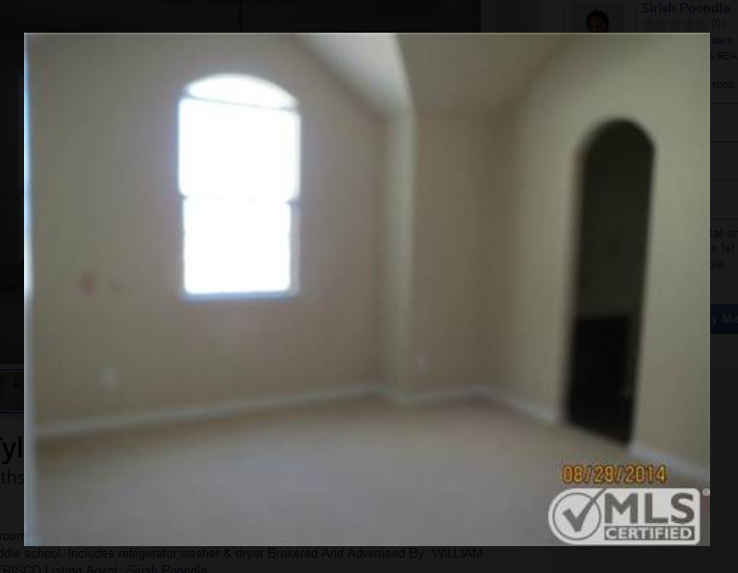
WHAT NOT TO DO
Notes:
Time stamp and blurry pictures somewhat diminish the nice house.

Slide 18
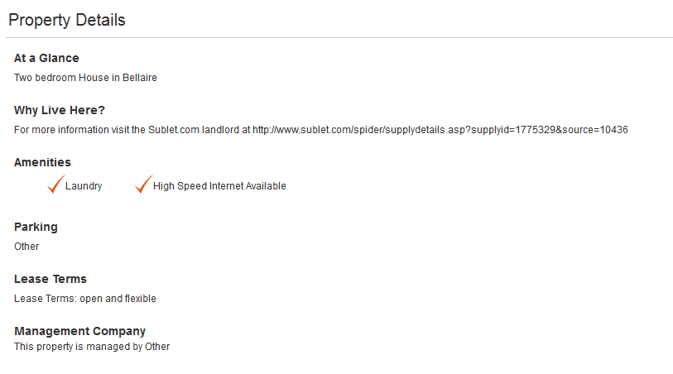
WHAT NOT TO DO
Notes:
Additional features only list two amenities. Not very impressive.

Slide 19
QUESTIONS?

Slide 20
THANK YOU!

