Slide 1

TRUE COLORS
Kathy Boyes
33rd Company Property Management
MINNESOTA

Slide 2
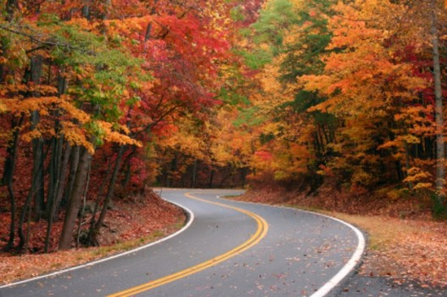
TRUE COLORS
National Convention
2014
MINNEAPOLIS

Slide 3

TRUE COLORS

Slide 4


Slide 5
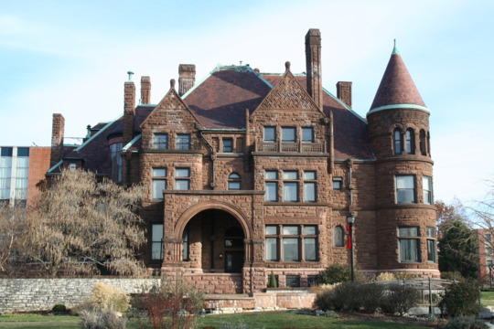
Property
Management

Slide 6
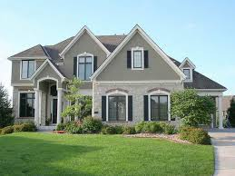
Property
Management

Slide 7
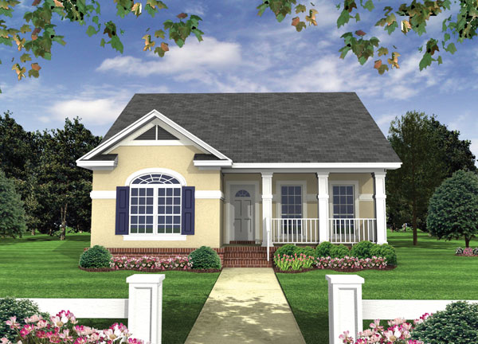
Property
Management

Slide 8
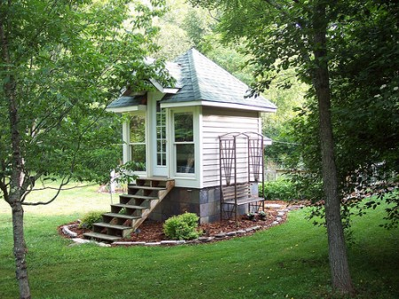
Property
Management

Slide 9
Property
Management
What do they all have in common?
PEOPLE

Slide 10
Property
Management
People

Slide 11

People Management
Owners
Tenants
Management

Slide 12
People Management
Owners
Tenants
Emotional
Need
Management

Slide 13

People Management
VALIDATION
Emotional
Need

Slide 14
People Management
TRUE COLORS
VALIDATION

Slide 15
People Management
TRUE COLORS
Let’s Start With You

Slide 16
1 2 3 4
least like you most like you
2
4
1
3

Slide 17
1 2 3 4
least like you most like you
9
18
2
4
2
2
1
4
3
4
1
4
1
2
4
2
3
1
1
3
3
3
15
8

Slide 18
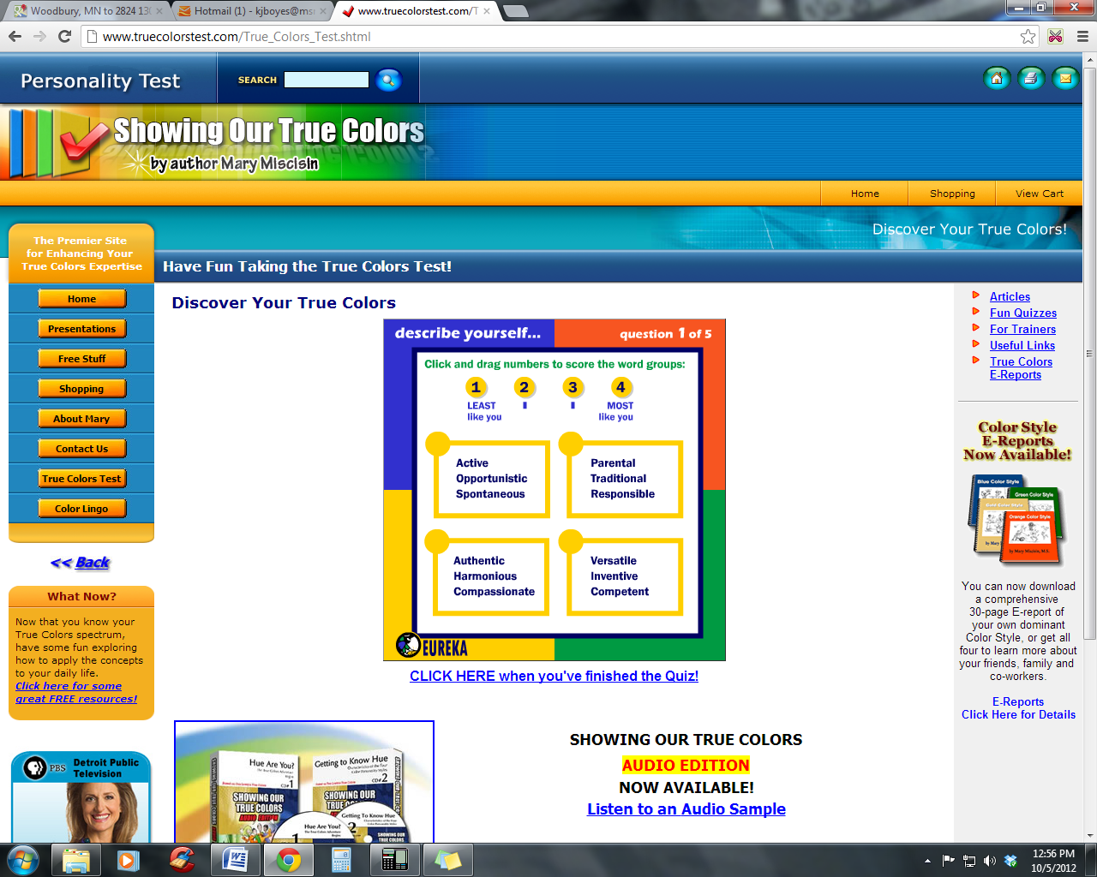
1

Slide 19
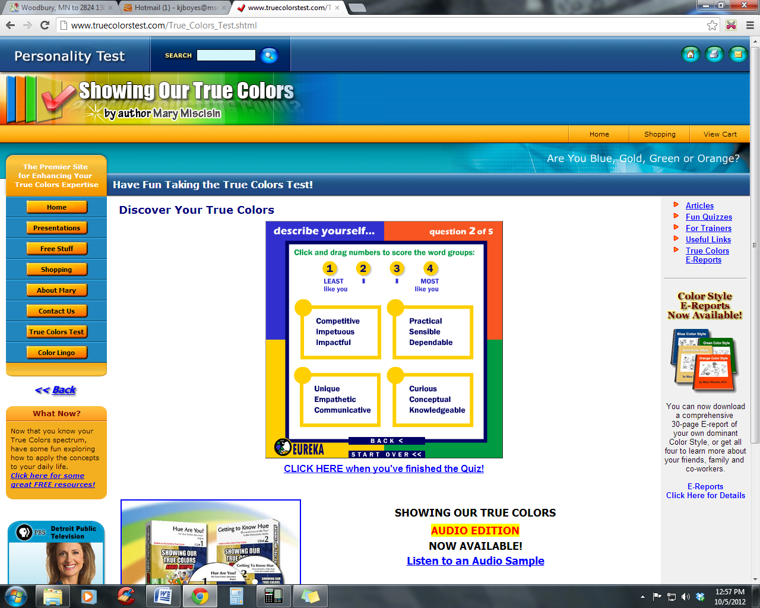
2

Slide 20
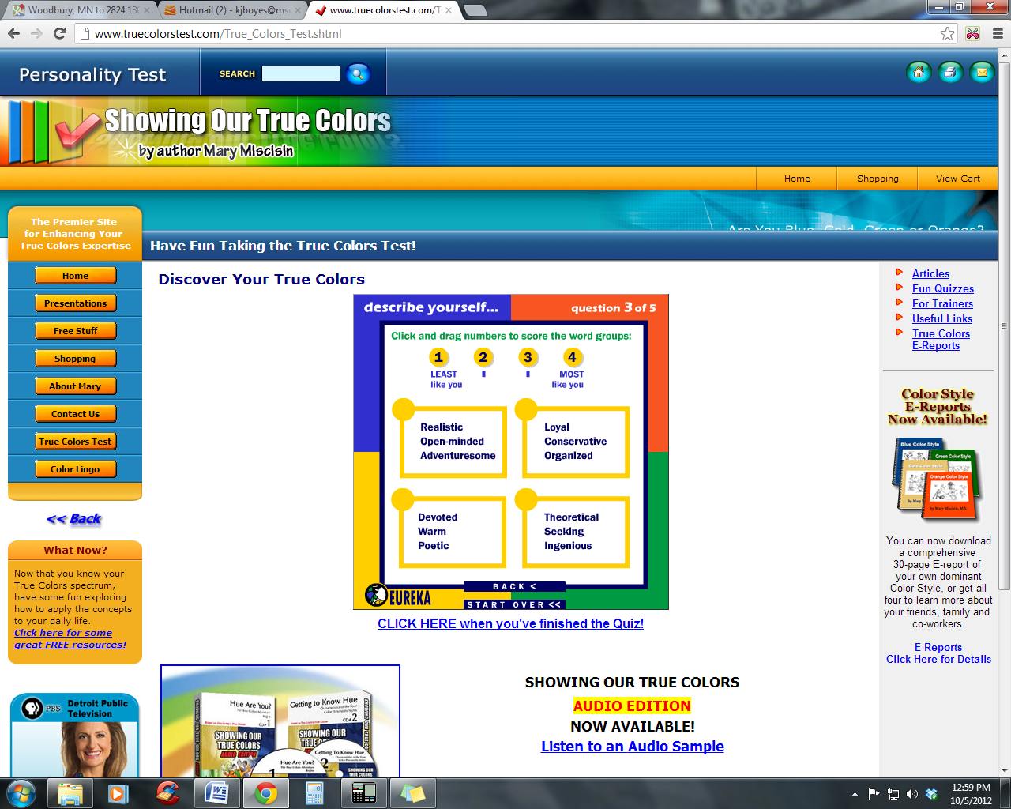
3

Slide 21

4

Slide 22

5

Slide 23
1 2 3 4
least like you most like you
9
18
2
4
2
2
1
4
3
4
1
4
1
2
4
2
3
1
1
3
3
3
8
15

Slide 24
We don’t see things as they are…
We see them as WE are.
Anais Nin

Slide 25




What is your
TRUE COLOR?
Thinker
Green?
Spontaneous
Orange?
Relationships
Organized
Blue?
Gold?

Slide 26
What do these COLORS mean???
Blue
Sensitivity
Friendship
Sharing
Spirituality
Honesty
Intuition
Compassion
Authenticity
Romance

Slide 27
What do these COLORS mean???
Gold
Rules
Reliability
Responsibility
Stability
Punctuality
Sincere
Fairness
Hard working
Practicality

Slide 28
What do these COLORS mean???
Green
Logic
Time alone
Emotional Stability
Justice
Integrity
Strategy
Personal space
Independent Thinking
Facts

Slide 29
What do these COLORS mean???
Orange
Fun
Independence
Freedom
Spontaneity
Adventure
Resourcefulness
Leadership
Creativity
Variety

Slide 30
So, you know your COLOR, now what???

Slide 31
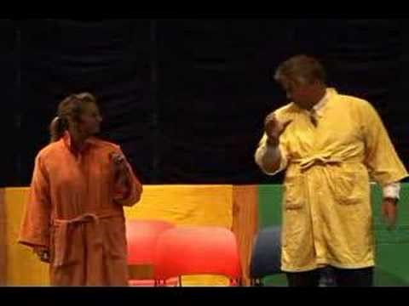

Slide 32

Raise Your Awareness…
Part I
Communication
Part II
Productivity
Part III
Perspective

Slide 33
Raise Your Awareness…
Part I
Communication
Part II
Productivity
Part III
Perspective

Slide 34
Raise Your Awareness…
Part I
Communication
Each color has their own way of speaking.
Each color has their own way of hearing.

Slide 35

I LOVE
your haircut!
BLUE COMMUNICATION
RELATIONSHIPS
Blues focus on feelings, connection and strive for belonging.
How a Blue will Speak
  Friendly and Helpful
  Optimistic and Cheerful
  Expressive with Emotion
How to Speak to a Blue
  Acknowledge them
  Show Appreciation
  Have Patience
  Don't "bark" orders

Slide 36

Your new haircut really suits you.
GOLD COMMUNICATION
ORGANIZED
Golds are generally respectful and responsible. They listen
for details so they know what their part is.
How a Gold will Speak
  Purposeful and Plan Ahead
  Supportive of Policies and Rules
  Detail Oriented, Loyal and Devoted
How to Speak to a Gold
  Be Prepared
  Give Details
  Don't Interrupt
  Recognize Their Contributions

Slide 37

When did you get your haircut?
GREEN COMMUNICATION
THINKER
Greens for the most part, communicate for the purpose
of gaining or sharing information.
How a Green will Speak
Logical and Objective
Includes Facts and Information
Big Picture, Questioning
How to Speak to a Green
Allow them time to Ponder
Skip the "small talk"
Don't misinterpret their need for info as interrogation.

Slide 38

Wow, you look HOT!
ORANGE COMMUNICATION
SPONTANEOUS
Interested in taking action and being expedient , Oranges generally
want to share their opinion the minute it hits their mind.
How a Orange will Speak
Casual and Playful
Spontaneous and Now Oriented
Fast-Paced
Changes Subjects Quickly
How to Speak to a Orange
Use "Sound Bites"
Move with Them While They Multitask
Appreciate Their Flair
Lighten Up

Slide 39
Raise Your Awareness…
Part II
Productivity
How We THRIVE!
How We FAULTER.

Slide 40

TIME
T0-Do Lists
Emails
Meetings
Do You Chase Time?
Or Do You
Harness Time
Paperwork
Paperwork
Interruptions
Questions
Deadlines
Appointments
Questions

Slide 41
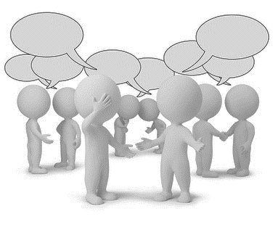
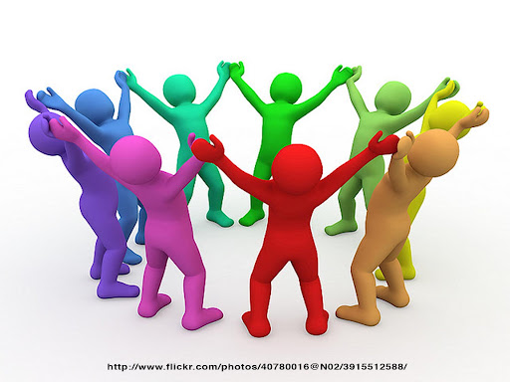
Blue
How You THRIVE!
How You FAULTER?
RELATIONSHIPS
Make YOUR work first priority
Focus on Tasks - Not People
Don’t Take on Too Many Commitments
Let go of Your Personal Life at Work
Practice saying No…or at least
“Not Right Now.”
Your Greatest
Productivity Sabotage…
SOCIALIZING

Slide 42

Gold
How You THRIVE!
How You FAULTER?
ORGANIZED
Plan Ahead and Prepare
Budget Time Realistically
Be Flexible with Change
Delegate with Trust
Accept Chaos as a Temporary State
Your Greatest Productivity Sabotage…
NOT PRIORITIZING

Slide 43

GREEN
How You THRIVE!
How You FAULTER?
Thinkers
View Time in an Orderly Way
See the Whole Picture and the Parts
Create Strategies for Completing Tasks
Get Started even if More Info is Pending
To Save Time - ASK vs. Being Resourceful
Your Greatest Productivity Sabotage…
PARALYSIS BY ANALYSIS

Slide 44
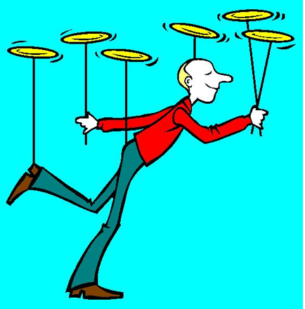
ORANGE
How You THRIVE!
How You FAULTER?
SPONTANEOUS
Bring Energy to a Project
Do NOT Procrastinate
Knock Out Your Boring Stuff First
Give Yourself more Time than You Think
Excellent at Multi Tasking
Your Greatest Productivity Sabotage…
DISTRACTIONS

Slide 45
Owners and Tenants

Slide 46
Owners and Tenants

Slide 47
Owners and Tenants

Slide 48
Owners and Tenants

Slide 49
Raise Your Awareness…
Part III
Perspective
How We See Ourselves.
How Others See Us.

Slide 50
Raise Your Awareness…
Golden Rule
Do unto others as you’d have
them do unto you.

Slide 51
Raise Your Awareness…
Platinum Rule
Do unto others as they’d have
done unto them.
VALIDATION

Slide 52


How You See Yourself.
How Others See You.
BLUE
RELATIONSHIPS
Idealist
Affirming
Strives to Please
Compassionate
Empathic
Trusting
Overly Emotional
Hopelessly Naïve
Smothering
Pushover
Often Wishful
Talks Too Much

Slide 53
How You See Yourself.
How Others See You.
GOLD
Decisive
Goal Oriented
Dependable
Firm
Efficient
Punctual
ORGANIZED
Rigid
Opinionated
Bossy
Controlling
Stubborn
Judgmental

Slide 54


How You See Yourself.
How Others See You.
GREEN
THINKER
Superior Intellect
Not Emotional
Seeks Justice
98% Right
Rational
Objective
Intellectual Snob
Unfeeling
Fault-Finding
Arrogant
Doesn’t care
Stingy with Praise

Slide 55


How You See Yourself.
How Others See You.
ORANGE
Fun-Loving
Adaptable
Problem-Solver
Carefree
Good Negotiator
Deals Well with Chaos
Irresponsible
Manipulative
Not Reliable
Obnoxious
Disregards Rules
Disruptive
SPONTANEOUS

Slide 56
Quick quiz…..
Problem Solving
Guess Who’s Talking
“We can solve this problem if we all work together.”
BLUE

Slide 57
Problem Solving
Guess Who’s Talking
“We can solve this problem if we take some time and examine all the facts.”
GREEN

Slide 58
Problem Solving
Guess Who’s Talking
“We can solve this problem if we improve our processes.”
GOLD

Slide 59
Problem Solving
Guess Who’s Talking
“We can solve this problem if we break free from the norm and shoot around ideas.”
ORANGE

Slide 60
GOLD | GREEN | BLUE | ORANGE
Accountant | Attorney | Human resources manager | Advertising
Dentist | Researcher | Minister | Marketing
Auditor | Engineer | Editor | Actor
Teacher | Criminologist | Therapist | Mediator
Financial planner | Critic | Journalist | Public speaking
Administrator | Technical writer | Social worker | Dance teacher
Librarian | Chemist | Fund raise | P.E. teacher
Manager | Veterinarian | Employment interviewer | Jet pilot
Bank officer | Physician | Flight attendant | Painter
Air traffic controller | Biologist | Host/hostess | Sculptor
Statistical clerk | Embalmer | Receptionist | Mechanic
Telephone operator | Photographer | Tour guide | Carpenter
Police officer | Ecologist | Travel agent | Comedian
Secretary | Anthropologist | Customer service | Puppeteer
Court reporter | FBI agent | Teacher | Disc jockey
Lastly…
A Bonus Slide

Slide 61
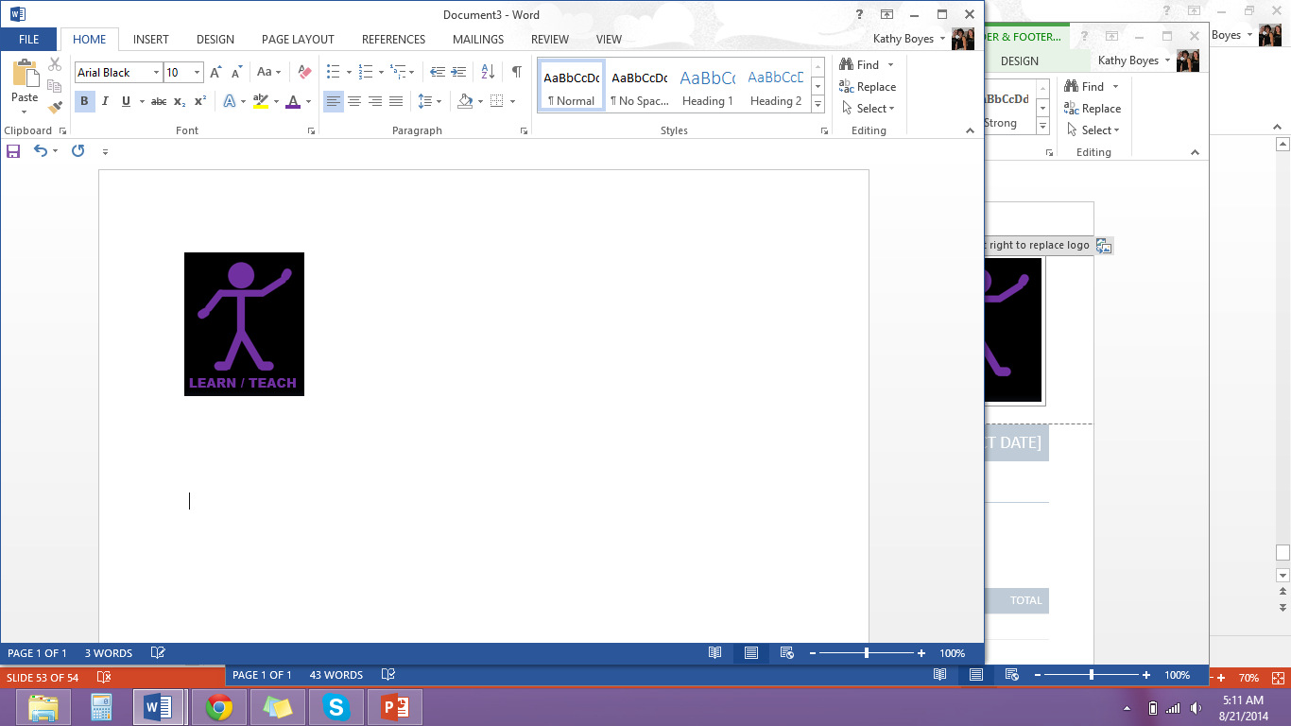
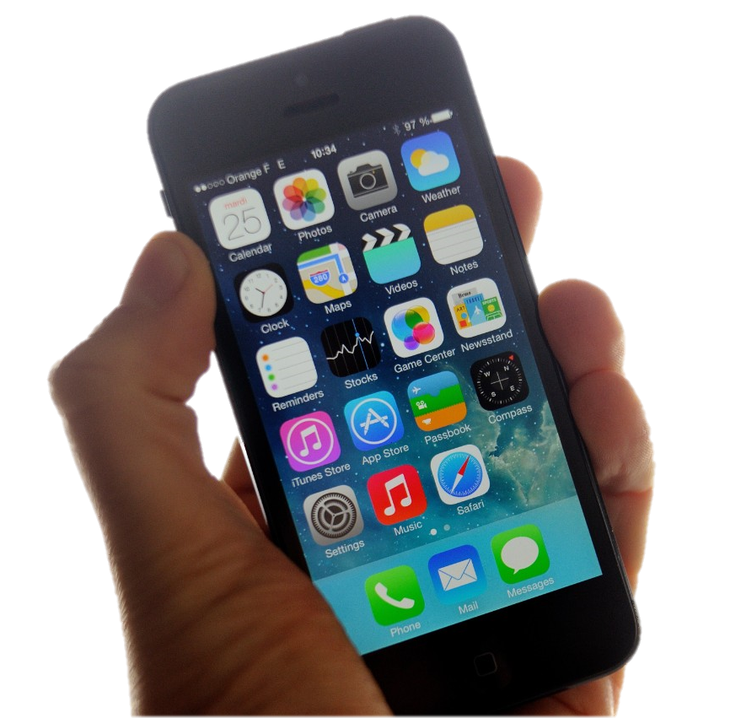
TRUE COLORS
kathyboyes@33rdcompany.com

