Slide 1
Reacting to a Changing Sales Market
Duke Dodson, RMP, MPM
NARPM National Convention, 2014

Slide 2
About me:
Started Dodson Property Management in Richmond, VA in 2007
Joined NARPM in 2010, RMP in 2012, MPM in 2013, Richmond Chapter President 2012-2013
Currently serve on the Finance Committee, Standards Committee, Co-chair of this conference! #ATLin2015
VA State Chapter President 2014-2015
DPM manages 2000 units in Richmond, Williamsburg, Newport News and Fredericksburg; we manage SFH’s, Multi-fam, office and retail

Slide 3
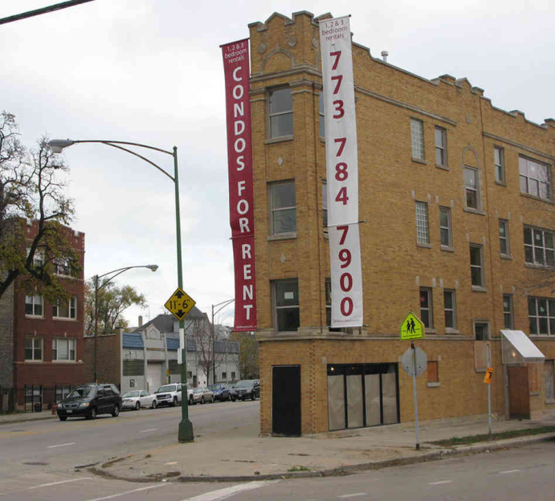
The Premise:
The market tanked in 2007-2009 and many homeowners found themselves upside-down. When they had to move, their best option was to rent out their homes, thus creating the “Reluctant Landlord”.

Slide 4
The Result:
These folks needed our help and our businesses grew!

Slide 5
What happened next?
As Real Estate usually does, it began to stabilize and appreciate in many areas. Some folks decided to keep their rental. Many have decided to sell.

Slide 6
The Result:
Our businesses shrank?

Slide 7
The NARPM approach
Traditionally, the NARPM approach has been to only manage single family homes in nice areas. This approach makes a lot of sense for a lot of reasons, but please note that mid to high-end single family homes are the property type most at risk to become “sales” in an improving market.

Slide 8
What do we do about the changing sales market?

Slide 9
What do we do about the changing sales market?
First, take an honest assessment of your business often. How at risk are you?
Don’t be a sitting duck, be in touch with your clients, study your attrition, why are you growing? Why are you shrinking?

Slide 10
What do we do about the changing sales market?
Second, form a plan!

Slide 11
Consider each of the following:
1 - Target your marketing to the “Long-term Landlords” as opposed to the “Reluctant Landlords”.
2 - Buy other Property Management firms
3 - Diversify, add other divisions to your firm

Slide 12
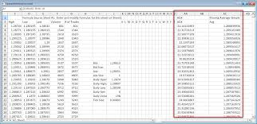
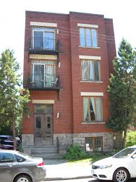
Marketing to the Long-term Landlord
Folks with portfolios of single family homes and/or small apartment buildings
Investment clubs
Apartment owner organizations
Understand the needs of an investor
Alter pricing model to account for volume
Get education necessary to help these folks

Slide 13
Buying other Property Management firms
As the “low hanging fruit” goes away, so will some Property Managers
When this happens, gobble them up
Form relationships with local competitors, let them know you are interested (local NARPM meetings, letters, quarterly check-ins, etc)

Slide 14
Diversify/Add Divisions
Sales – do it yourself? Bring on an Agent? Refer?
Small multi-family
Maintenance
Commercial
HOA
Development

Slide 15
Adding Divisions – Disclaimers!
These decisions should be based on volume, your market and your expertise
Do not make these decisions without proper due diligence
Add one at a time
Research, test, implement, assess, improve, assess, improve, assess, etc
Don’t become a jack of all trades and a master of none
Get one right before you add another

Slide 16
Whatever you do…..

Slide 17
Whatever you do…..
Don’t be the guy who refuses to change/adapt and goes out of business and blames:
The market
The weather
Obama
Your employees
Bad luck
Institutional Investors
Anyone but yourself!

Slide 18
Quotes about change:
“Change is the only constant in life.” ~Heraclitus
“It is not the strongest or the most intelligent who will survive but those who can best manage change.” ~Charles Darwin
“Adaptability is about the powerful difference between adapting to cope and adapting to win.” ~Max McKeown
“I’m not a rapper, I’m an adapter - I can adjust.” ~Eminem from “Survival”

Slide 19
Questions?
Duke Dodson
Duke@DodsonProp.com
804-426-4148
Thank you for listening!

