Slide 1


Economic Outlook for Residential Rentals

Slide 2
World and U.S. Economic Outlook
Residential Rental Outlook

Slide 3

Disclaimer
The views expressed here are the presenter's and not necessarily those of the Federal Reserve Bank of Minneapolis or the Federal Reserve System.
minneapolisfed.org

Slide 4
Web:
minneapolisfed.org
Twitter:
@TobyCMadden
Blog:
fedgazette Roundup

Slide 5
Real World GDP
(2014 $ in trillions)
Gross Domestic Product, trillions of constant 2014 dollars
Source: World Bank, World Development Indicators

Slide 6
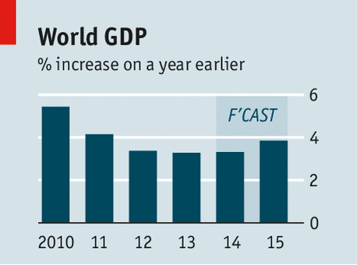

Slide 7
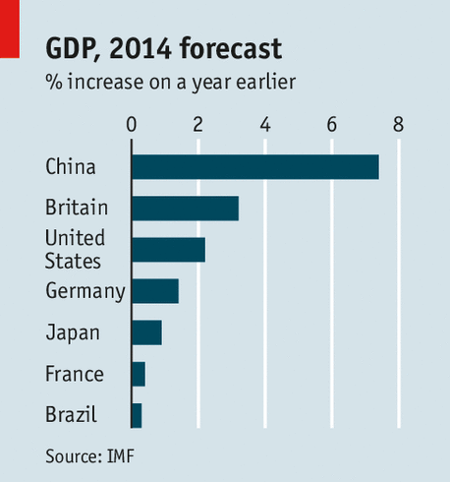

Slide 8
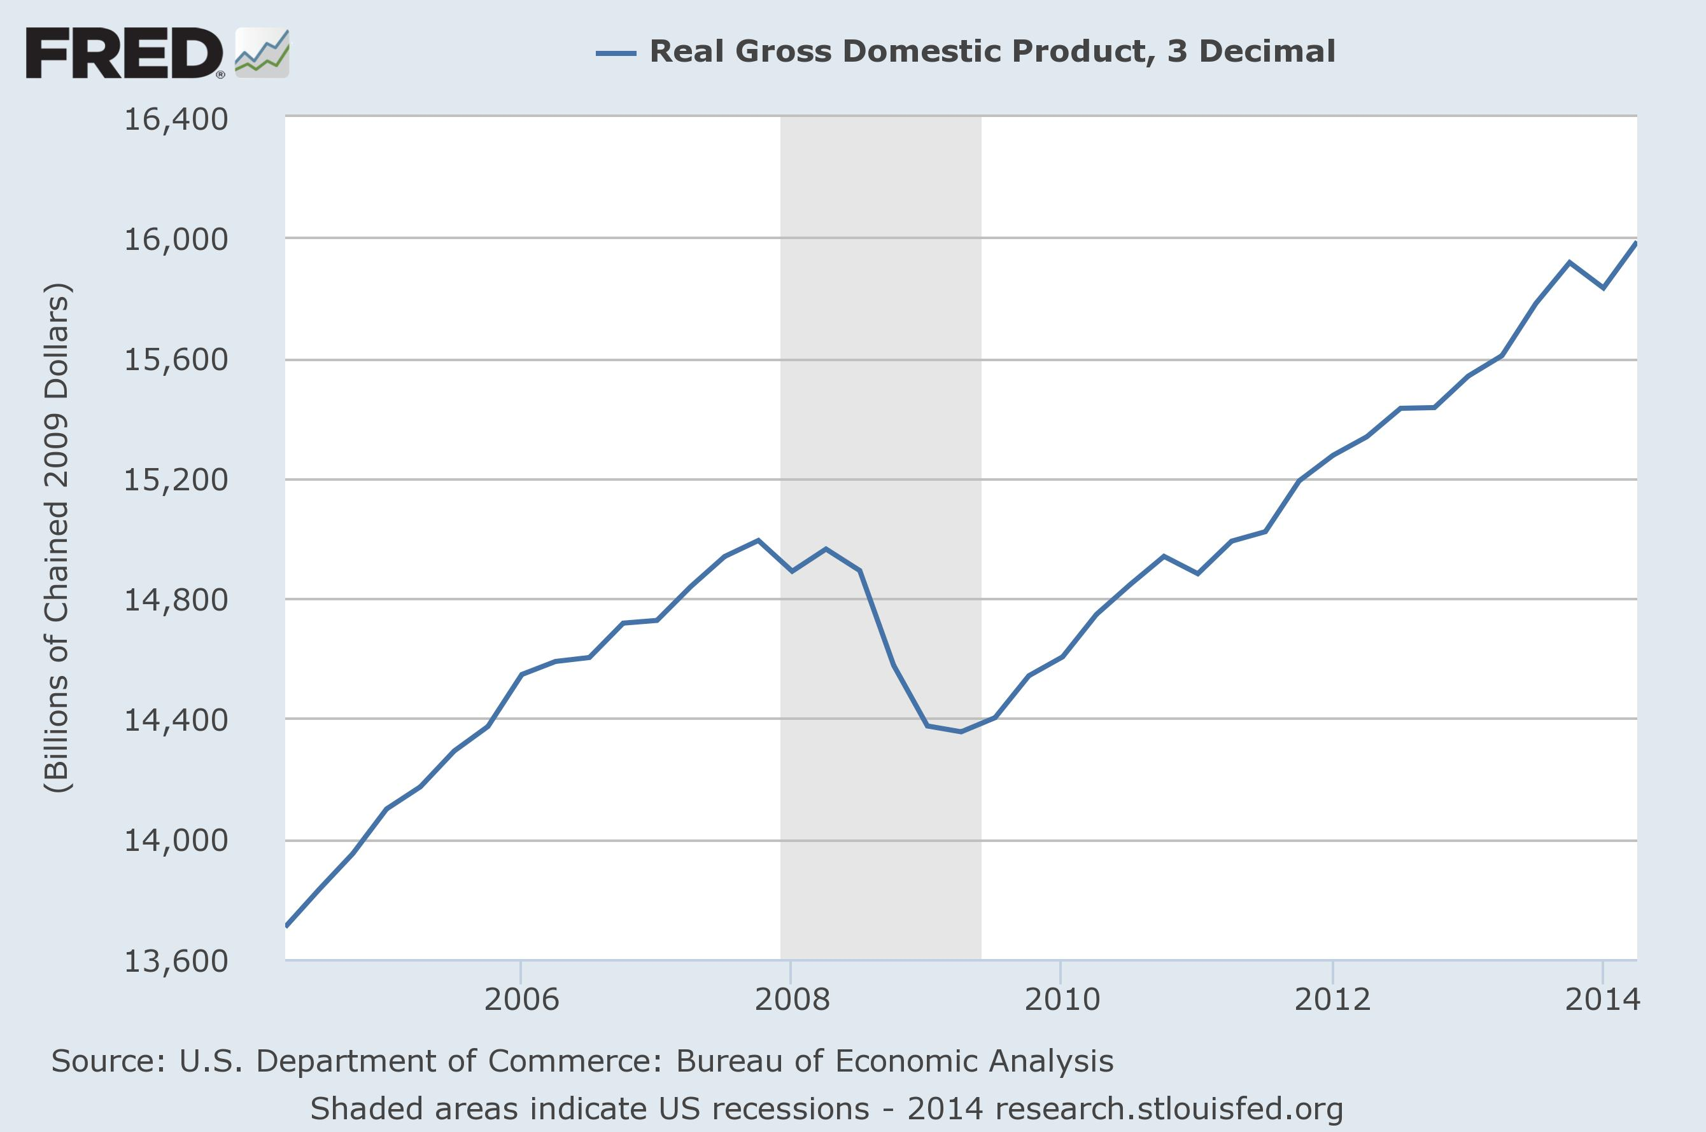
Expansion
Recovery

Slide 9
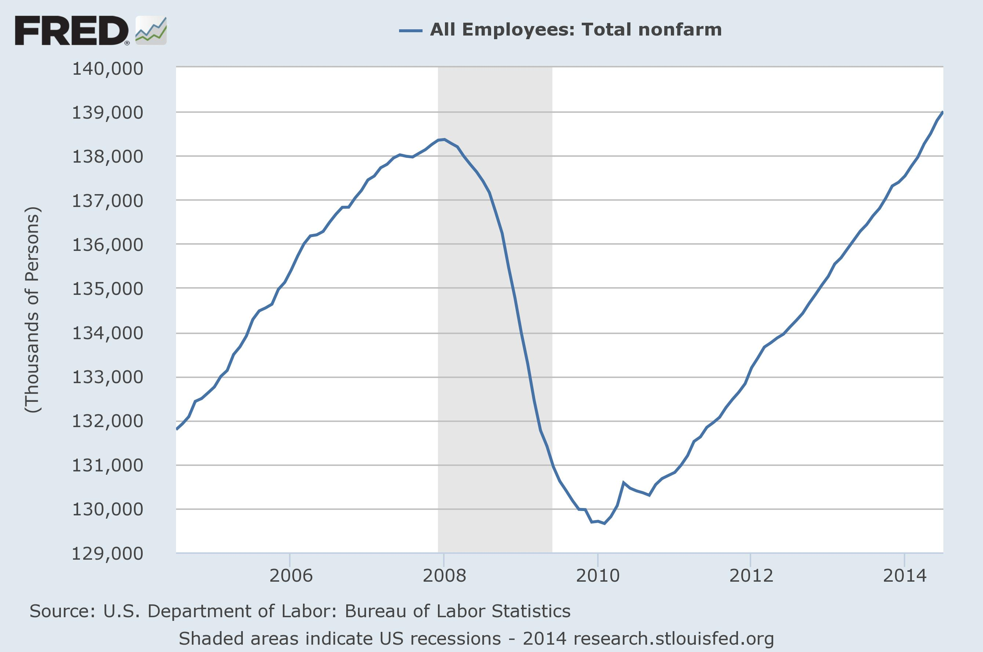
Record Employment

Slide 10
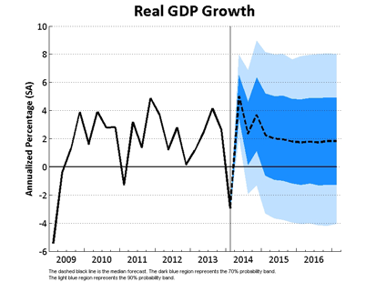
U.S. Expansion is sluggish

Slide 11
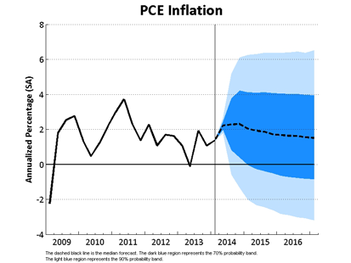

Slide 12
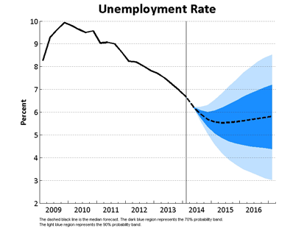

Slide 13
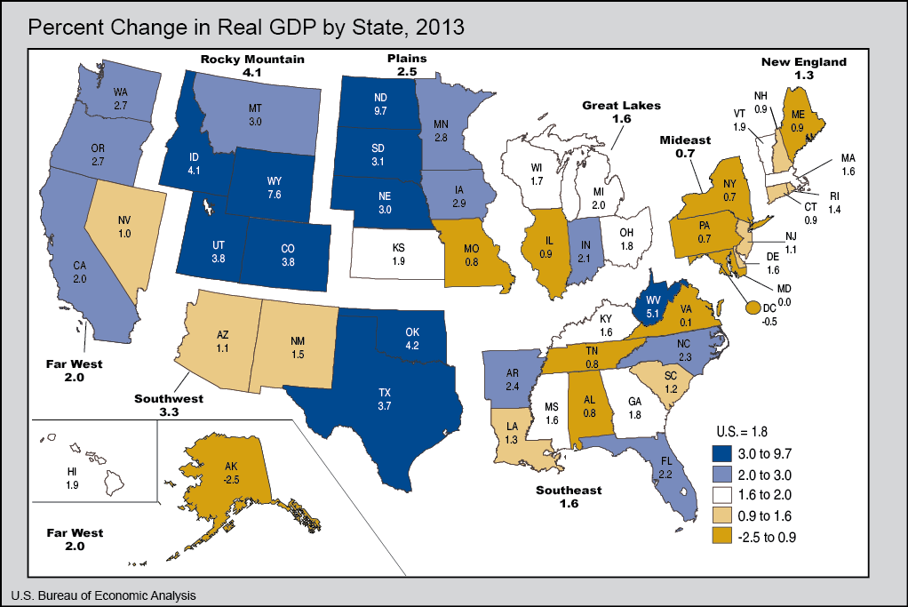
34 the states are in expansion
7% West Virginia
7% Utah
7% Texas
7% District of Columbia
10% Alaska
10% Louisiana
14% Oregon
30% North Dakota

Slide 14
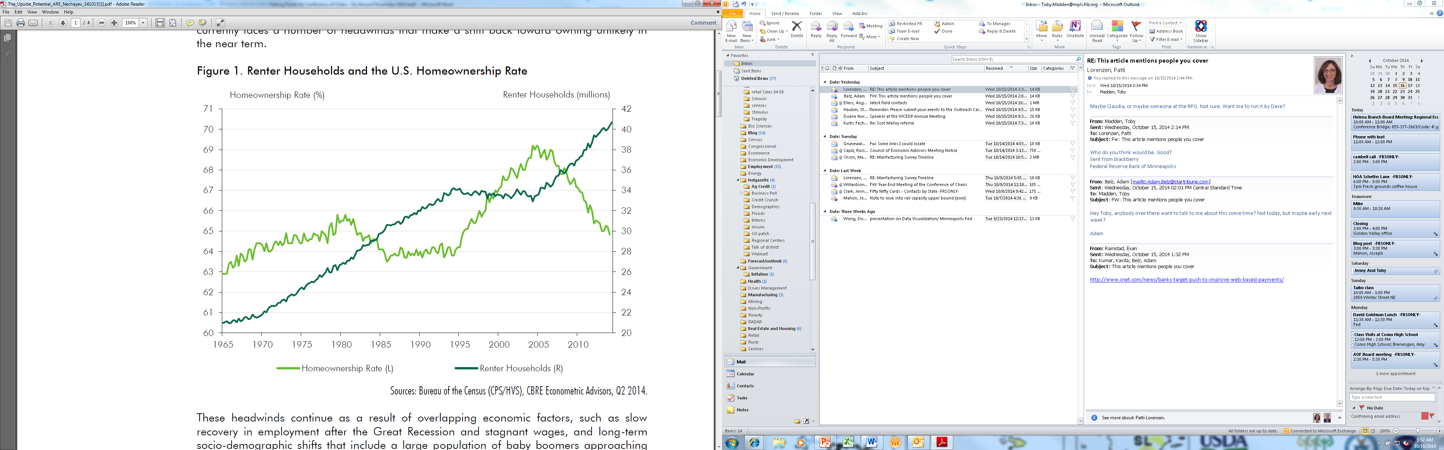
Share of single-family homes to rental market went from 31 percent in 2005 to 35 percent in 2013
Rental households increased dramatically!

Slide 15
Future of Rental Market
Supply
  Building Cycles → UP for competitor's
  Investors → Foreclosures are DOWN
  Accidental landlords → Higher home prices
  Hedge funds → Slowing down purchases

Slide 16
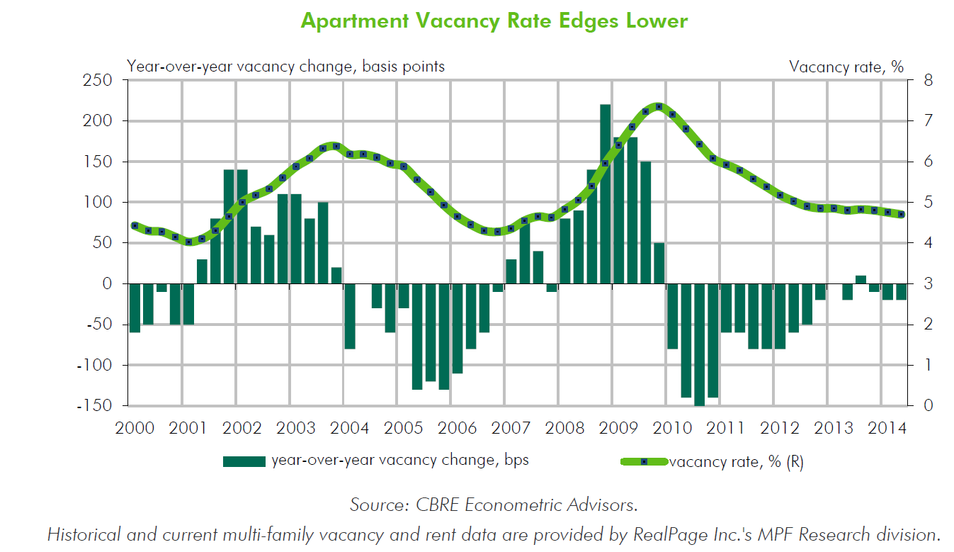

Slide 17
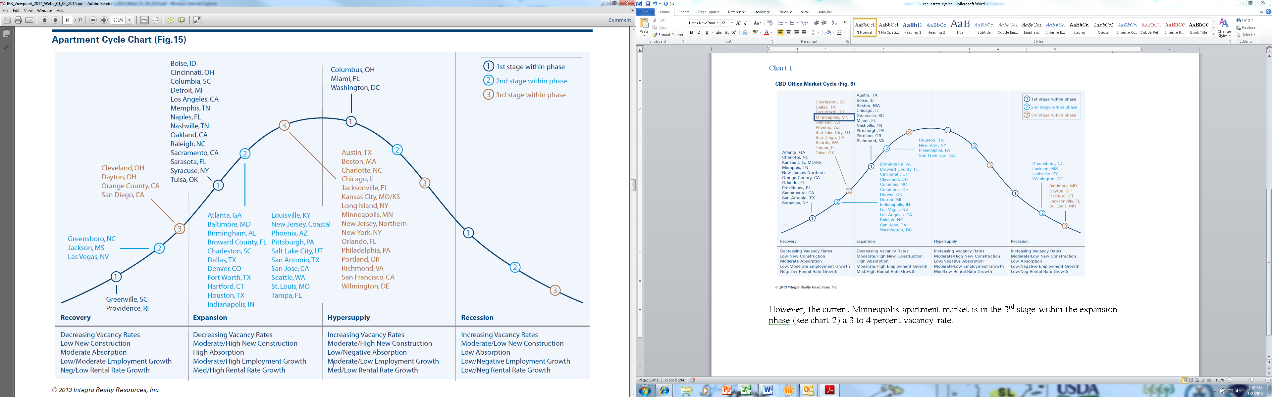

Slide 18
Future of Rental Market
Supply
  Building Cycles → UP for competitor's
  Investors → Foreclosures are DOWN
  Accidental landlords → Higher home prices
  Hedge funds → Slowing down purchases

Slide 19
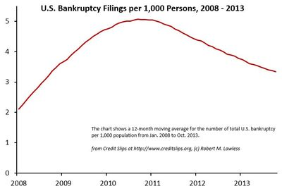

Slide 20
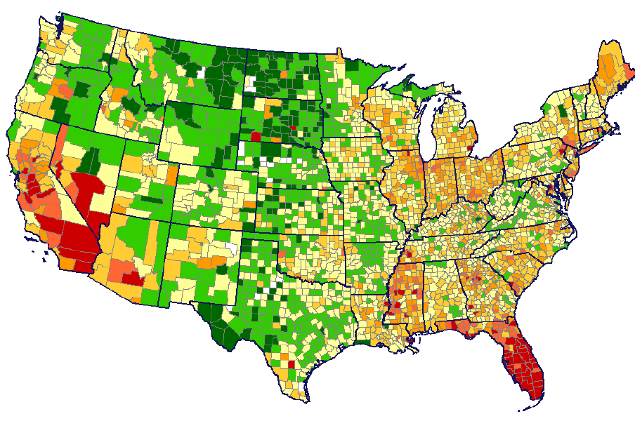
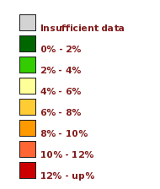
More than 90 days past due
June 2010

Slide 21
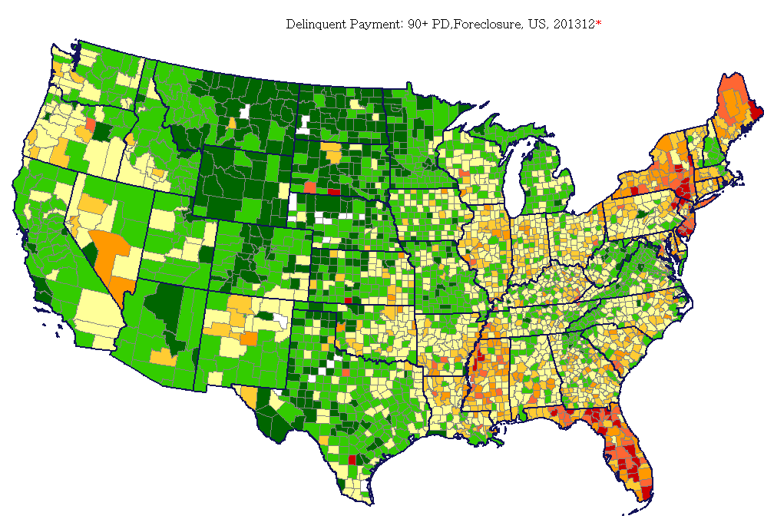
More than 90 days past due
December 2013

Slide 22
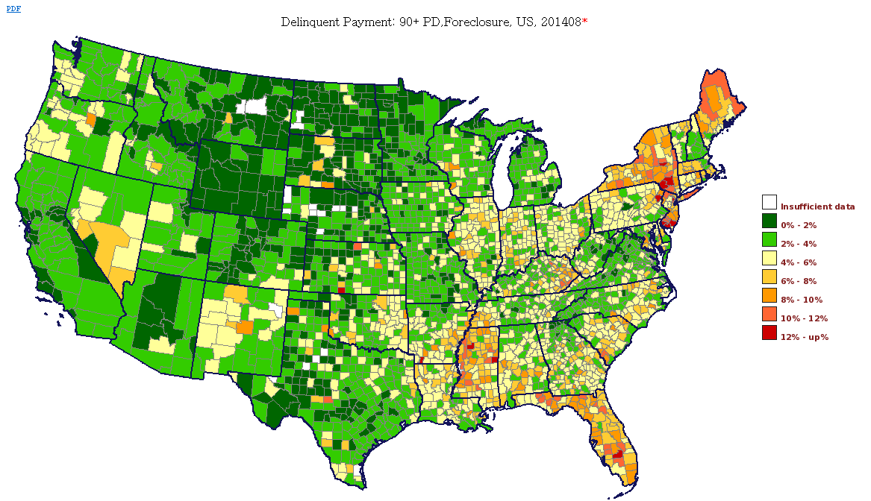
More than 90 days past due
August 2014

Slide 24
Future of Rental Market
Supply
  Building Cycles → UP for competitor's
  Investors → Foreclosures are DOWN
  Accidental landlords → Higher home prices
  Hedge funds → Slowing down purchases

Slide 25
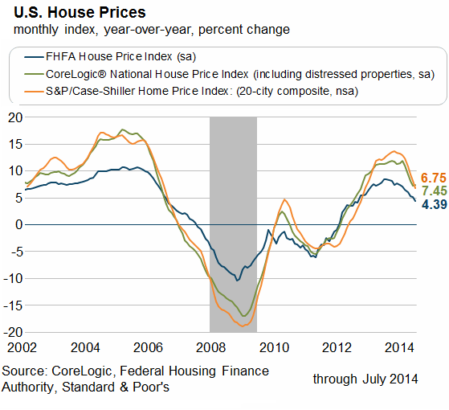
Home Price chart

Slide 26
Future of Rental Market
Demand
  Demographic shifts
    Pop growth → DECREASING (0.8 to 0.5)
    Immigrants → lower sqft/person INCREASING
    People of color → INCREASING
    Seniors → HOAs INCREASING
  Ownership
    Foreclosures →DOWN
    Wages → NOT UP MUCH
    Financing → SOMEWHAT TIGHT
      Standards
      Interest rates

Slide 27
It all adds up to……
Slower growth in property management!!

Slide 28
Questions?

Slide 29
Rent Supply/Demand conditions
Supply
  Cycles (build - close substitute) UP for competitor's
  Investors (foreclosures) DOWN
  Accidental landlords (higher home prices) DOWN
  Hedge funds SLOWING DOWN
Demand
  Demographic SLOWING
    Immigrants (lower sqft/person) INCREASING
    People of color INCREASING
    Seniors (hoas) INCREASING
    Pop growth DECREASING
  Ownership
    Foreclosures DOWN
    Wages NOT UP MUCH
    Financing SOMEWHAT TIGHT
      Standards
      Interest rates
MEANS -> Lower growth in property management demand

Slide 32
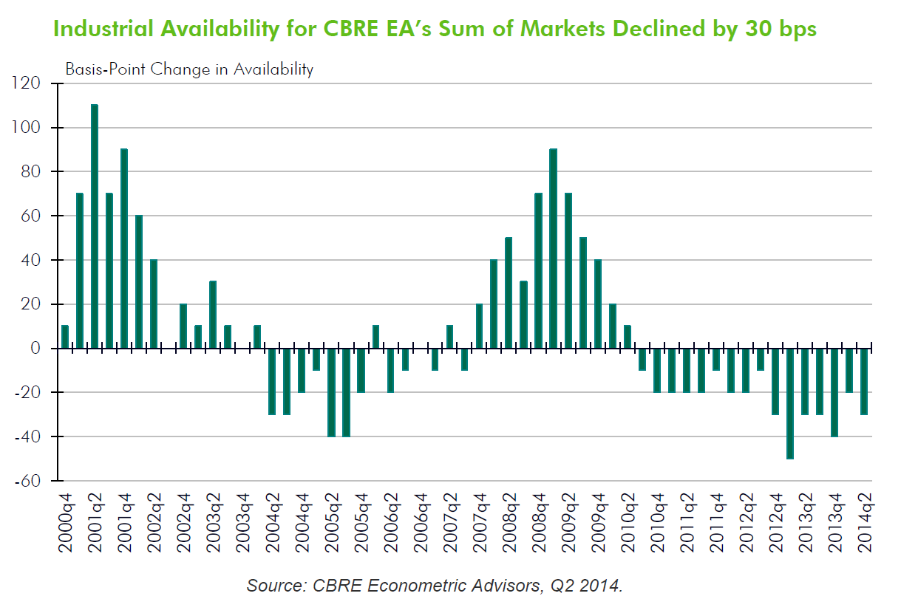

Slide 33
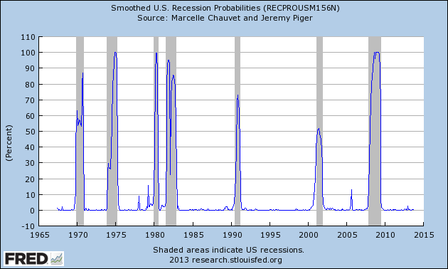

Slide 34
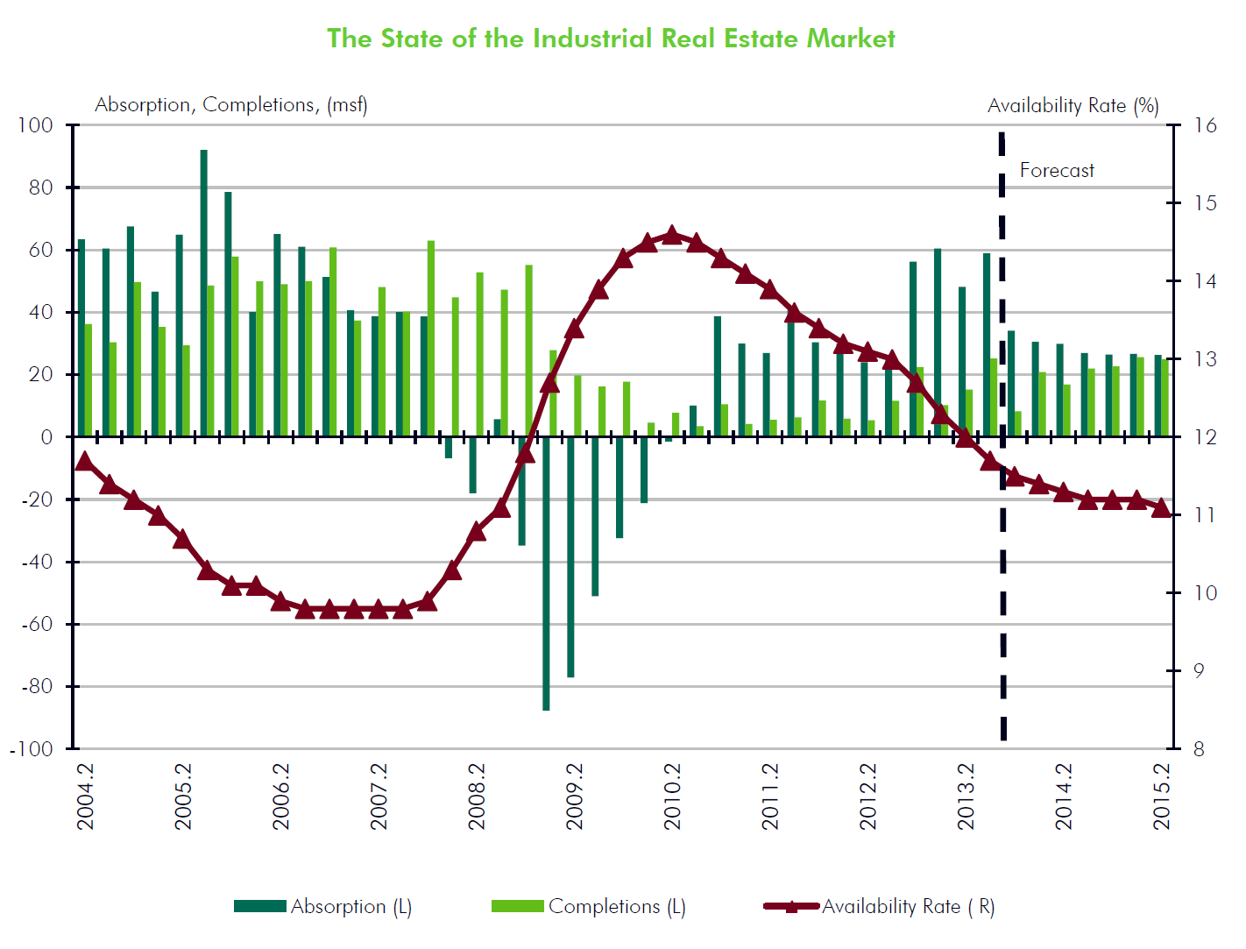

Slide 35
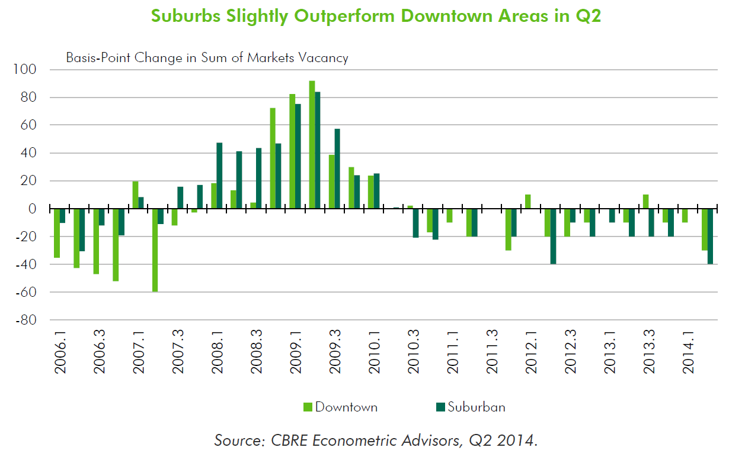

Slide 36
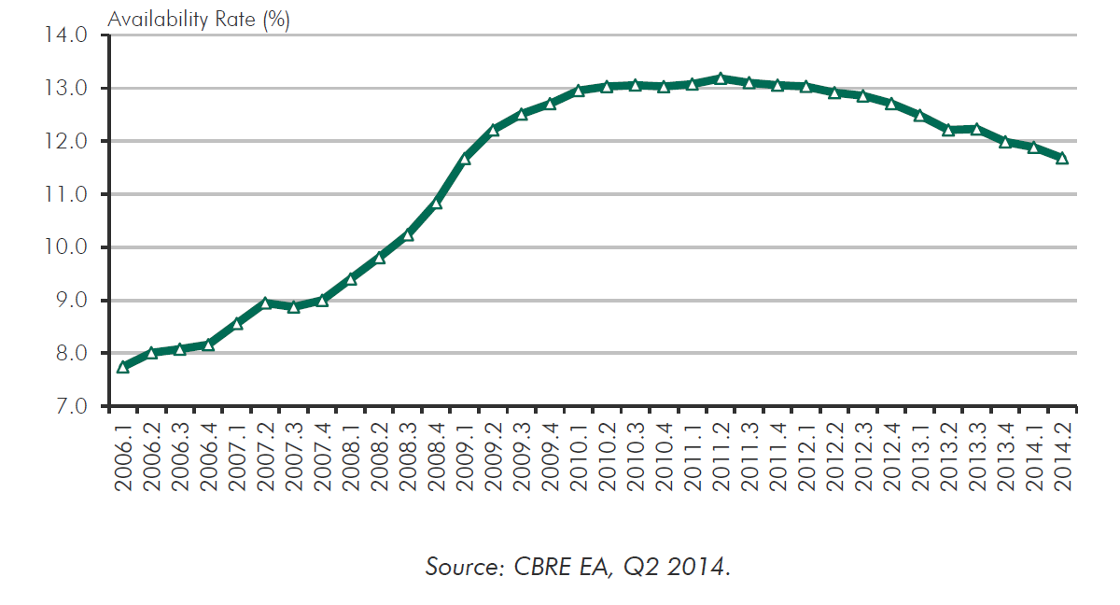

Slide 37
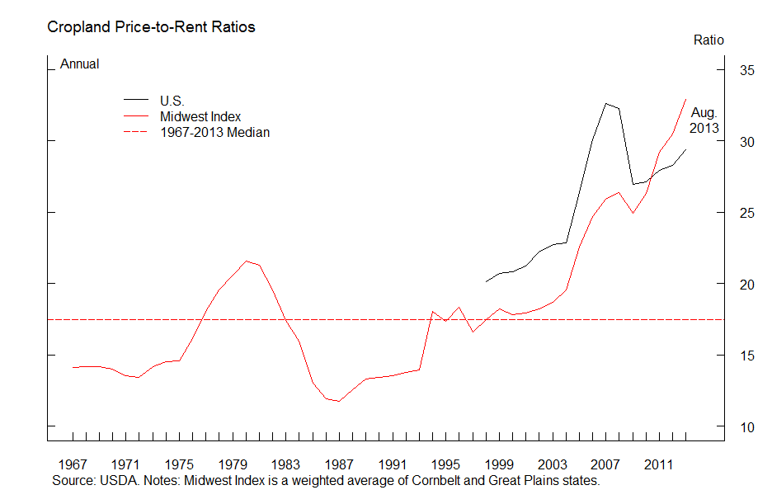
Midwest price to rent ratio at historic highs; US ratio high
Notes:
The USDA asks about cash rents in the same survey from which the land values estimates are derived. That data is pooled with a separate cash rents survey conducted by mail and telephone beginning in spring to derive the annual cash rents estimates (rent estimates are available at the county level). Both estimates are released in late summer.

Slide 38
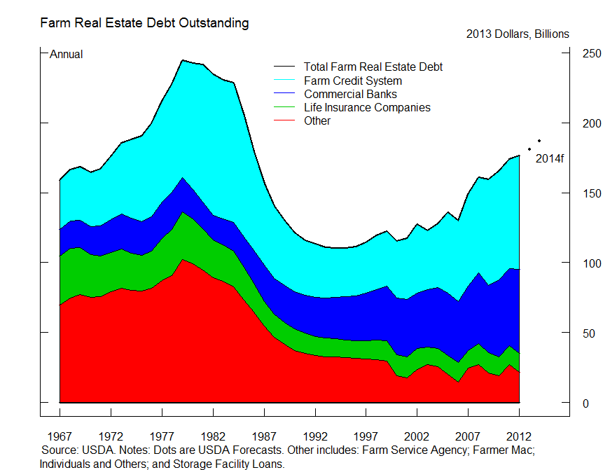
Overall farm real estate debt up

Slide 39
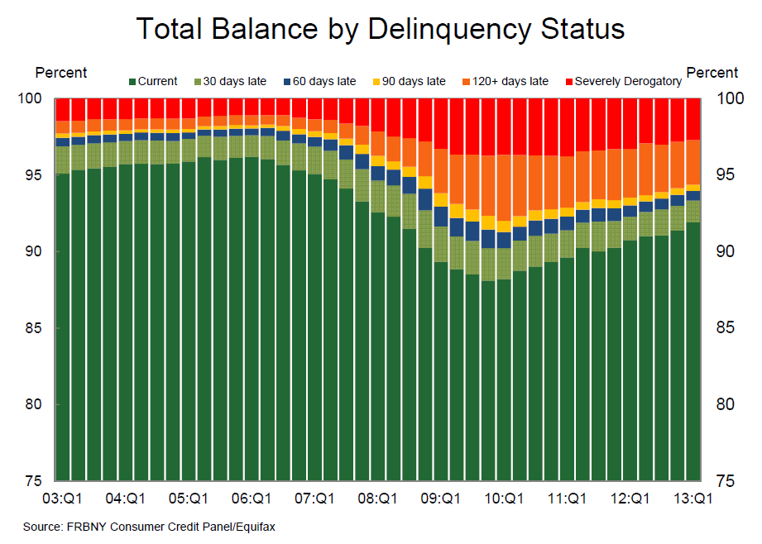

Slide 40
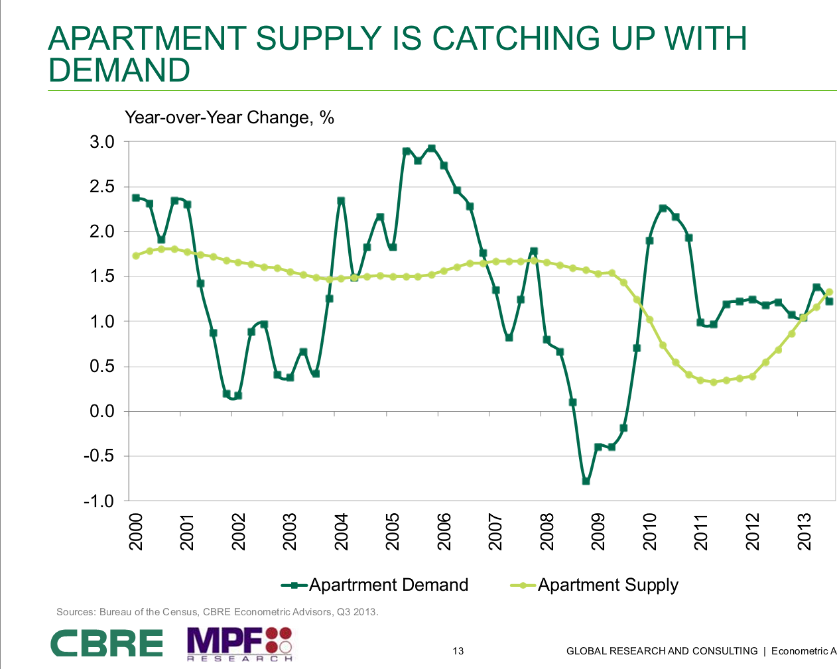

Slide 41
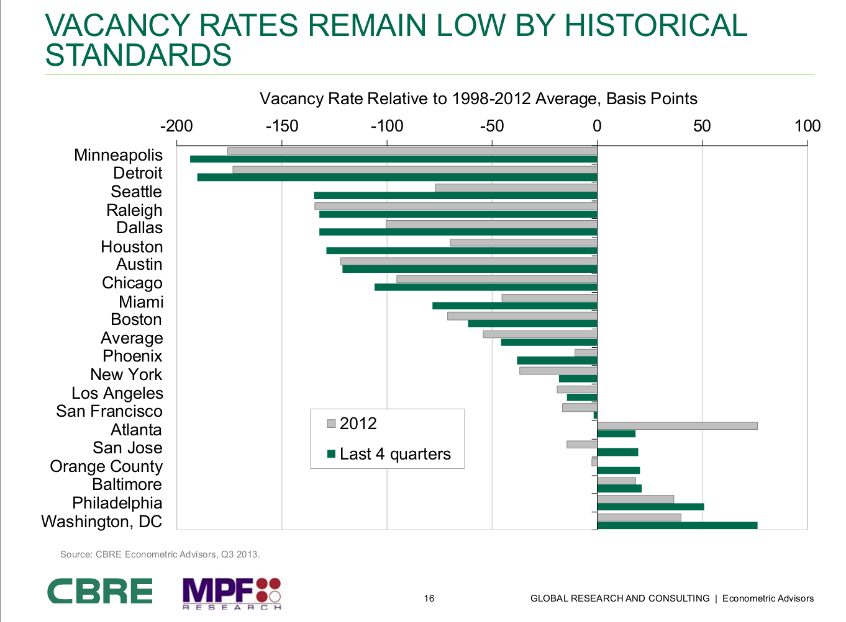

Slide 42
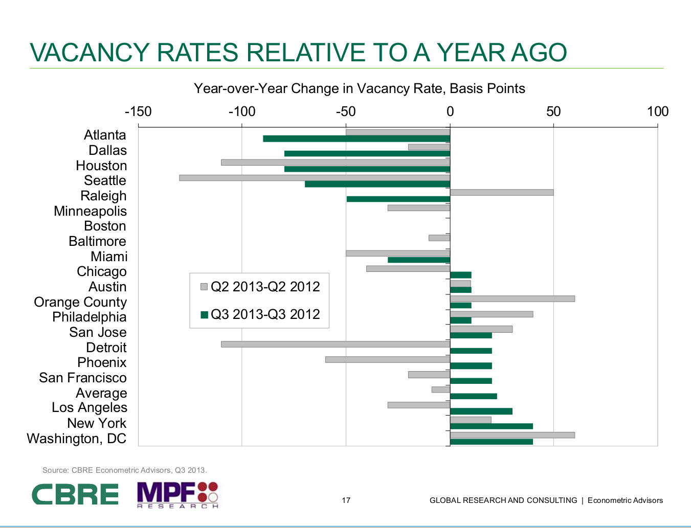

Slide 43
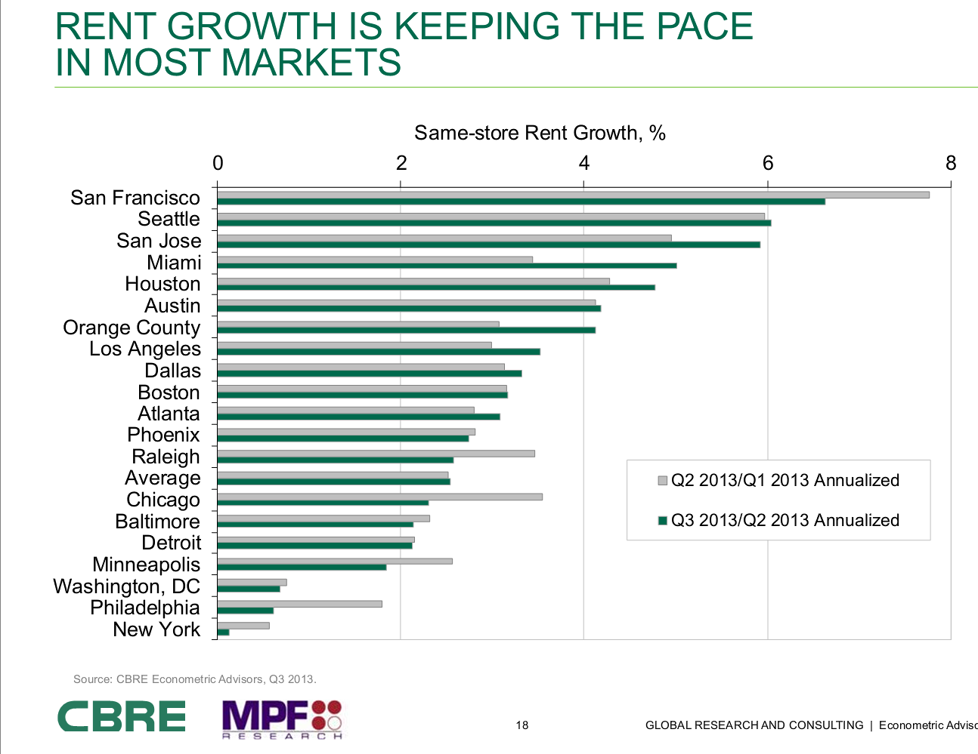

Slide 44
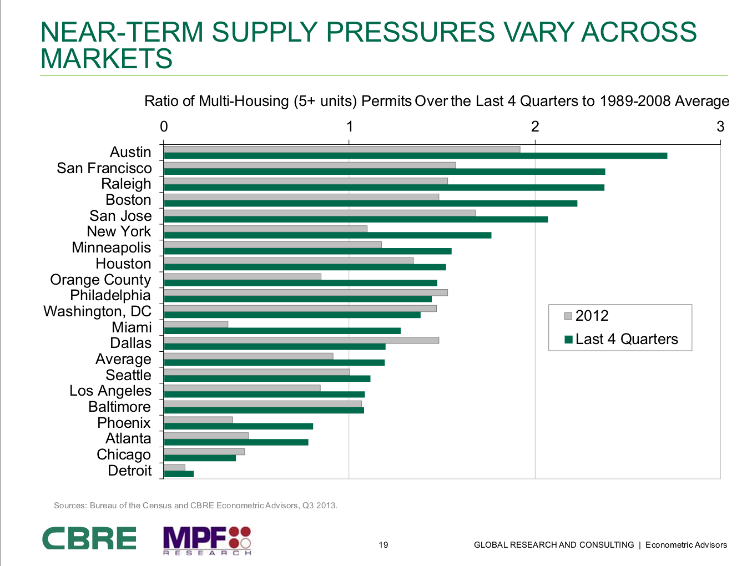

Slide 45
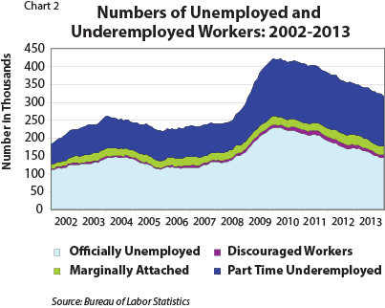

Slide 46
