Slide 1
From Rough Seas To Smooth Sailing
Creating Real Work/Life Balance

Slide 2
The Dream
Financial Independence & Security
Time with Family & Friends
Flexible Schedule
Being Your Own Boss
Building a Legacy
Control Your Own Destiny – Take your Passion and create a business
Being Challenged

Slide 3
The Reality
Will never be able to retire
Don’t recognize the person occupying the 3rd bedroom of the family home
You have a job – 24/7 – 365
Can’t give 2 weeks notice
No control and destiny looks bleak
Everyday is a challenge and not in a good way
Notes:
I have felt everyone of those bullet points at some time or another and some weeks I have felt all of it at the same time.

Slide 4
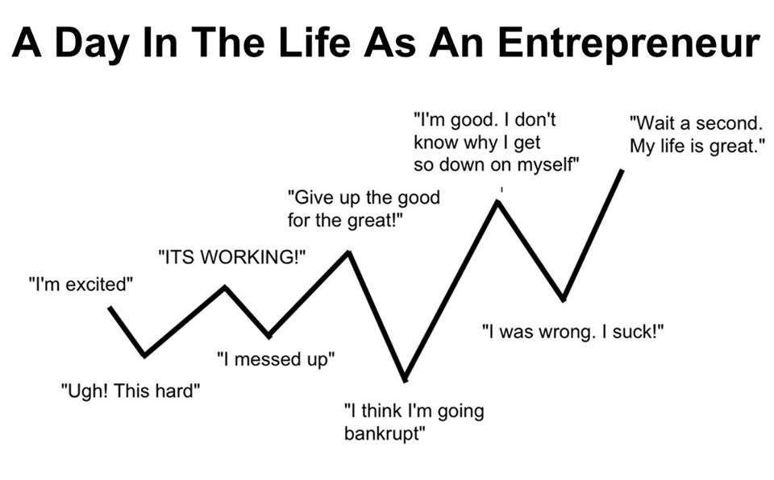
Is This You?

Slide 5
Work/Life Balance
What is your definition?
Is it True?
What gets in the way?
How will you know when you have it?
What will it look like, feel like?
What is the plan to get to the balance you desire?

Slide 6
Definition
Work–life balance is a concept including proper prioritizing between "work" (career and ambition) and "lifestyle" (health, pleasure, leisure, family and spiritual development/meditation).
Notes:
Concept but not reality.
Why do we want balance? When people say they want balance they are trying to express the struggle they are feeling in their lives of being pulled in opposite directions.
I think it is more about shifting our focus from one thing to another. We are shifting our priorities.
We will prioritize where we want to spend our time and energy in different ways at different times in our lives.

Slide 7
Is It True?
Does work-life balance exist?
Where does this idea/feeling that we need work-life balance come from?
Our expectations which are influenced by:
Family, Friends, Culture, Education, Religion, Beliefs and Values
Notes:
When we feel stressed or pulled in different directions we will often state we need balance.
When we feel out of balance it is because we are not honoring or living by our values. Our values are intrinsic to who we are.

Slide 8
What Gets In The Way?
The Inner Critic
I’m not good with numbers. I’m not a sales person.
Assumptions - past experiences
When I give employees tasks they don’t do it right so I have to do everything or it doesn’t get done.
Interpretations – how we view situations/people
That owner client is so demanding I can never do anything right – In actuality the owner is trying to control you because their spouse has terminal cancer and they feel out of control.
Limiting Beliefs – you accept ideas that limits you.
I need to have all the answers
No one can do the job better than me
It is a sign of weakness to show emotion
Notes:
Inner Critic – I’m not good enough is the core feeling. I’m a bad parent.
Assumptions – just because it happened once before doesn’t mean it will happen again.
Interpretations – stories we tell ourselves. We always think it is about us but it is always about them.
Limiting Beliefs – You have come to accept what others have said or what you say about yourself. We also create excuses and stories around why we are doing what we know we need to do.

Slide 9
Work-Life Out-of-Balance
Values Conflict
Family | Achievement
Honesty | Integrity
Respect | Power
Orderliness | Professionalism
Service | Fun
Recognition | Safety
Security | Freedom
Friendships | Fulfillment
Passion | Loyalty
Leadership | Avoidance of Conflict
Work | Autonomy
Notes:
Values – do you clearly know what yours are?
Can your employees state the company values?
Can you reframe how you view your values – example Family is
important but you are a new business owner and working 24/7 for the first year.
Reframe – you are doing this because you love your family and want to be able to support them etc. Now you don’t want to do this forever but for the short run it makes logical sense why you are working like a dog.
Does your family know your values?
Priority on different values will change over time and circumstances too.
Security & Achievement may be high on your list in your 20’s but less so in your 50’s. It might shift to Fulfillment & Service in your 50’s as a higher priority.

Slide 10
Yes, Smooth Sailing Is Possible
What Do You Really Want?
If money and time weren’t an issue what would your IDEAL life look like?
So what is stopping you?
Path of PPM
Passion New Business Owner
Family Life Emergencies
Overwhelmed with responsibility (work and life)
Coaching – What did I want? (PTO & Team)
Notes:
Want? Solicit from audience.
Ideal Life – work, feel challenged, help people discover their true path, attain what they want. Be happy.
Stopping you?
Fear of failure, Fear of losing clients if you raise your prices or close the office on weekends?
We can’t make decisions based upon fear. Fear gobbles up a ton of energy and leaves you tired not to mention causes you to make bad decisions. Think Stock Market.
PPM Path –
Passion – worked 24/7, Dan retired and gone for 6 months at a time.
Family & Life Emergencies – care giving for 4 years – systems in place
Overwhelmed – work and life both started to pay a price.
Coaching – helped me focus my priorities, and to put into perspective the other stuff.
Time off and with family (6 weeks paid time off), Help more people including my Staff – created a team that is accountable for their actions and to each other.
Me want to help my colleagues. What is my gift – teaching and coaching my new direction.

Slide 11
Words of Wisdom
You cannot make a mistake; opportunities for growth.
Don’t take it personally.
The only constant is Change.
Pain is inevitable, suffering is optional.
We either grow or die.
The greatest freedom is the freedom of choice.
Energy attracts like energy.
Doing is work, Being is effortless
“Hard work. Well, that’s all right for people who don’t know about anything else.” Dan Totheroh
Notes:
Mistakes – there are none. You can’t learn unless you make mistakes. Sometimes mistakes lead to new ideas.
Personally – always remember it isn’t your property. It is never about you.
Change – keep in mind everyone has their own speedometer when it comes to change.
Pain and Suffering – it is how we choose to react that is always important
Grow or die. As business owners we always want to keep moving forward. If we don’t others will and eventually we will be out of business.
Freedom of Choice – is control, is happiness. Choice is about making decisions and decisions move us forward. Forward motion creates momentum.
Energy – the law of attraction. Positive vs. Negative. Birds of a feather flock together. It is true. People want to be around success.
Doing/Being - So true remember you are Human Beings not a Human Doings. I want for all of you to BE Happy. To BE working in Property Management. To BE mommies and daddies and loyal and good friends. I want all of you To BE whatever YOU WANT to BE. Shakespeare – To Be or Not To Be that is the Question.

Slide 12
Business Leader’s Tips
Say YES to what feeds your Energy
Express your struggles openly
Life is a marathon
Think more and work less
Have reasonable expectations of people
Get more sleep
Calendar Fun
Recognize and accept that you can’t do it all
Notes:
Yes – know and nurture your skills and strengths.
Struggles – make you human and people can relate but don’t be a victim no one likes that.
Marathon – long view
Think more – love this. I get on a plane to go on vacation and my mind starts pouring out ideas.
Expectations – no one is perfect not even you.
Sleep and studies – better problem solver, happier, etc.
Fun – this was my goal for 2015. I actually calendared it and made it an activity to do daily. Dance in my office, laugh more.
Can’t do it all (at once). You need a team at home and at work. Life is more fun in partnership, in sharing the work and the celebration.

Slide 13
Practical Real World Tips
Calendar everything – even fun.
Block tasks such as email, phone calls, projects.
Have a routine – office time in a.m., field in p.m.
Don’t overbook your calendar - block out open time.
One to One meetings with Staff regularly.
Set and Explain Expectations.
Create Accountability and Ownership.
Control your time fiercely – Learn to say NO.
Steady growth with people and systems in place.
Set clear boundaries for yourself & your business.
Other Tips?

Slide 14
Take Away – Sail into the Sunset
Decide on your ideal work/life situation.
Assess your values.
Are they in alignment with your vision?
Remove barriers to your vision.
Create systems (people & processes).
Prioritize and spend your energy on YES tasks.
Allow time to implement.
Live the life YOU create.
Notes:
Work/life situation – are you morning person, work in office or at home, want to be a big company or a small one person operation.
Values – be honest with yourself. It isn’t selfish to do what you want, to feed your soul, to be happy.
Alignment – if not what change(s) can you make. I small step.
Barriers – Again be honest with yourself. Question whenever you say “I can’t do that” ask instead, “Is that true?”
Systems – it is counter intuitive. The more systems you have in place the more freedom you will have. Template for teaching vs custom classes.
Prioritize – Get focused on priorities and then do them. Just pick 1-3 per day and do it first. Often, we stall and let other things get in our way. Yes tasks keep you moving forward, building the business and your employees. – The One Thing – Gary Keller
Implement – it takes time to change, try new things. It takes time for changes to be seen. Be realistic.
Remember – you get to make all the choices about how you want to live your life. Don’t hand that off to others. When you are doing your life work Life will just Flow for you. It is easy. I love what I do and I want you to love what you do.

Slide 15
About the Presenter
Kathleen Richards, MS, MPM®, RMP®
Owner - Portola Property Mgt, Inc. CRMC®
Instructor – Cabrillo College, SJSU, State Dept.
Author – Property Management A-Z (2015)
Certified Professional Coach®
Founder – The Property Management Coach
Notes:
Kathleen Richards is Broker/Owner/ President of Portola Property Mgt, Inc – CRMC for 10 years.
She has served on her local and state boards for NARPM and teaches regularly on Property Management subjects at Cabrillo College. She has her RMP and MPM designations.
Kathleen has a MS Degree in Organizational Development and Management and a BA in International Studies and Economics. She was a US State Dept Cross-Cultural Trainer, Corporate Trainer, Lecturer at SJSU and Internationally on Business, American Culture, and English. She has lived and worked in Japan, Sweden and Mexico.
Kathleen authored her first book in 2015 – Property Management A-Z which can be purchased on Amazon.
Her latest endeavor is launching The Property Management Coach – a business dedicated to coaching and consulting for the Property Management Professional. Kathleen is a Certified Professional Coach and is available for speaking opportunities as well.
For fun she loves to travel and has been to 48 countries. Spending time with Dan and her dog Woody.

