Slide 1
“Only those who can see the invisible
can achieve the impossible.
The belief in your vision holds the key
to creating your own destiny.”
—Patrick Snow

Slide 2
2

Slide 3
Hawaii

Slide 5
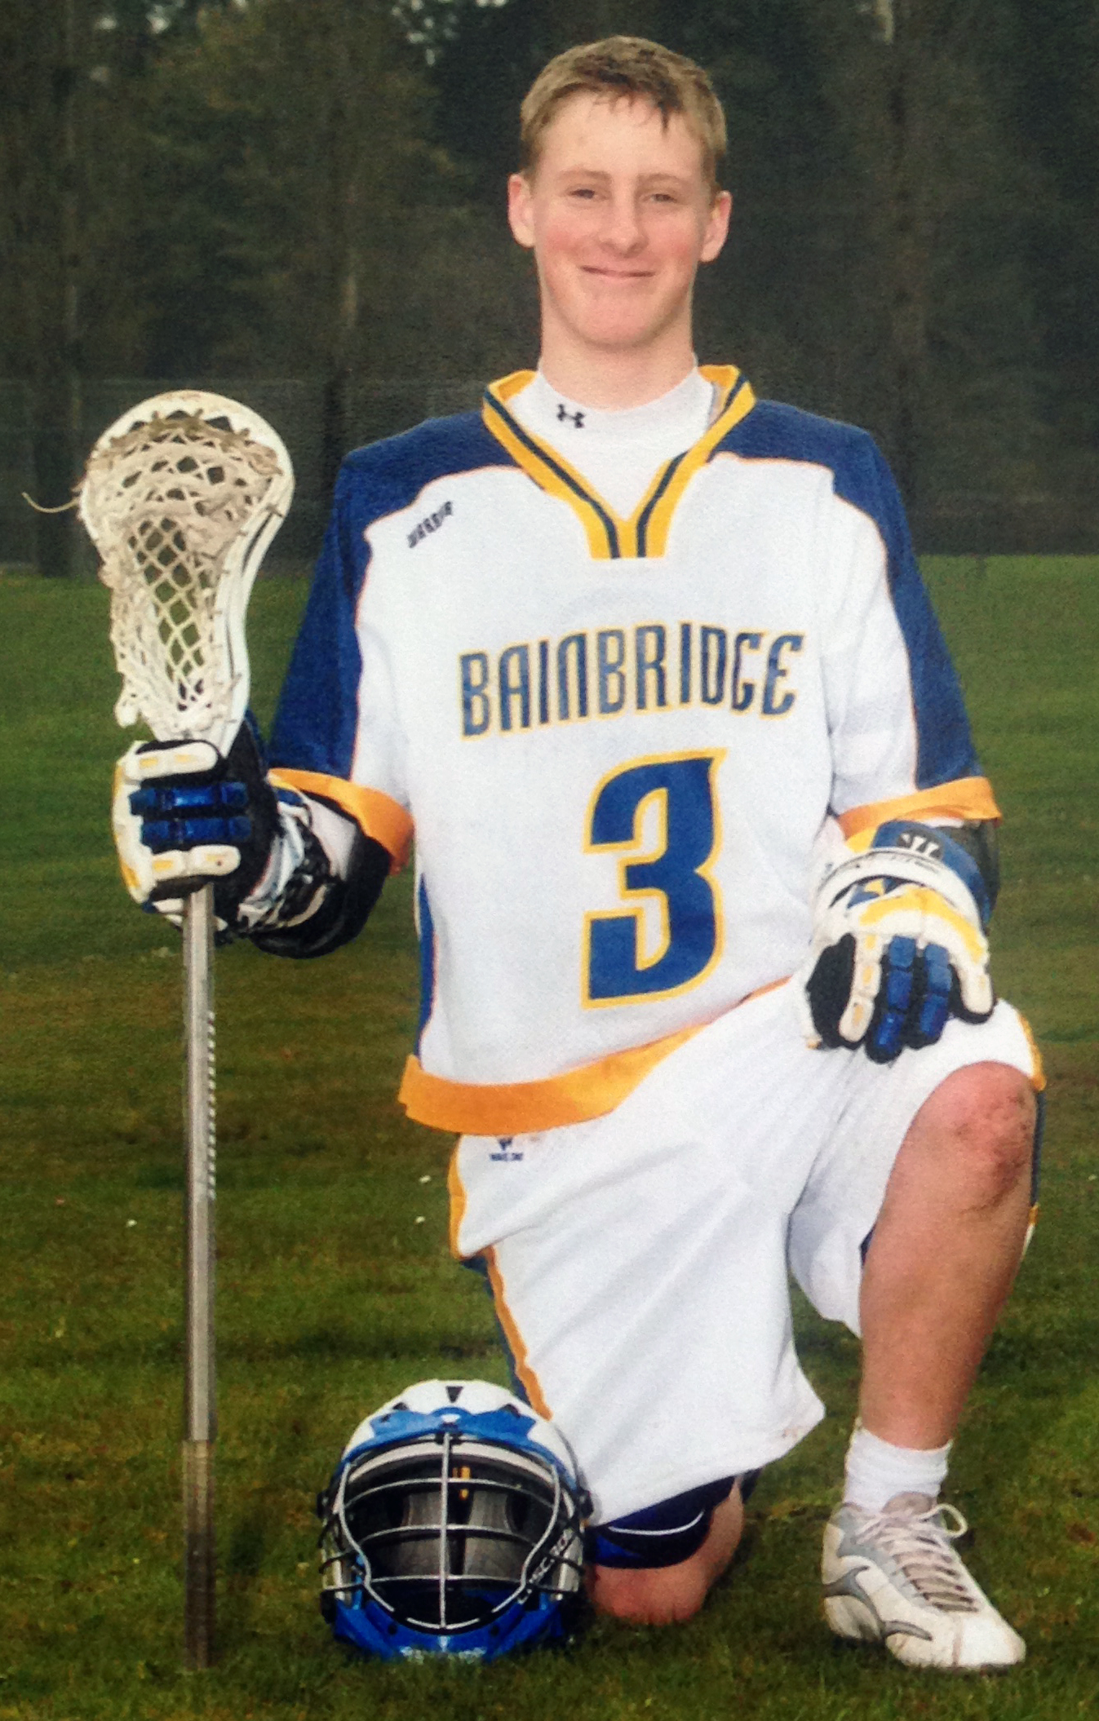
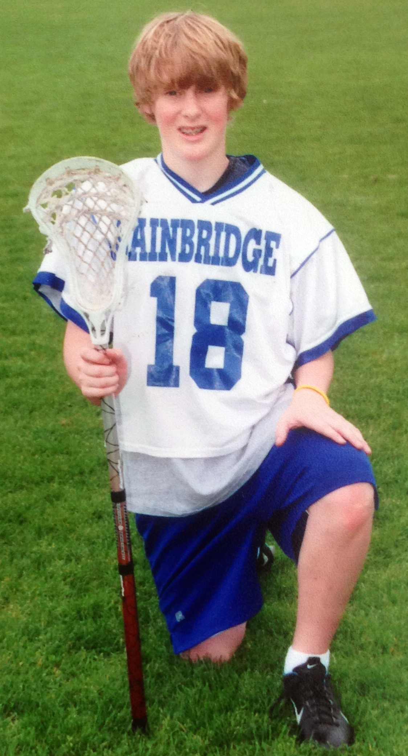
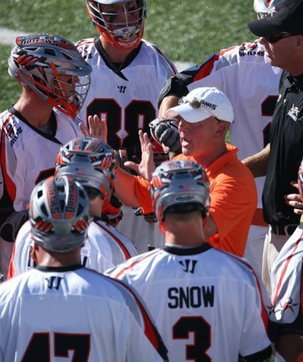
Sam Snow
Fairfield University
55th Pick 2013 Major League Lacrosse Draft

Slide 6
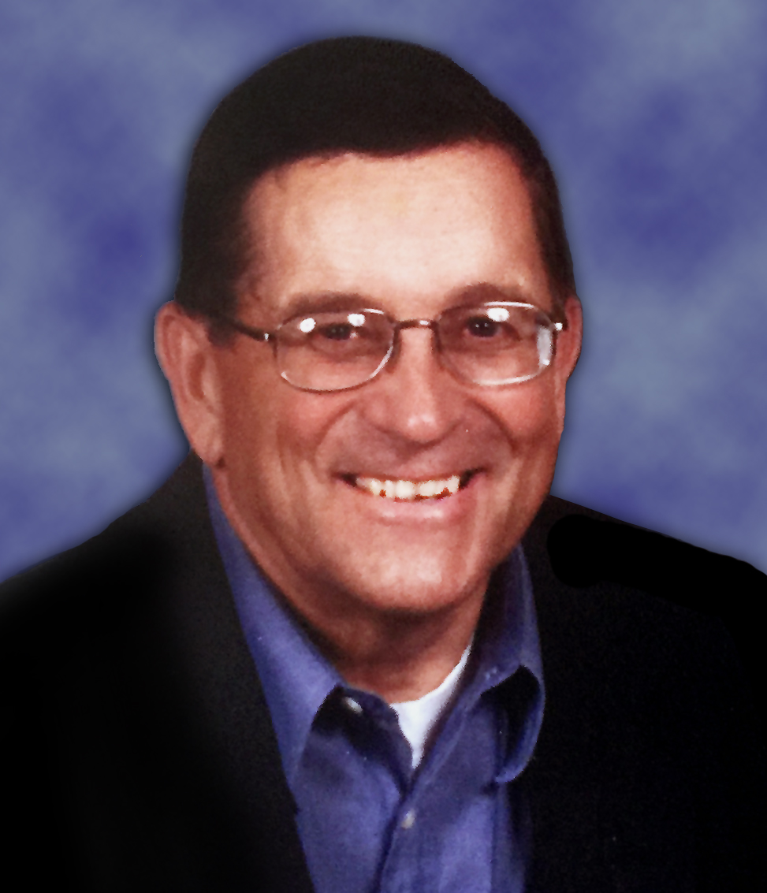

Slide 8
GOOD-BYE
COMPLETION
LETTER

Slide 12
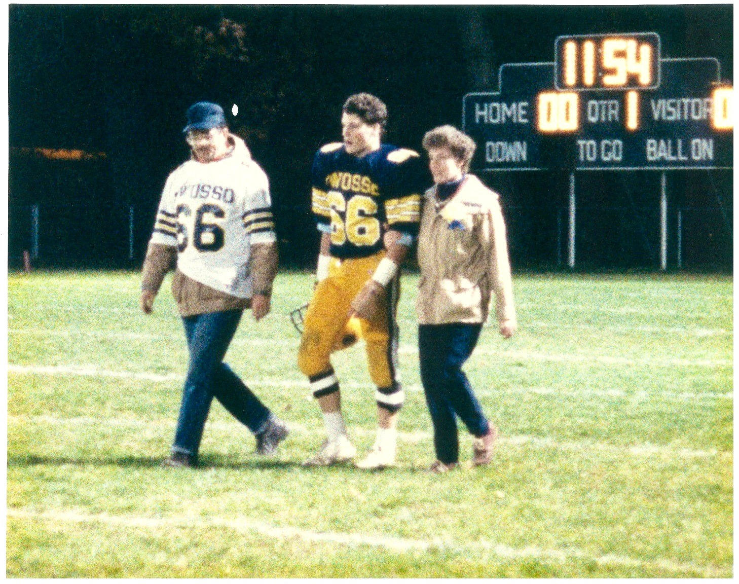

Slide 13
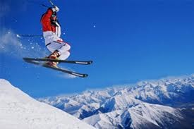
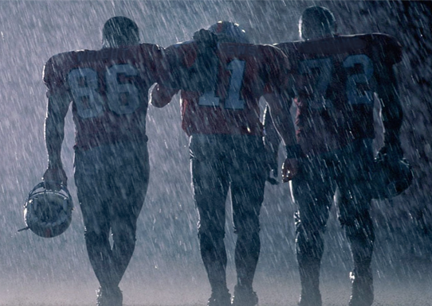

Slide 16
.com

Slide 17
14

Slide 19
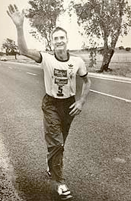
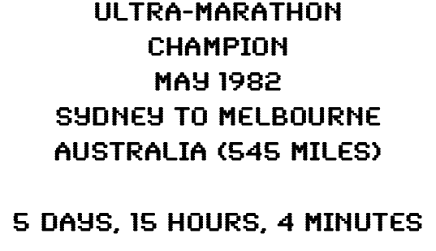

Slide 20
“Leadership is not given it is taken! Real leaders exude confidence in themselves, pursue their passions regardless of their obstacles, and inspire others to do the same.”
— Patrick Snow
“The key to becoming an effective leader is not to focus on making other people follow, but on making yourself the kind of person they want to follow.”
— John Maxwell
“Success comes from learning to serve, build and inspire others. For followers, this is the path to leadership.”
— Cory Bouck

Slide 21
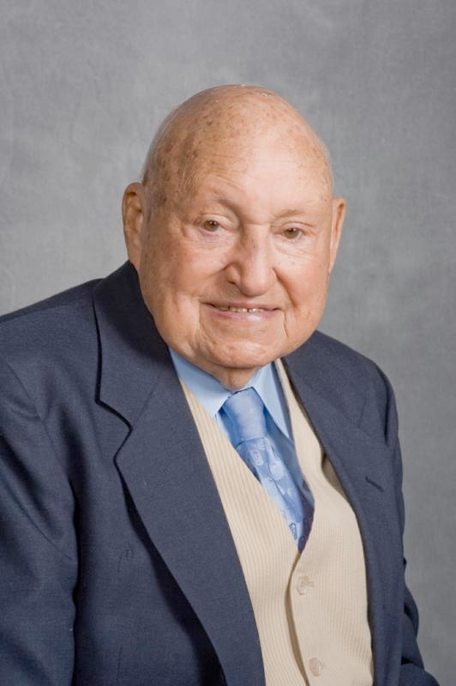
S. Truett Cathy
Founder

Slide 25
22

Slide 26
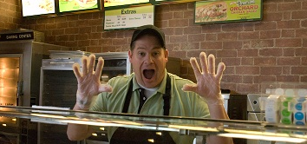
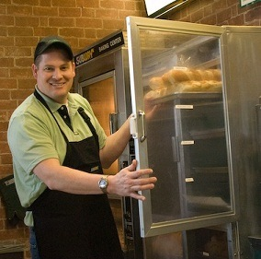
Walk A Mile In Your Prospects Shoes
(In preparation for my keynote speech)

Slide 27
24

Slide 29
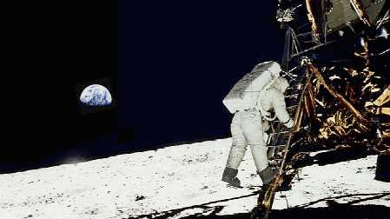
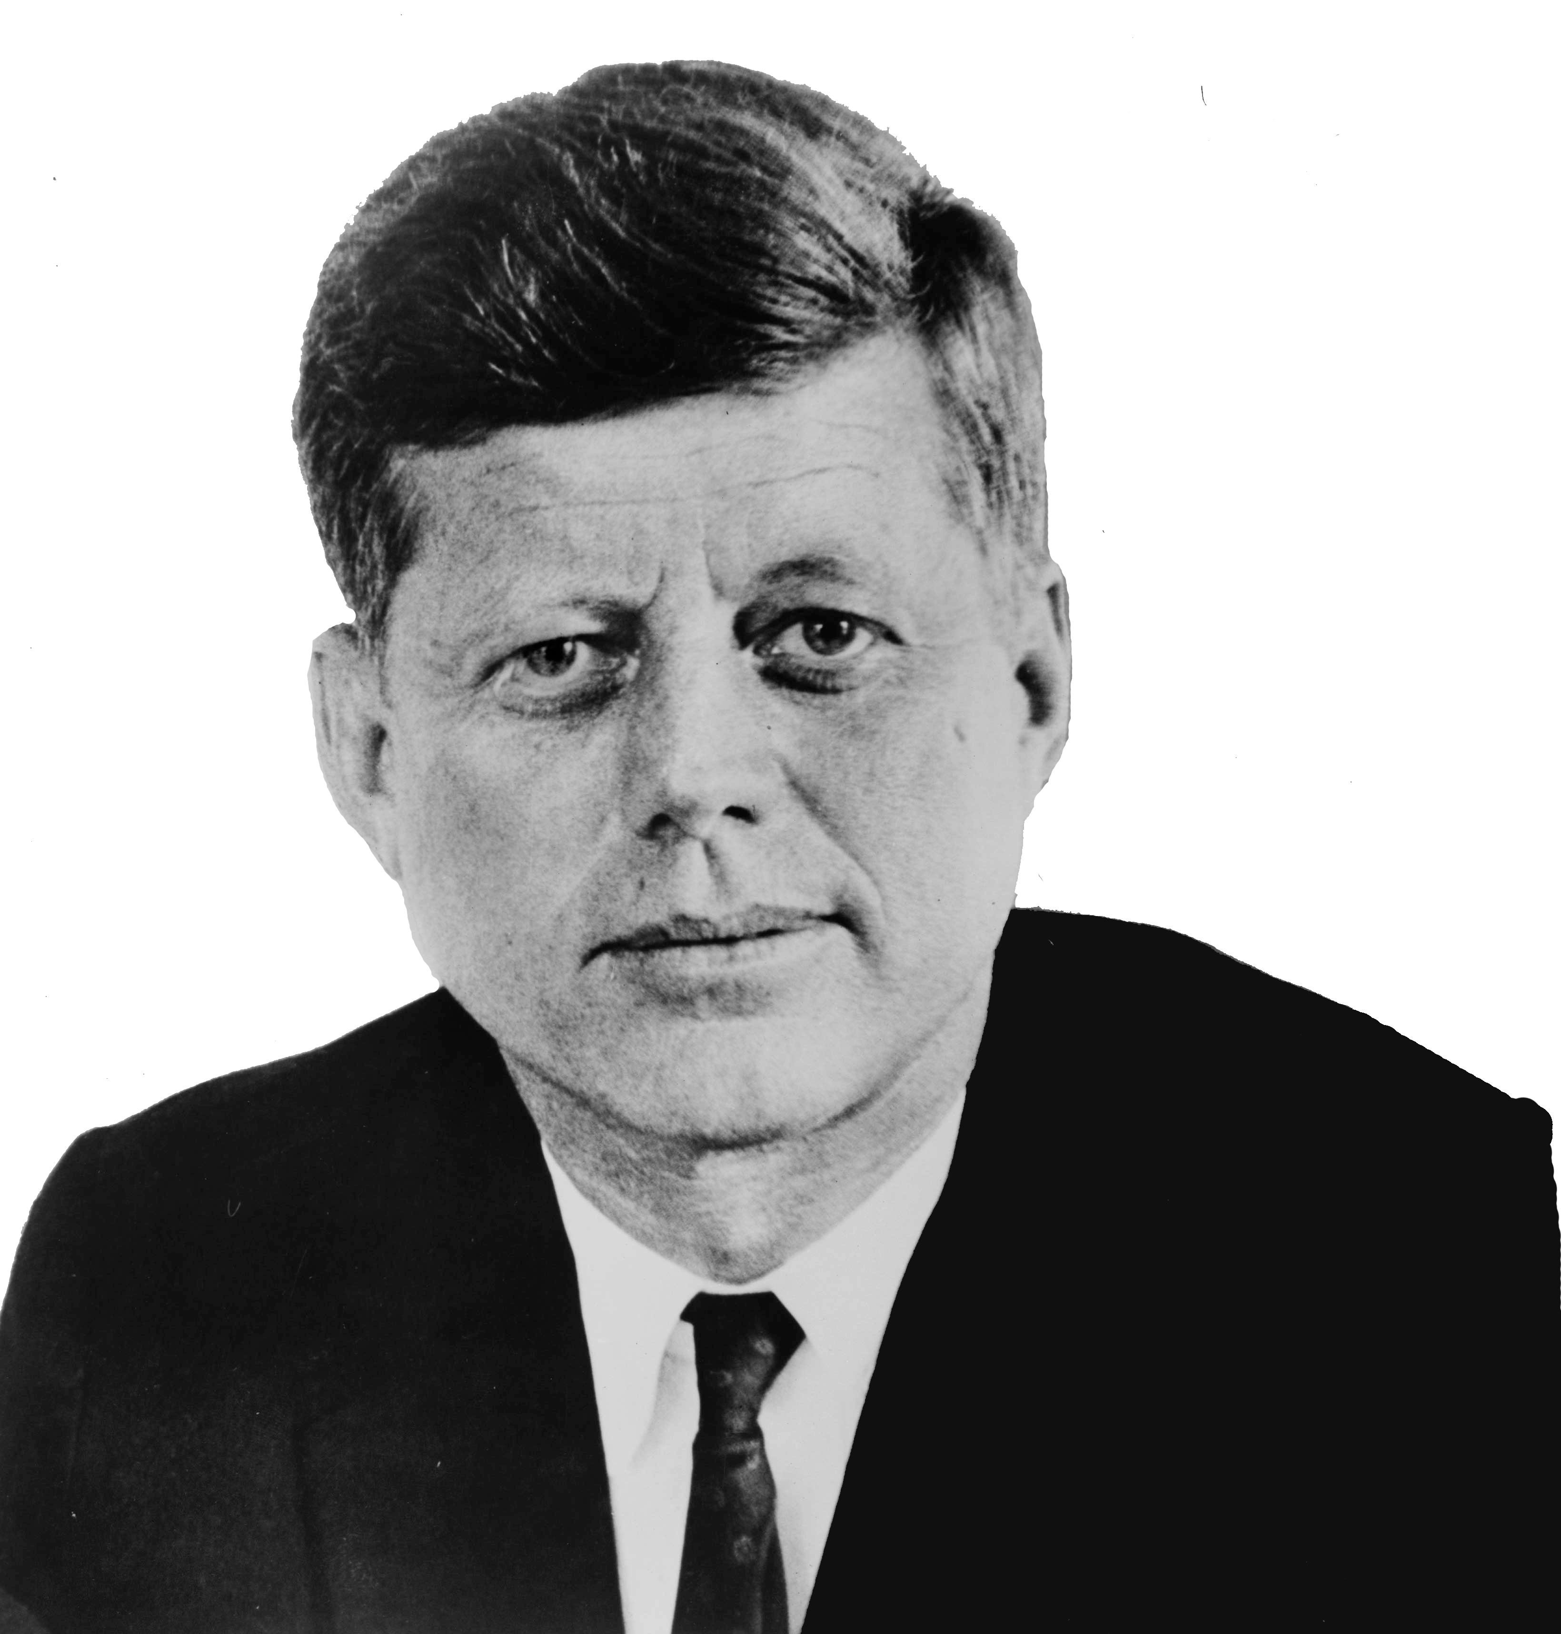

Slide 30
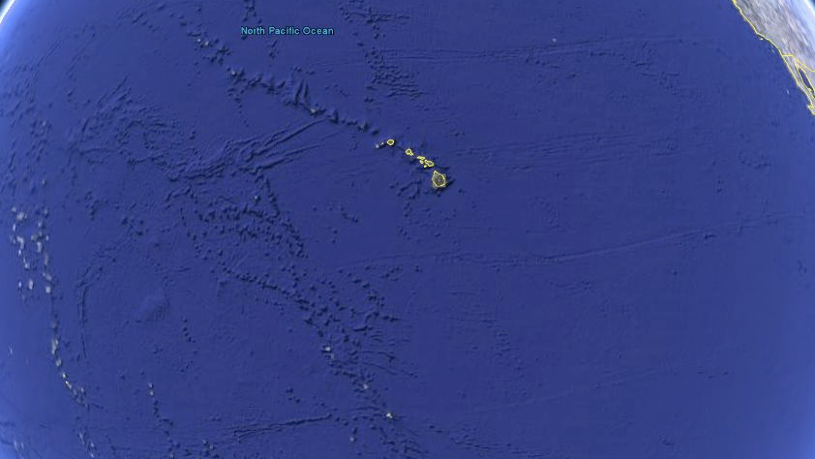

Slide 31
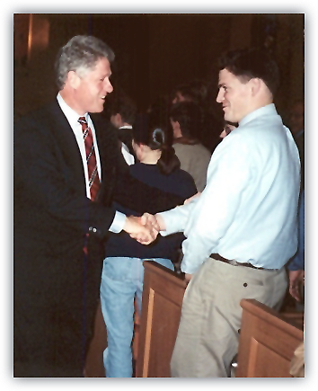

Slide 32
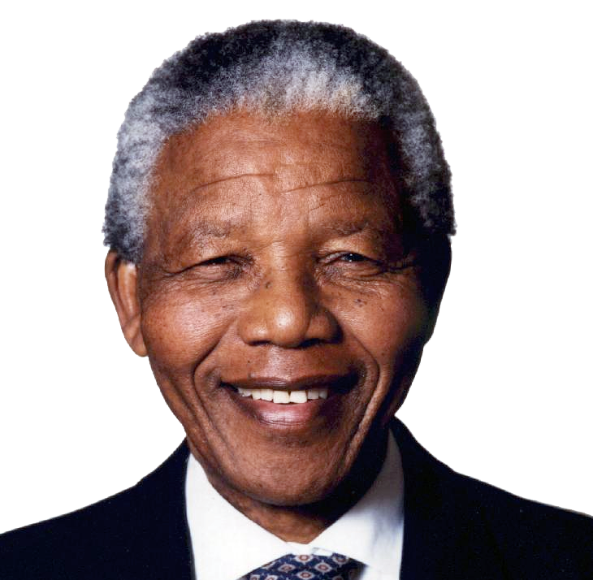

Slide 34
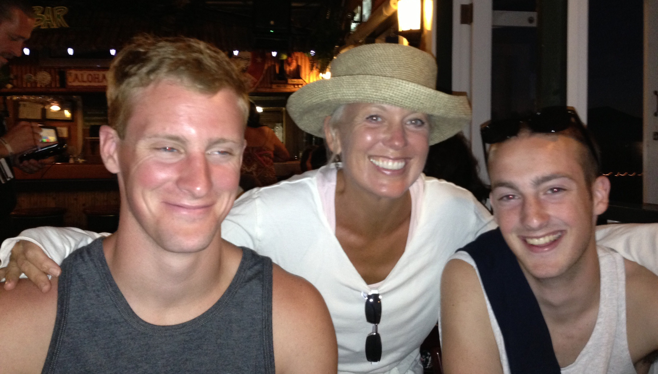
31

Slide 35
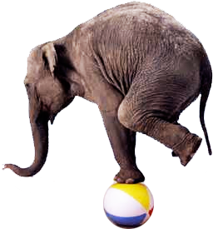

Slide 36
Moral of the Story…
Know where you are going in life; you may already be there!

Slide 37
1 Hour of
Exercise
per Day

Slide 38
May 2010
December 2011

Slide 39
Coming soon
Sept
2014

Slide 40
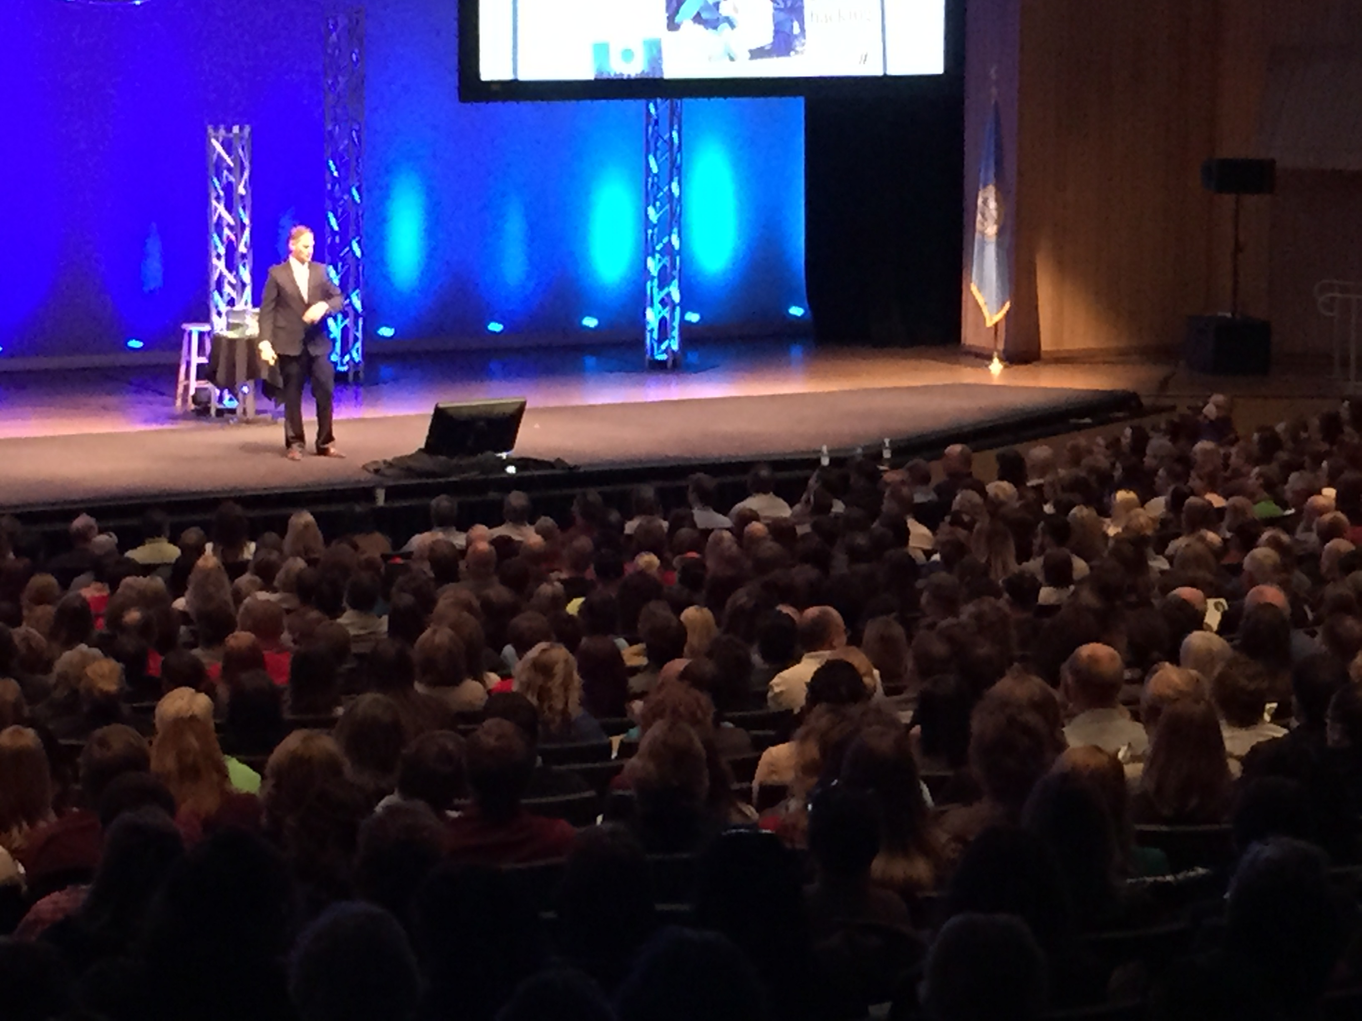
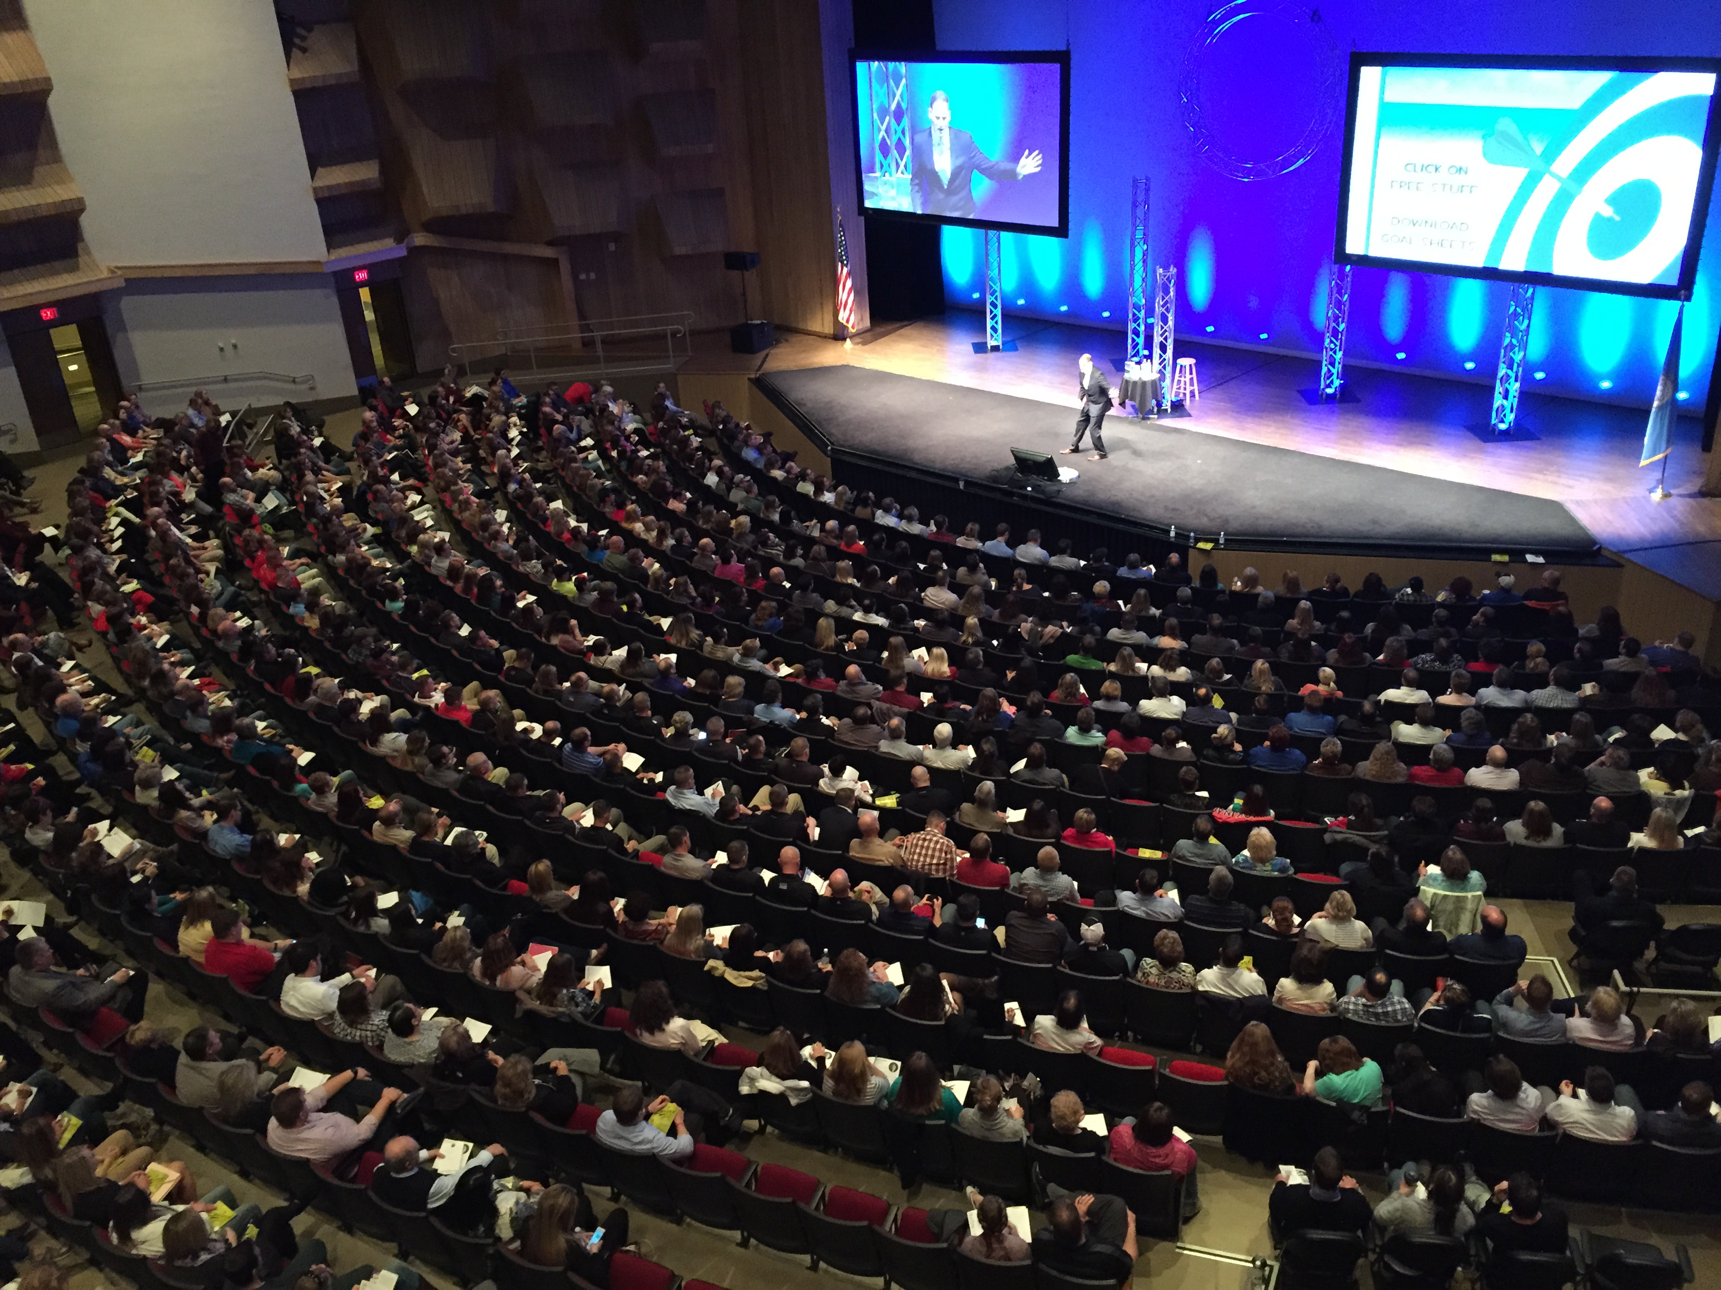
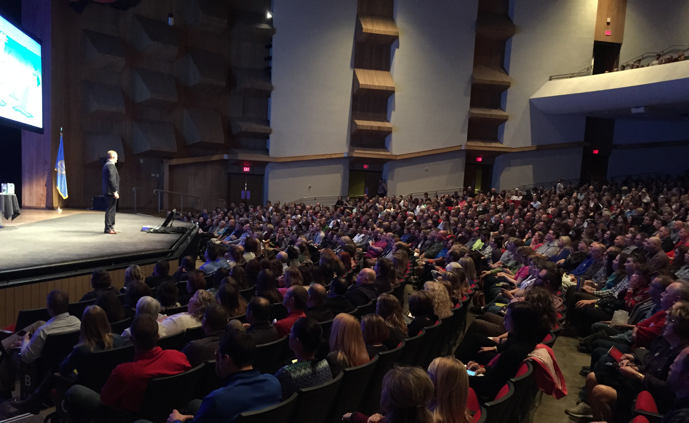

Slide 41
EVALUATION &
INVITATION
FORM

Slide 43
“Do what you fear and the fear disappears.”
— David Joseph Schwartz

Slide 45
Jacob
Patrick
Sam

Slide 47
Produced by AngelDogProductions.com
“Only those who can see the invisible
can achieve the impossible.
The belief in your vision holds the key
to creating your own destiny.”
—Patrick Snow

