Slide 1
Systematizing For Success
Marc Cunningham
Marc Cunningham
Download session workbook now a www.RentGrace.com/systems
Notes:
----- Meeting Notes (11/13/15 10:43) -----
test 1-2-3

Slide 2
What is a System

Slide 3
What is a System
Why you need a System

Slide 4
What is a System
Why you need a System
How to create

Slide 5
What is a System
Why you need a System
How to create
How to implement

Slide 6
What is a System
Why you need a System
How to create
How to implement
How to improve

Slide 7
The Foundation of a System:

Slide 8
The Foundation of a System:
Variation is evil

Slide 9
What is a System ?

Slide 12
✪

Slide 13
System:
“The way we do it here”

Slide 14
Documented Automation

Slide 15
Playbook

Slide 17
Roadmap

Slide 18
System Manual Overview
The system shall run the business, and the team members shall run the system.
Systems are simply road maps or instructions that allow the Grace Management process to be repeated and easily duplicated.

Slide 19
Property management done on a large scale is an extremely complex business with many moving parts. In order for Grace Management to be successful, it must be consistent.

Slide 20
The purpose of the system manual is to provide a consistent and specific way of doing business, and to ensure that each property, resident, owner, and as much as possible, each situation, is treated the same.
Also to define HOW Grace Management will do property management.

Slide 21
The Finished Product

Slide 22
17 Reasons Why you need a System

Slide 23
Why you need a System
1. Stops the revolving door to your office

Slide 24
Why you need a System
1. Stops the revolving door to your office
2. Improves new employee training

Slide 25
Why you need a System
1. Stops the revolving door to your office
2. Improves new employee training
3. Reduces liability

Slide 29
Why you need a System
1. Stops the revolving door to your office
2. Improves new employee training
3. Reduces liability
4. Increases company value

Slide 30
Why you need a System
1. Stops the revolving door to your office
2. Improves new employee training
3. Reduces liability
4. Increases company value
5. Improves employee clarity on the WHAT and the HOW ✪

Slide 31
Why you need a System
6. Gets you in compliance with required Policy & Procedure manual

Slide 32
Why you need a System
6. Gets you in compliance with required Policy & Procedure manual
7. Creates a storage repository for your templates and checklists

Slide 33
Why you need a System
6. Gets you in compliance with required Policy & Procedure manual
7. Creates a storage repository for your templates and checklists
8. Allows you to feel ‘ok’ about giving up control and delegating

Slide 34
Why you need a System
9. Creates employee accountability

Slide 35
Why you need a System
9. Creates employee accountability
10. Makes everyone replaceable ✪

Slide 36
Why you need a System
9. Creates employee accountability
10. Makes everyone replaceable
11. Creates simplicity of process and consistency of outcome

Slide 37
Why you need a System
9. Creates employee accountability
10. Makes everyone replaceable
Creates simplicity of process and consistency of outcome
Makes the business scalable

Slide 38
Why you need a System
9. Creates employee accountability
10. Makes everyone replaceable
11. Creates simplicity of process and consistency of outcome
12. Makes the business scalable
13. Prioritizes the tasks and work to be done ✪

Slide 39
Why you need a System
14. Helps you go from being reactive to proactive

Slide 40
Why you need a System
14. Helps you go from being reactive to proactive
15. Sustains the business beyond you

Slide 41
Why you need a System
14. Helps you go from being reactive to proactive
15. Sustains the business beyond you
16. Breaks down property management tasks into their smallest components

Slide 42
Why you need a System
17. Protects the current and future culture of the organization

Slide 43
Unicorn World

Slide 44
How to create a System Manual

Slide 45
How to create a System Manual
Note –
As you work through creating your Systems, they should be a combination of the best of what your organization is today,
plus what you want it to be
tomorrow

Slide 46
How to create a System Manual
Step 1. List the major functions of the company.

Slide 47
Rent collection
Accounting
Leasing
Tenant relations
Managing the office
Owner relations
Managing employees
Maintenance coordination
New account acquisition
Vendor oversight
Property Inspections

Slide 48
How to create a System Manual
Step 1. List the major functions of the company.
Step 2. Assign a job title to each function.

Slide 49
Rent collection – Director of Accounting
Vendor Oversight – Vendor Coordinator
Accounting - Director of Accounting
Leasing – Director of Leasing
Tenant relations – Property Manager
Managing the office – Director of Operations
Owner relations – Property Manager
Managing employees – Director of Operations
Maintenance coordination – Property Manager
New account acquisitions – New Account Specialist
Property Inspections – Assistant Property Manager

Slide 50
Job Titles
Director of Accounting
Director of Leasing
Property Manager
Resident Services Coordinator
Director of Operations
President
Vendor Coordinator
New Account Specialist
Assistant Property Manager

Slide 51
How to create a System Manual
Step 1. List the major functions of the company.
Step 2. Assign a job title to each function.
Step 3. List 5 to 10 Key Result Areas (KRAs) for each job title.

Slide 52
Key Result Areas (KRAs) are the essential tasks and activities for which that job title is completely responsible.

Slide 53
Key Result Areas (KRAs) are the essential tasks and activities for which that job title is completely responsible.
This means that if that ‘job title’ doesn't do it, it doesn't get done.

Slide 54
Key Result Areas (KRAs) are the essential tasks and activities for which that job title is completely responsible.
This means that if that ‘job title’ doesn't do it, it doesn't get done.
It is the ‘what’, not the ‘how’.

Slide 55
Director of Leasing Key Result Areas - KRAs:
Phone inquiries
E-mail inquiries
Schedule Showings
Showing Presentation
Application Processing
Lease Signing
Move-in Coordination
Other

Slide 56
Property Manager Key Result Areas - KRAs:
Resident Relations
Owner Relations
Security Deposit Returns
Prepare / List new properties for rent
Assist DA with delinquent rent collection
Show vacant units outside office geographic showing area
Maintenance coordination

Slide 57
Director of Accounting Key Result Areas - KRAs:
Create bank deposits
Post bank deposits into Appfolio software
Prepare 3-day demand notices
Drive the collection of delinquent rents
Process NSF payments
Close out the monthly accounting cycle
Drive the ex-resident collection process
Other

Slide 58
How to create a System Manual
Step 1. List the major functions of the company.
Step 2. Assign a job title to each function.
Step 3. List 5 to 10 Key Result Areas (KRAs) for each job title.
Step 4. Create a Measure of Success for
each KRA.

Slide 59
A Measure of Success defines what winning looks like for the person doing the task, – it is a metric

Slide 60
A Measure of Success defines what winning looks like for the person doing the task, - it is a metric
A Measure of Success must be:
Specific

Slide 61
A Measure of Success defines what winning looks like for the person doing the task, - it is a metric
A Measure of Success must be:
Specific
Timely

Slide 62
A Measure of Success defines what winning looks like for the person doing the task, - it is a metric
A Measure of Success must be:
Specific
Timely
Measurable

Slide 63
Position Title: Director of Leasing
KRA: Phone inquiries

Slide 64
Position Title: Director of Leasing
KRA: Phone inquiries
Return phone calls quickly

Slide 65
Position Title: Director of Leasing
KRA: Phone inquiries
Return phone calls quickly
Do your best to call back and be friendly

Slide 66
Position Title: Director of Leasing
KRA: Phone inquiries
Return phone calls quickly
Do your best to call back and be friendly
Calls should be returned as soon as possible

Slide 67
Position Title: Director of Leasing
KRA: Phone inquiries
Return phone calls quickly
Do your best to call back and be friendly
Calls should be returned as soon as possible
Return each phone call the same business day it was left

Slide 68
Position Title: Director of Leasing
KRA: Application Processing
Approve only high quality applicants

Slide 69
Position Title: Director of Leasing
KRA: Application Processing
Approve only high quality applicants
Run applications and get information as soon as possible

Slide 70
Position Title: Director of Leasing
KRA: Application Processing
Approve only high quality applicants
Run applications and get information as soon as possible
Run applications immediately upon receipt

Slide 71
Position Title: Director of Leasing
KRA: Application Processing
Approve only high quality applicants
Run applications and get information as soon as possible
Run applications immediately upon receipt
Have all applications processed within 24 business hours of receipt and notification made to applicant.

Slide 72
Position Title: Property Manager
KRA: Resident Relations
Keep residents happy

Slide 73
Position Title: Property Manager
KRA: Resident Relations
Keep residents happy
Provide the highest level of customer service

Slide 74
Position Title: Property Manager
KRA: Resident Relations
Keep residents happy
Provide the highest level of customer service
Respond to all tenant phone calls within 2 days

Slide 75
Position Title: Property Manager
KRA: Resident Relations
Keep residents happy
Provide the highest level of customer service
Respond to all tenant phone calls within 2 days
Receive 1 written compliment and no complaints each month

Slide 76
How to create a System Manual
Step 1. List the major functions of the company.
Step 2. Assign a job title to each function.
Step 3. List 5 to 10 Key Result Areas (KRA’s) for each job title.
Step 4. Create a Measure of Success for each KRA.
Step 5. Write a detailed step-by-step describing how each KRA will be done, in order to achieve the Measure of Success

Slide 77
How Detailed ??

Slide 78
✪

Slide 79
How to create a System Manual
Step 1. List the major functions of the company.
Step 2. Assign a job title to each function.
Step 3. List 5 to 10 Key Result Areas (KRA’s) for each job title.
Step 4. Create a Measure of Success for each KRA.
Step 5. Write a detailed step-by-step describing how each KRA will be done, in order to achieve the Measure of Success
Step 6. Organize, order, and insert templates

Slide 80
How to create a System Manual
What are templates?
Any and every checklist, office document, written policy, reoccurring e-mail, guideline, lease template, etc., that you have on hand.

Slide 81
Examples of templates
Canned e-mail responses
you write it with your voice and your heart
set up as auto-signatures

Slide 82
Examples of templates
Canned e-mail responses
you write it with your voice and your heart
set up as auto-signatures
Checklists

Slide 83
Examples of templates
Canned e-mail responses
you write it with your voice and your heart
set up as auto-signatures
Checklists
Lease and management agreement

Slide 84
Examples of templates
Canned e-mail responses
you write it with your voice and your heart
set up as auto-signatures
Checklists
Lease and management agreement
FAQ training info

Slide 85
Examples of templates
Canned e-mail responses
you write it with your voice and your heart
set up as auto-signatures
Checklists
Lease and management agreement
FAQ training info
Fair housing guidelines

Slide 87
4. How to Implement a System Manual

Slide 88
One person shop vs Large Team

Slide 89
Implementation: One person shop:

Slide 90
Implementation: Large team:

Slide 91
Warning !! Do NOT implement your System Manuals around your existing team – rather implement your team around your System Manuals

Slide 92
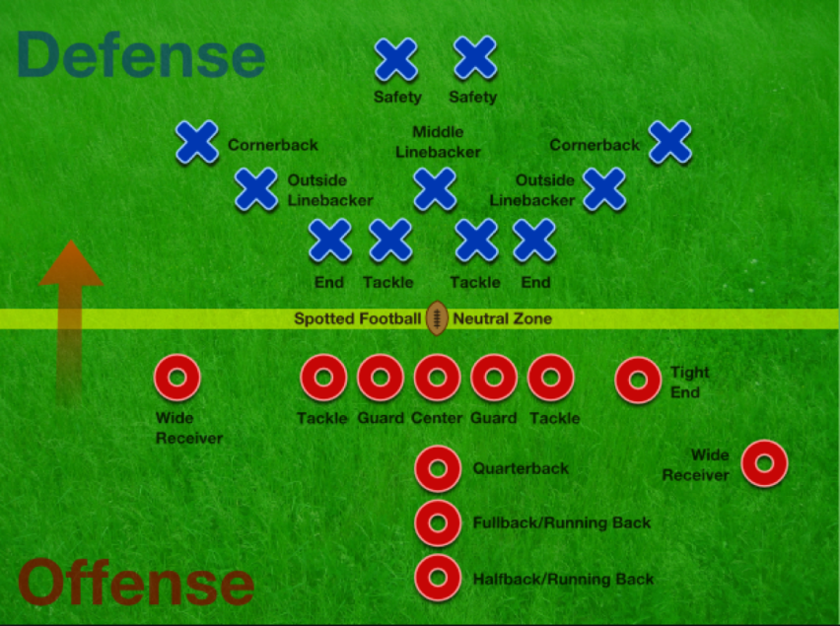

Slide 94
5. How to Measure & Improve a System Manual

Slide 95
Performance / Evaluation (PE) Meetings

Slide 96
Performance / Evaluation (PE) Meetings
1 time per month with each individual

Slide 97
Performance / Evaluation (PE) Meetings
1 time per month with each individual
Calendared

Slide 98
Performance / Evaluation (PE) Meetings
1 time per month with each individual
Calendared
30-60 min in length

Slide 99
Performance / Evaluation (PE) Meetings
1 time per month with each individual
Calendared
30-60 min in length
First 5 min is their personal time with me

Slide 100
Performance / Evaluation (PE) Meetings
1 time per month with each individual
Calendared
30-60 min in length
First 5 min is their personal time with me
Address non-urgent questions / issues

Slide 101
Performance / Evaluation (PE) Meetings
1 time per month with each individual
Calendared
30-60 min in length
First 5 min is their personal time with me
Address non-urgent questions / issues
Review 1 or 2 KRA’s in detail

Slide 102
Performance / Evaluation (PE) Meetings
3 questions to keep in mind while reviewing each Key Result Area (KRA):
Is the SM correct?

Slide 103
Performance / Evaluation (PE) Meetings
3 questions to keep in mind while reviewing each Key Result Area (KRA):
Is the SM correct?
Are you doing it the way the SM says?

Slide 104
Performance / Evaluation (PE) Meetings
3 questions to keep in mind while reviewing each Key Result Area (KRA):
Is the SM correct?
Are you doing it the way the SM says?
How can we improve the System?

Slide 105
Performance / Evaluation (PE) Meetings
I have a ‘team member coaching’ form

Slide 106
Performance / Evaluation (PE) Meetings
I have a ‘team member coaching’ form
Team member fills out a PE sheet in advance of the meeting and gives to me at the meeting

Slide 107
Performance / Evaluation (PE) Meetings
I have a ‘team member coaching’ form
Team member fills out a PE sheet in advance of the meeting and gives to me at the meeting
Common vs position specific questions

Slide 108
Performance / Evaluation (PE) Meetings
I have a ‘team member coaching’ form
Team member fills out a PE sheet in advance of the meeting and gives to me at the meeting
Common vs position specific questions
Review their self-scored measures of success for each Key Result Area (KRA)

Slide 109
For each item, circle the number corresponding to the percentage of your success. Director of Leasing - KRA 1: Phone Inquiries Measure of Success: Return each phone call the same business day the message was left 10% 2 3 4 5 6 7 8 9 100% __________________________________________________

Slide 110
For each item, circle the number corresponding to the percentage of your success. Resident Services Coordinator - KRA 8: Re-invoicing Measure of Success: Re-invoice all 3rd party vendor invoices within 48 business hours of receipt 10% 2 3 4 5 6 7 8 9 100% _________________________________________________

Slide 111
…Marc is naive & gullible…

Slide 113
For each item, circle the number corresponding to the percentage of your success. Resident Services Coordinator - KRA 8: Re-invoicing Measure of Success: Re-invoice all 3rd party vendor invoices within 48 business hours of receipt 10% 2 3 4 5 6 7 8 9 100% _________________________________________________

Slide 114
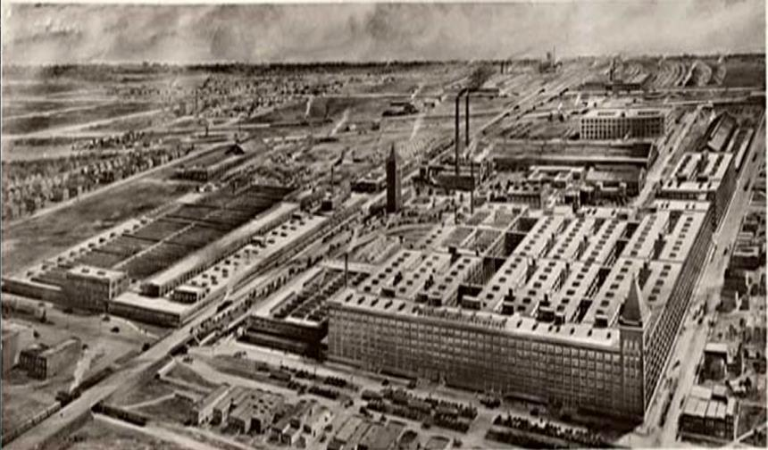
✪ Hawthorne Works, Cicero, Illinois 1905 – 1983

Slide 115
Hawthorn Effect: When people think their work is being measured, their productivity increases.

Slide 116
Hawthorn Effect: When people THINK their work is being measured, their productivity increases.

Slide 117
Performance / Evaluation (PE) Meetings
End with feedback, encouragement, compliments

Slide 120
System Manual Overview
The system shall run the business, and the team members shall run the system.
Systems are simply road maps or instructions that allow the Grace Management processes to be repeated and easily duplicated.

Slide 121
Property management done on a large scale is an extremely complex business with many moving parts. In order for Grace Management to be successful, it must be consistent.

Slide 122
The purpose of the system manual is to provide a consistent and specific way of doing business, and to ensure that each property, resident, owner, and as much as possible, each situation, are treated the same.
Also to define HOW Grace Management will do property management.

Slide 123
The System Manual will provide each team member with specific KRA’s (Key Result Areas) for which they are responsible and a specific measure of success for each KRA, so that each team member always knows whether or not they are succeeding.

Slide 124
Team members should always refer to their specific system manual to determine the answer to a question before bringing that question to the Director of Operations.

Slide 125
Any deviation outside of the system must be recognized as an exception to the system. While exceptions are necessary from time to time, each exception is by nature inefficient, and should therefore be avoided.

Slide 126
Each team member shall constantly work to improve the system. One purpose of the monthly Performance / Evaluation (PE) meeting with the Director of Operations is to ensure that on-going system improvements are suggested, discussed, and implemented.

Slide 127
15 FAQs & Tips

Slide 128
FAQs & Tips
1. Does it stifle employee creativity?

Slide 129
FAQs & Tips
1. Does it stifle employee creativity?
2. Can the SM be in digital format?

Slide 130
FAQs & Tips
1. Does it stifle employee creativity?
2. Can the SM be in digital format?
3. When should I step outside the SM?

Slide 131
FAQs & Tips
1. Does it stifle employee creativity?
2. Can the SM be in digital format?
3. When should I step outside the SM?
4. Should the boss have a SM?

Slide 132
FAQs & Tips
5. How well should employees know their SM?

Slide 133
FAQs & Tips
How well should employees know their SM?
6. Can 1 person have multiple SM’s?

Slide 134
FAQs & Tips
How well should employees know their SM?
Can 1 person have multiple SM’s?
7. What should NOT go into a SM?

Slide 135
FAQs & Tips
Should I still do annual reviews?

Slide 136
FAQs & Tips
Should I still do annual reviews?
What about small misc tasks, where should they go in the SM?

Slide 137
FAQs & Tips
Should I still do annual reviews?
What about small misc tasks, where should they go in the SM?
This won’t work for me because I don’t have the “personality” for it. ✪

Slide 138
Second Rule of the Army:
“If it’s stupid but works, it’s not stupid”

Slide 139
FAQs & Tips
11. Do all employees report to the ‘boss’ for the Performance Evaluation (PE) meetings?

Slide 140
FAQs & Tips
Do all employees report to the ‘boss’ for the Performance Evaluation (PE) meetings?
12. Does it have to be all or nothing, or can I implement a few pieces of this concept?

Slide 141
FAQs & Tips
13. How often should the System Manuals be updated?

Slide 142
FAQs & Tips
13. How often should the System Manuals be updated?
14. Is it hard to change the System Manuals with company growth?

Slide 143
FAQs & Tips
Should every aspect of the business be ‘systematized’?

Slide 144
5 Final Thoughts:

Slide 145
1. The Foundation
Variation is evil

Slide 146
2. The Importance of People
Even the best system, if run by the wrong people… will fail

Slide 147
3. The Importance of Execution
A mediocre system run well, will be more effective than a great system run poorly

Slide 148
4. A System Manual Proverb
Your job is to build the System,
The team members job is to run the System,
the SYSTEMS job is to make the business successful

Slide 149
You Do Noble Work

Slide 150
Download a free sample of each of the 9 Grace Management System Manuals www.RentGrace.com/systems Success@RentGrace.com
Notes:
----- Meeting Notes (11/13/15 10:41) -----
test123

Slide 151
.

