Slide 1
What Behavioral Insight Can Do For You
Presented by:
Carletta Clyatt, SVP

Slide 2
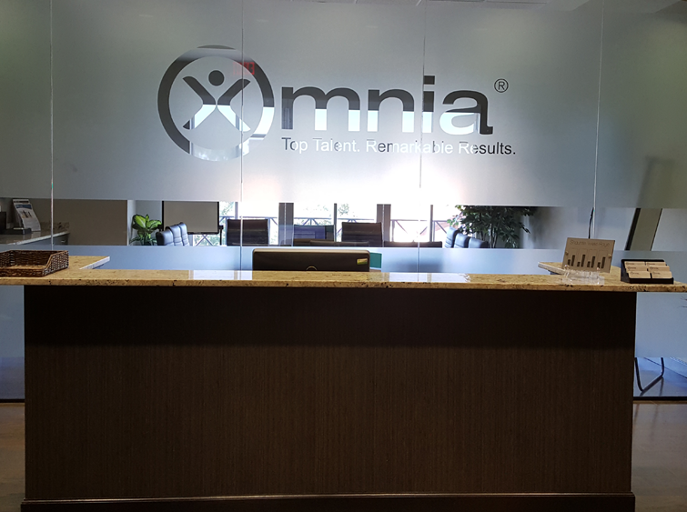
Established in 1985
Validated, behavior-based, selection and management tools.
Over 1.3 million behavioral profiles processed.
30,000 active clients worldwide

Slide 3
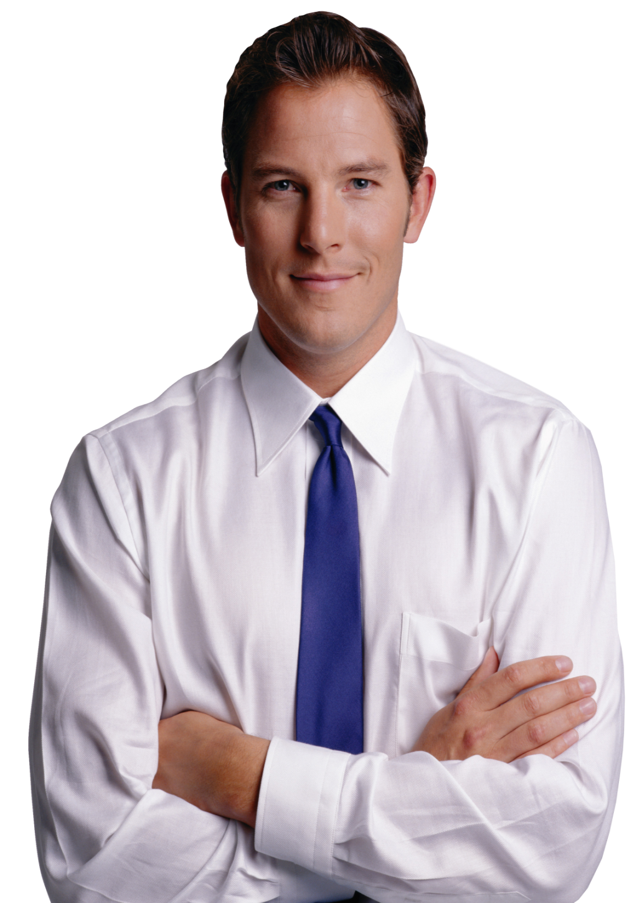
Interview day…

Slide 4
Shows up for work!

Slide 5
Have You Ever…
Wondered if an evil twin switched places with your new hire?
Hired someone you really liked who couldn’t do the job?
Hired a candidate with loads of experience, only to watch him struggle?

Slide 6
What Makes a Great Hire?
Talent
Skills
Culture

Slide 7
Best Practices In Hiring

Slide 8
Development
Engagement
Recruitment

Slide 9
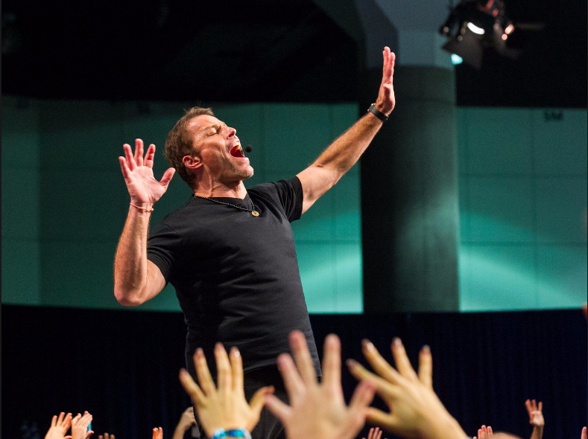
Communication Style
Assertiveness
Pace & Adaptability
Need for Structure

Slide 10
The Columns Work in Pairs

Slide 11
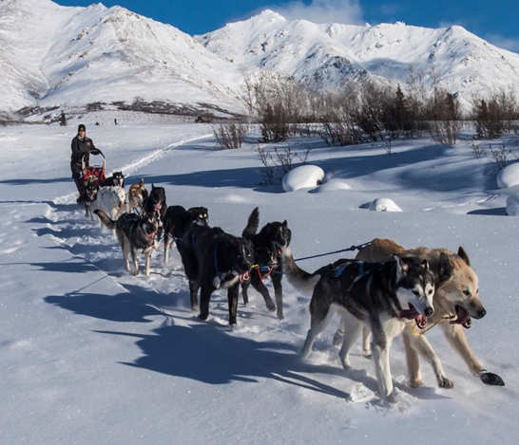
Columns 1 & 2 = Level of Assertiveness
Column 1: “Me” Oriented
Competitive
Self-starting
Enjoys a challenge
1
2
Column 2: “We” Oriented
Collaborative
Helpful
Fixed salary
1
2

Slide 12
Coaching 1 & 2
Column 1
Make sure they are not so aggressive that they unintentionally make others uncomfortable.
Offer a viable way to keep score that recognizes individual attainments.
Column 2
Provide realistic, “safe” goals that do not require this individual to step outside of their comfort zone.
Have them observe others to gain new perspectives on negotiating techniques.

Slide 13
3 & 4 = Communication Style
Column 3: Socially Assertive
Develops instant rapport
Needs recognition
Intuitive decision maker
3
4
Column 4: Analytical / Thinker
Good listener and observer
Wants proof and answers
Objective decision maker
3
4

Slide 14
Coaching 3 & 4
Column 3:
Coach on taking more time to ask questions and take notes with others.
To motivate, commend their achievements (in front of their peers) at meetings, etc.
Column 4:
Provide a clear chain of command and open lines of communication with management.
Let them know exactly what is expected and give them specific feedback on their performance.

Slide 15
Columns 5 & 6 = Pace and Adaptability
Column 5: Likes Variety
Multi-tasking
Handles interruptions and changes easily
Can get bored with too much predictability
5
6
Column 6: Likes Routine
Methodical
One thing at a time
No last minute
5
6

Slide 16
Coaching Columns 5 & 6
Column 5:
Establish goals that can be quickly achieved and offer timely rewards.
Regularly help / offer to review priorities to ensure there is an effective follow-up system.
Column 6:
Allow them to follow a routine, focus on one objective at a time.
Introduce changes slowly, give time to prepare.

Slide 17
Columns 7 & 8 = Need for Structure
Column 7: Likes Independence
Decisive
Big picture/ visionary
Resilient
7
8
Column 8: Likes Structure
Detail-oriented / accurate
Self-manages within guidelines
Quality conscious
7
8

Slide 18
Coaching Columns 7 & 8
Column 7:
Set performance goals with, not for this person.
Give them ample latitude to improvise in elective areas in exchange for compliance with non-negotiable rules.
Column 8:
Help to understand that criticism and some rejection is normal; remind them not to take personally.
Give very clear input as to what to do, why to do it and how you see it as best being done.

Slide 19
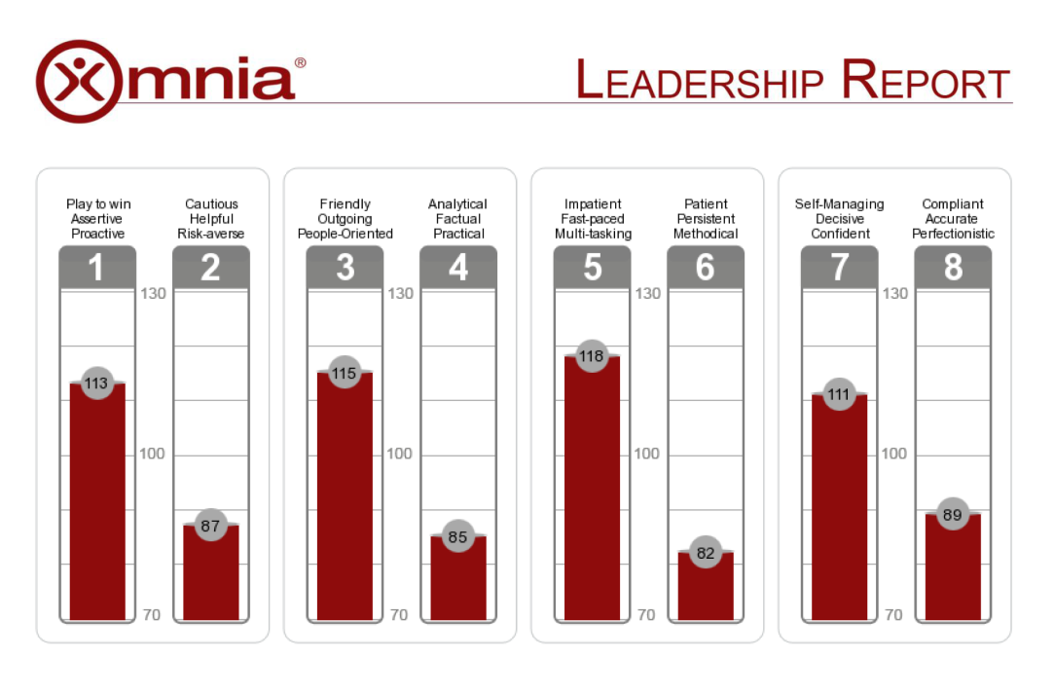
The Omnia Profile for Any Position
Online
15 minutes to complete
Instant results
Results-based interview questions
Profile review with trained analyst

Slide 20
Your People. Discover. Engage. Evolve.
For more information…
Carletta Clyatt
Senior Vice President
800.525.7117 x1226
Carletta@OmniaGroup.com
www.OmniaGroup.com
omniagroup
omniagroup
the-omnia-group
theomniagroup

