Slide 2
Introduction
Andrew L. Propst
MPM®, CPM®, CCIM®,
Chief Executive Officer
Appointed CEO upon formation of HomeRiver Group (“HRG”)
Managing properties for 18+ years for two property management companies
Joined Park Place Property Management, CRMC, as President and part-owner in 2008. Helped grow that company from 150 doors in 2008 to 4000+ doors today.
Member of NARPM® National Board of Directors since 2010 serving in multiple capacities before becoming NARPM® National President in 2015

Slide 3
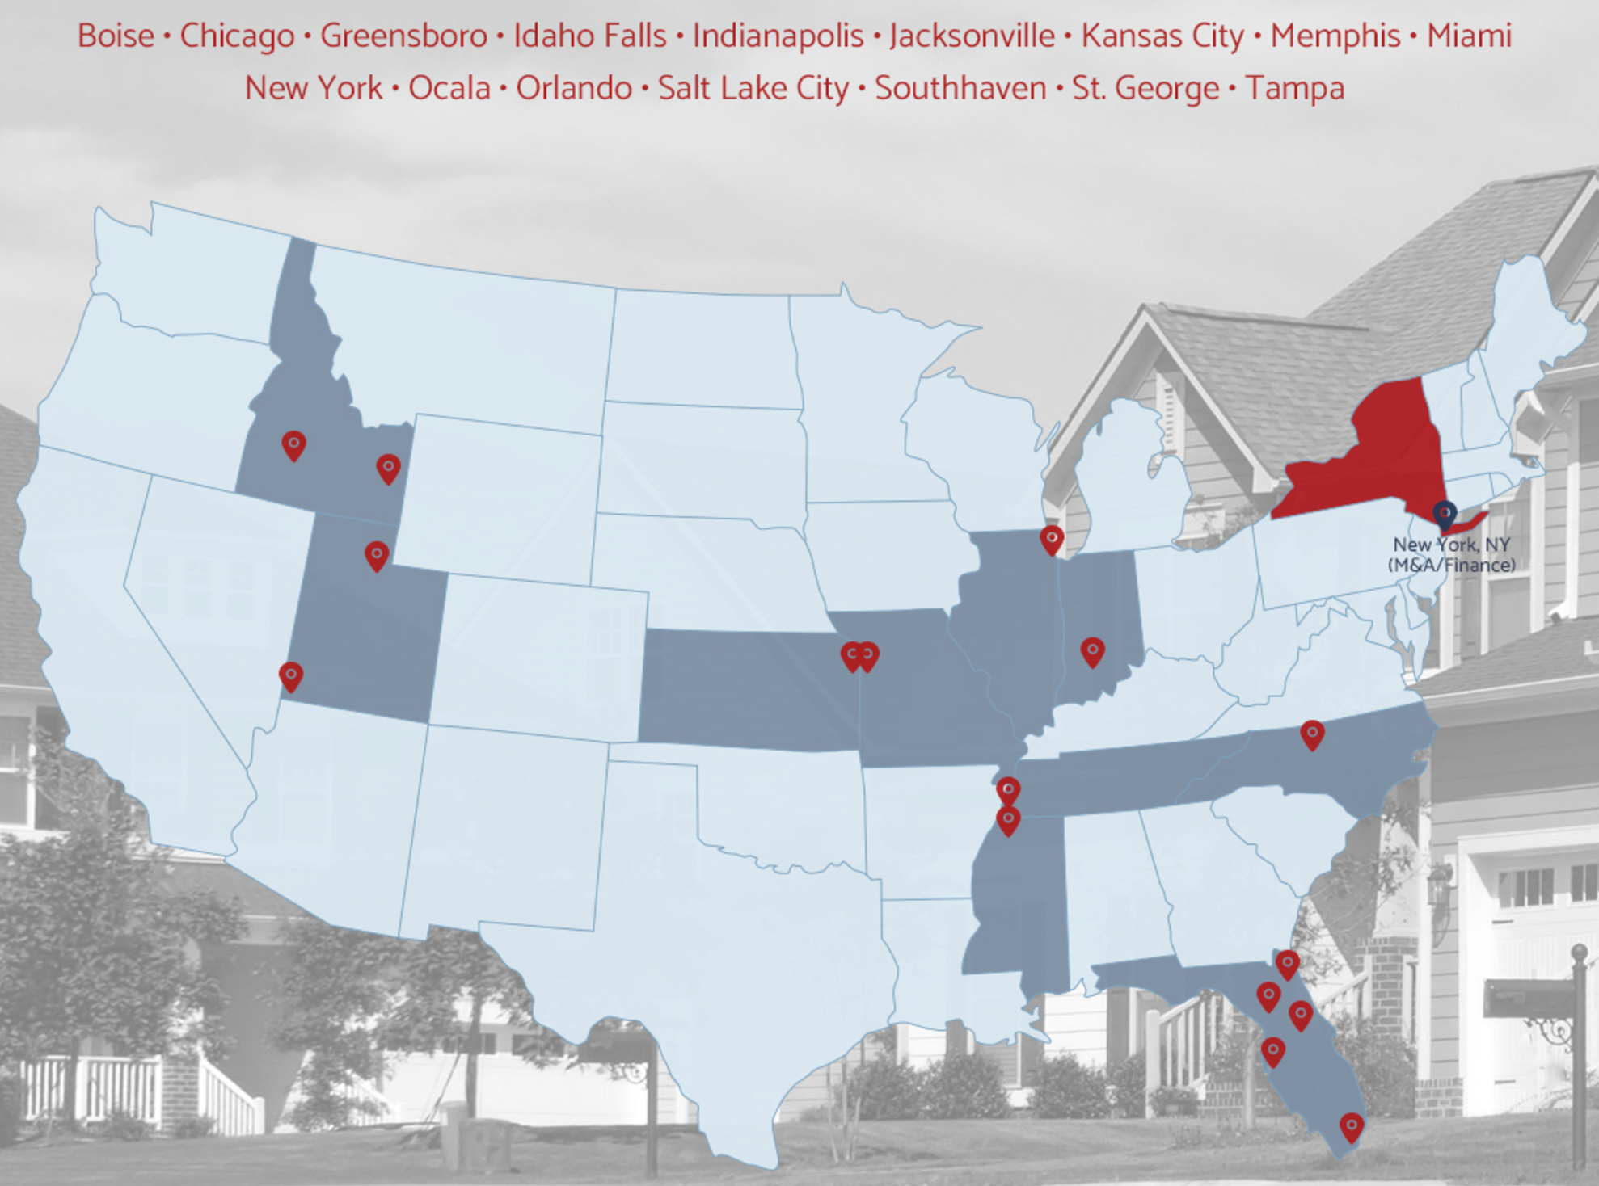

Slide 4
Capital Partner

Slide 5
Go Forward Strategy
Platform – Acquire mid-size to larger property management firms keeping senior management in place. Unique equity rollover opportunity to keep operators engaged, and diversify risk while avoiding taxes
Portfolio – Acquire assets of existing companies. Empower local operators to make multiple local acquisitions annually.
Best Practices – Strategize to develop synergies to implement throughout the country
Investment Services – Provide capital to investors to acquire multiple real property investments
Current Pipeline – Texas, Georgia and Arizona

