Slide 1
www.narpm.org
2016 State of NARPM®
Notes:
Good morning. I am Gail Phillips, Executive Director for NARPM® National. I was asked today to review some of the major reasons and benefits that you should be involved in NARPM®

Slide 2
Mission and Vision Statement
MISSION:
NARPM® provides resources for residential property management professionals who desire to learn, grow, and build relationships.
VISION:
NARPM® will be the recognized leader in the residential property management industry.
Notes:
The Mission of NARPM® outlines the benefits that the organization brings to you the members. As you will note members of NARPM® are Professional, Well educated by taking additional training whether it is through taking courses and earning designation, or attending events such as these. Ethics by agreeing to abide by the NARPM® Code of Ethics. These are the core competencies of the organization.
And the Vision of NARPM® is what the organization desires to be and that is the Leader in this industry!

Slide 3
The Core Values of NARPM®
Networking – Cooperation and sharing as colleagues
Education – Promotion of education and business development
Advocacy – Advance the profession by influencing issues that impact the residential property management industry
Professionalism – Recognize expertise through professional designation
Ethics- Respect and integrity among members brought about by ethical, honest and credible behavior
Notes:
Over the years, NARPM® has defined the core values of the organization. Networking has, and remains, to be the number reason members benefit from NARPM®. The cooperation and sharing of members is outstanding.
NARPM® continues to build the advocacy in the industry. In 2015 the DOTH visits also included a day to visit with other organizations that are similar to NARPM® to discuss working together to make that influence stronger.

Slide 4
The Reason for NARPM®
The National Association of Residential Property Managers, Inc., (NARPM®) is an association designed for real estate professionals who know first-hand the unique challenges of managing single-family and small residential properties.
NARPM® offers an effective, professional learning environment for owners of property management companies, property managers and their office staff.
NARPM® has over 4,500 members around the country and internationally and over 60 chapters.
Notes:
What was the reason you joined NARPM®? We hear stories whenever we are with a group of members as to how NARPM® has helped members grow and enhance their business.
NARPM® has assisted them in making more money while educating them about the industry. Make sure you tell your story and introduce new members to NARPM®.

Slide 5
The Reason for NARPM®
NARPM® was born out of a need for more education, validation, networking and recognition for those individuals who manage residential properties for others in the late 1980's.
Members of NARPM® handle all aspects of the management of single family and small multi-family properties for owners.
NARPM® has over 4,500 members and over 6 chapters around the country and internationally
Notes:
The creation of the National Association of Residential Property Managers, Inc., (NARPM®) was born out of a need for more education, validation, networking and recognition for those individuals who manage residential properties for others in the late 1980's. The management of this type of income property had in the past been left to the part-time activities of a real estate sales agent. The individuals that were managing single-family rentals were doing so with a little to no outside education and often isolated from other agents doing the same type of management.
Members of NARPM® handle all aspects of the management of single family and small multi-family properties for owners. Enhancing the ethical behavior of the membership has always been a basic principle for the Association. NARPM® promotes a high standard of business ethics, professionalism, and fair housing practices. Members of NARPM® subscribe to the following Code of Ethics and Standards of Professionalism for property managers of single family and other small residential properties.
Membership in late 1988 totaled only 13 members. By 1989, membership had grown to 78 members, and by the fall of 1991, membership stood at over 150. The need had arisen to develop local leadership and structure. A system of chapters was set up. The growth and success of NARPM® has been and will always be dependent on the work done by our membership at all levels of the organization. By January 1997, membership had grown to almost 1,300 members with 34 chapters in place. In 2005, NARPM® breached the 2,000 member mark with 68 chapters. Today, there are more than 4,500 members.

Slide 6
Networking
Chapters & Regions
Conventions and Conferences
Access to discussion groups for all members of NARPM® go to NARPM.org log in to discussion boards (http://www.narpm.org/members/discussion-boards/)
Notes:
Local Chapters make NARPM® strong. You are the immediate contract with the members and it is imperative that we are always finding ways to help members network.
Top two benefit from NARPM® is the discussion group where you can ask a question and receive responses from all across the country. There are two groups, one for general property managers and one from Business Owners

Slide 7
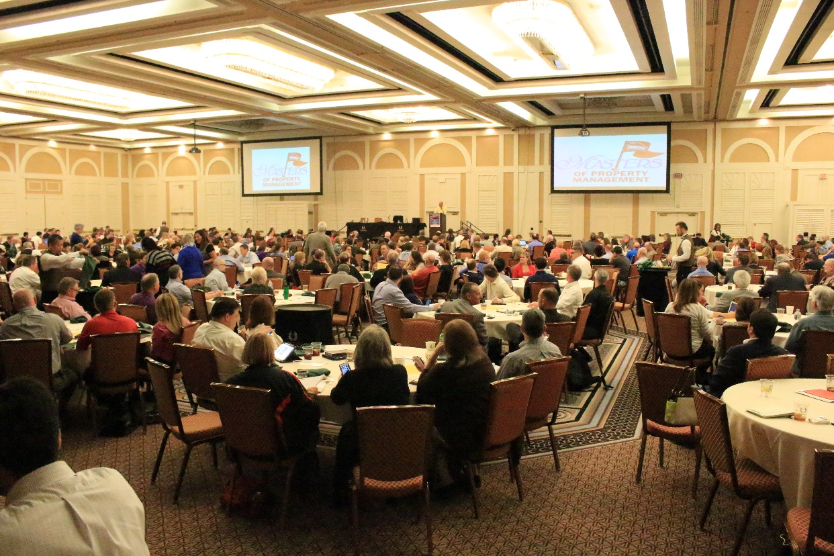
Networking
Best Practices share at Broker/Owner Retreat.
National Conventions held in October.
Partnership with Local and State education.
Notes:
NARPM® offers the National Convention, Broker/Owner and several other conferences
National also partner with local and state chapter to offer education courses. By the way speaking of education don’t forget that you must take an ethics before December 31, 2015 to retain your professional membership status

Slide 8
Networking
Virtual Chapter Meetings are recorded and archived on NARPM.org (must log in and see them at http://www.narpm.org/members/resources/videos.htm
Public Relations Campaign that is free for members to use (www.WhyUseOne.com)
Notes:
Each month at least one Virtual Chapter meeting is help. We record these session and are downloaded on the website
The public relations campaign Why use a NARPM® member has many handouts that were designed for your use in promoting your membership in NARPM®.

Slide 9
Education
NARPM® offers individual members the RMP® and MPM® designations.
Company designation is also available CRMC®.
Certifications: CSS® (Certified Support Specialist); CMC (Certified Maintenance Coordinator); and Certified Residential Management Bookkeeper (CRMB) are certifications also available to individual members.
Notes:
Education is the reason NARPM® was formed.
Along with the MPM® and RMP®, NARPM® kicked off two new certification programs, the Certified Maintenance Coordinator and the Certified Residential Management Bookkeeper
Your company can also hold the Certified Residential Management Company designation.

Slide 10
Education
MPM® and RMP® Candidates can choose what NARPM® courses to take to meet requirement
Requirement and courses offerings can be found at http://www.narpm.org/education/designations-and-certification/

Slide 11
Education
Online Education and Ethics Course continue to grow – http://www.narpm.org/education/online-courses/
Instructors/Training – rewriting courses annually with all instructors that’s rising the level of NARPM® education
NARPM® has Instructor Standards and Code of Conduct
Notes:
To make it easier on the members, all courses are offered online so you can take them anytime you desire. They do not have to be completed in one day.
NARPM instructors meet annually to discuss ideas in rising the level of NARPM® education and they also have a Standards and Code of Conduct

Slide 12
Designations (CRMC® MPM® RMP®)
Symbols of Success and Professionalism
Strategic Alliances – co-wrote course with IREM®
Constant Review of courses that meet members needs
Develop new courses as needed.
Market the designations.
constantly studying ways to increase the awareness of the NARPM® designations
Notes:
Why should you obtain your designation? It shows you have gone above just your licensing requirements to understand the industry which enhances your clients representation.
NARPM® is constantly reviewing all courses and studying ways to increase members and the publics awareness of what the NARPM® designations symbolize.
Currently working on a new Disaster Recovery course

Slide 13
Legislative
Website that educates you the member on what is happening around country. http://www.narpm.org/legislative/narpm-action-center/narpm-engage/
Sponsoring Day on the Hill in Washington, DC
Looking at ways to work with similar organizations
Notes:
NARPM® is building their legislative voice.
The Website allows you to track what is happening around the country so you can determine if you it will affect your area.
Sponsored first Day on the Hill in 2015 that had other members in attendance
Met with similar organizations to discuss ways we can work together to assure the industry is safe guarded.

Slide 14
Legislative
NARPM® can assist chapters in lobbying efforts by designing education packages.
Helps in educate Chapters on the need to set up Legislative Committees and visit state legislature
Create a “call to action” capability.
Central data base of legislators
Information posted on www.narpm.org/legislative
Notes:
NARPM® National can assist your chapter in being more involved legislatively from resources to grants to assist in putting on a day on the bill.

Slide 15
Other Benefits
Residential Resource news magazine is available to members online (http://www.narpm.org/members/resources/residential-resource/)
Notes:
Residential Resource, NARPM® magazine written by members for members, is archieved on NARPM.org so you can look at past issues and pull articles that you feel are beneficial to your business can clients

Slide 16
Other Benefits
Business Building Referrals - Build your business with referrals through networking with other members across the country via the NARPM® website. This includes a free listing on the NARPM® website gives you international exposure. http://www.narpm.org/find/property-managers
Notes:
NARPM® also enables you to send referrals to other members through out the country and allows the members to search for property managers in the area they are searching for rentals. You have the ability to upload either your picture or logo.

Slide 17
Other Benefits
Affinity Partner Programs - NARPM® has several affinity programs with various product and service companies, such as Home Depot and Lowes. http://www.narpm.org/about/affinity-programs/
To find out more about NARPM®, visit www.NARPM.org
You can find the numerous benefits at http://www.narpm.org/join/membership-benefits/
Notes:
Affinity partners are affiliates who offer members discounts and benefits to use their products. The two largest partnerships NARPM® has is with Home Depot who gives you a rebate when you make purchases and Lowes who offers you discounts on your purchases. These companies also send royalties back to NARPM® for allowing them to promote their programs to you the members.

Slide 18
What’s In It For You?
Networking with like minded colleagues
Education to improve and grow your business
Designations that are rapidly becoming recognized as symbols of professionalism
Benefits that will help you grow your business
Notes:
Get involved in NARPM®. You will find many things that benefit you and your business from Networking, education, designations, and many other benefits.

Slide 19
Upcoming Events
National Convention and Trade Show
Maui, HI Grand Wailea Resort & Spa October 19-21, 2016
Education begins Oct 17 Pre-Convention Activities - Oct 18
#narpm2016
Find more details at:
http://www.narpmconvention.com/
Notes:
I look forward to seeing everyone in Atlanta, GA at our National Convention. The Convention Subcommittee has put together a stellar program and we encourage you to check it out at www.narpmconvention.com. I know it is a long trip for you but we are sure you will gain many benefits from making the commitment to attend, and Atlanta is a stellar city to hold a convention with a great deal to do.

Slide 20
Thank You
Contact National at:
info@narpm.org
800-782-3452
This presentation can be found at http://www.narpm.org/about/
Notes:
Thank you for allowing me a few moments to discuss NARPM® and the many benefits it offers you as a member. We are excited about the future growth of the organization and are glad you are on board for the ride.

