Slide 1
Clients, Profit and Sanity
Matthew Tringali
CEO | BetterWho

Slide 2
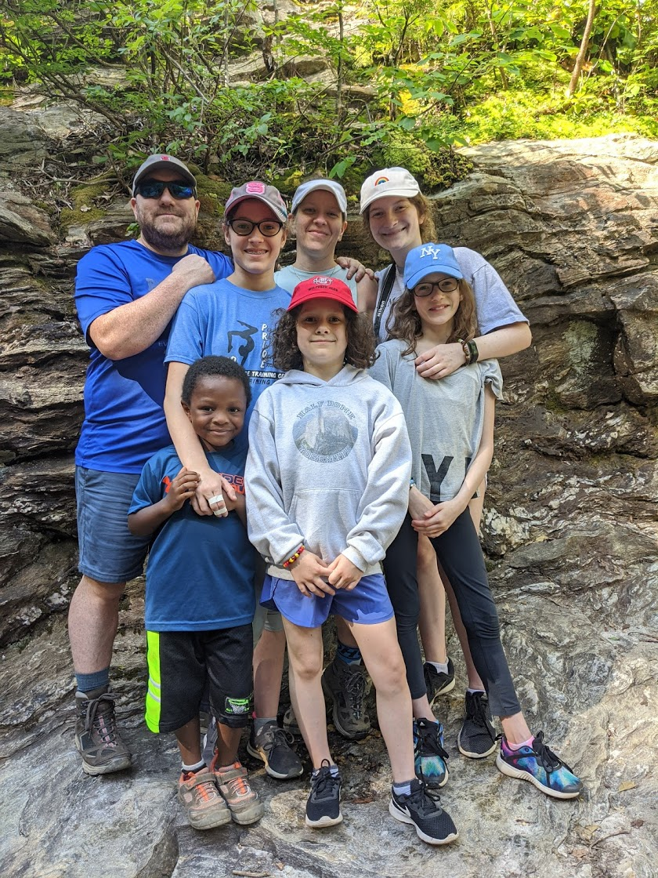
Hi, I’m Matthew Tringali - Why should you care?
I was a property manager, just like you
Proudest Achievement: 4.8 DLER
I have made more mistakes than you
Previous EOS Implementer
CEO BetterWho
Creator of the Build SMART System
Creator of RTM Direct

Slide 3
Why Am I Here?
How to grow from 0 to 475 units
be completely unprofitable
and stressed out.

Slide 4
Why Am I Here?
How to grow from 0 to 475 units
be completely unprofitable
and stressed out.
How to go from 475 to 175 units
be highly profitable
and regain your sanity.

Slide 5
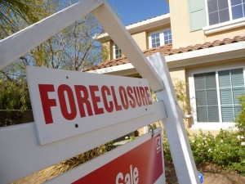
My Origin Story

Slide 6
Real Estate Agent Mentality
False Belief: Scope of work = everything
Mindset Shift: Clearly defined scope of service

Slide 7
Investor Mentality
False Belief: I am my target client
Mindset Shift: I might not be my target client

Slide 8
0 to 475
False Belief: Growth is the highest priority
Mindset Shift: Growth comes last
Better System - I had none
Better Team - They were stressed out
Better Profit - Stay tuned!

Slide 9
My 475 Unit Mix Snapshot
200 SF
50 small MF
75 in one MF property (awkward size!)
150 institutional SF
But wait! There’s more!
3 HOA’s
4 Commercial
Even had a trailer park!

Slide 10
My 475 Unit Mix Snapshot

Slide 11
My 475 Unit Mix Snapshot
False Belief: All business is good business
Mindset Shift: Niche to your target client and lose the misfits

Slide 12
My 475 Unit Profitability Snapshot
RPU: ~$110/mo
DLER: ~2.0
Profitability: 0%? Masked by other verticals

Slide 13
My 475 Unit Profitability Snapshot
False Belief: PM & Verticals are all one business
Mindset Shift: PM should stand on its own

Slide 14
A Better Way
Stopped lying to myself that growth cures all
Set the Vision
Scope matters
Value Max
Develop better systems and a better team
Cut Expenses
Add Revenue

Slide 15
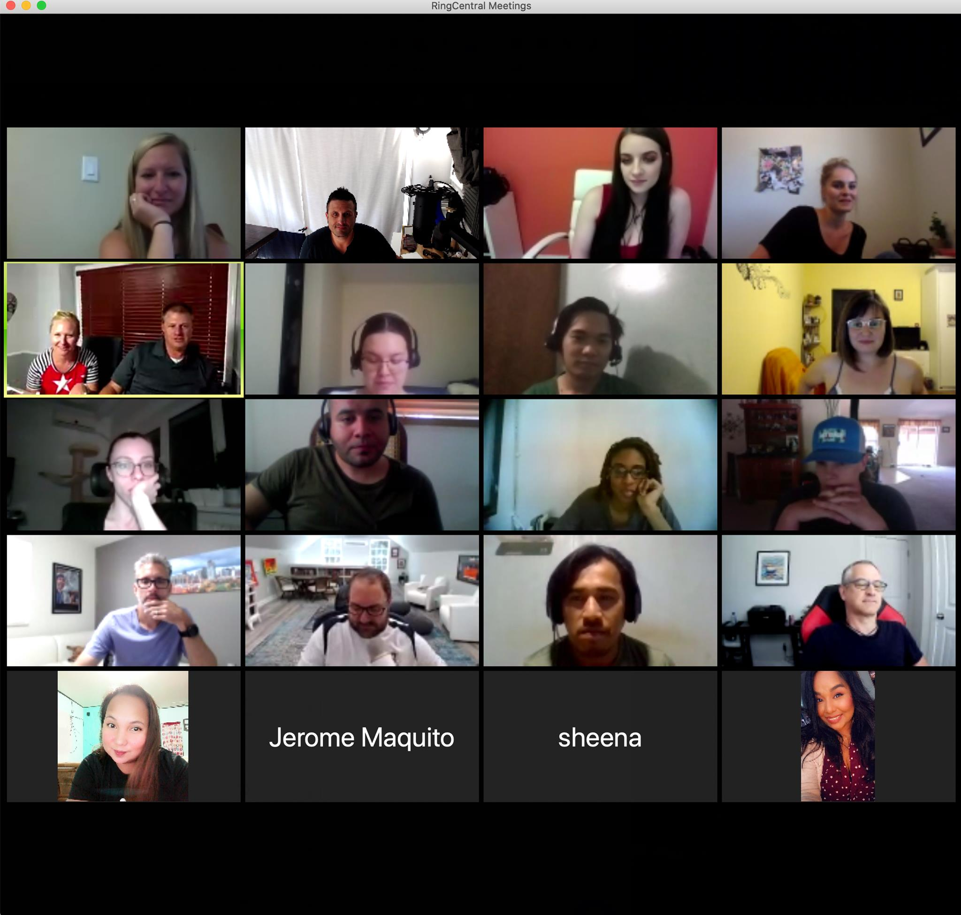
Cut Expenses - Virtual Office
5%

Slide 16
Cut Expenses - Virtual Office
False Belief: Tenants pay rent in the office
Mindset Shift: There are better options

Slide 17
Cut Expenses - Focus on DLER
Sneak Peak on the Benchmarking Study!
New Metric: Global Talent Utilization Rate
Impact on Profitability: Every RTM you add increases your profitability

Slide 18
Cut Expenses - Focus on DLER
Sneak Peak on the Benchmarking Study!
New Metric: Global Talent Utilization Rate
Impact on Profitability: Every RTM you add increases your profitability
RTM’s are your competitive advantage.

Slide 19
Cut Expenses - Focus on DLER
Sneak Peak on the Benchmarking Study!
New Metric: Global Talent Utilization Rate
Impact on Profitability: Every RTM you add increases your profitability
RTM’s are your competitive advantage.
You must successfully incorporate RTM’s into your team to stay competitive.

Slide 20
Cut Expenses - Focus on DLER
Sneak Peak on the Benchmarking Study!
New Metric: Global Talent Utilization Rate
Impact on Profitability: Every RTM you add increases your profitability
RTM’s are your competitive advantage.
You must successfully incorporate RTM’s into your team to stay competitive.
Those who do it the right way will be highly profitable

Slide 21
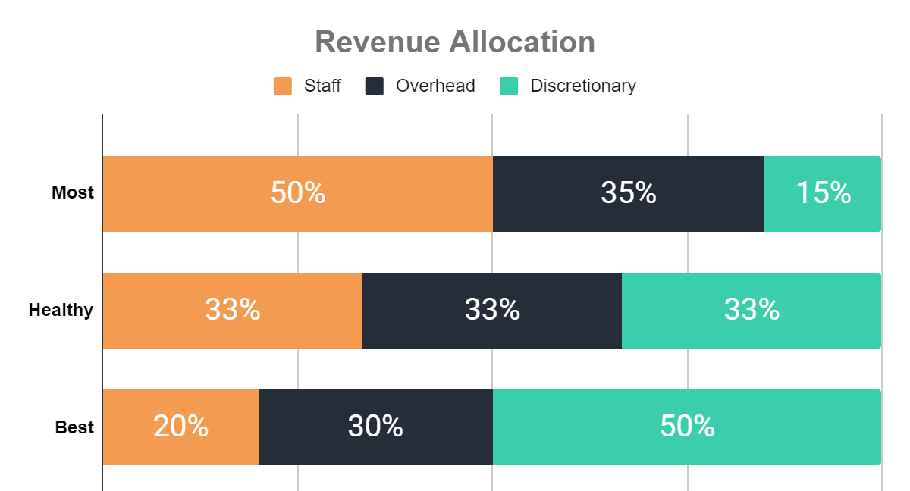
Cut Expenses - Focus on DLER

Slide 22
Cut Expenses - Focus on DLER
False Belief: RTM’s are poor quality or accent
Mindset Shift: US has not cornered the HR market

Slide 23
Cut Expenses - Focus on DLER
False Belief: We are “staffed for growth”
Mindset Shift: You can have good DLER and be “staffed for growth”

Slide 24
Cut Expenses - Fine Tooth Comb
2%

Slide 25
Cut Expenses - Fine Tooth Comb
False Belief: I need all of the bells and whistles
Mindset Shift: Be critical of your toolbelt

Slide 26
Add Revenue - Start with a Competitive Analysis
Base management fees
% vs Flat
Vacant Management
Leasing Fees
Total average cost

Slide 27
Rent belongs to the owner;
Fees belong to the PM.
Why?
Because all fees are Administrative Fees

Slide 28
Fees

Slide 29
Fees
Value Add Services

Slide 30
#1: Resident Benefits Package
Build Your Own - Mine Included:
Keyless Access
Tenant Liability Insurance (later moved out)
Air Filter Service
Utility Concierge
Periodic Property Visits
Tenant Portal
24/7 Maintenance Hotline
Credit Reporting
Done for You

Slide 31
#1: Resident Benefits Package
False Belief: It isn’t a value
Mindset Shift: Build something you believe in

Slide 32
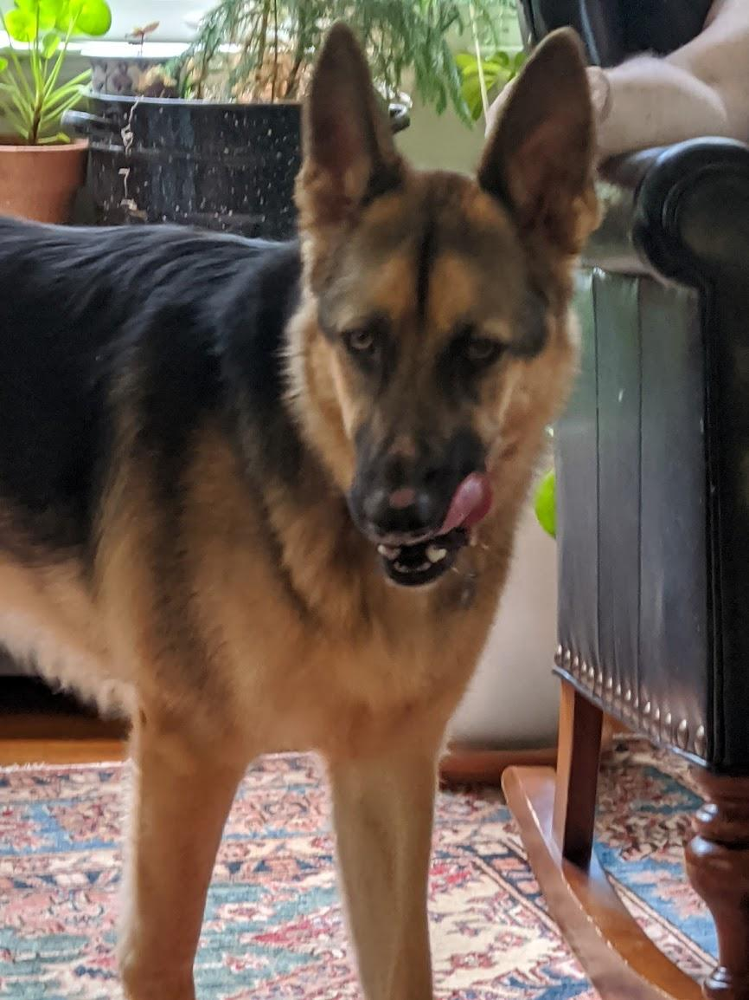
#2: Pet Management Service
Pet Onboarding Service
Monthly Pet Management

Slide 33
#2: Pet Management Service
False Belief: Pet rent should go to the landlord
Mindset Shift: Pets cause you extra work

Slide 34
#3: Contingent Lease
Contingent Lease Setup
Monthly Contingent Lease Management

Slide 35
#3: Contingent Lease
False Belief: That’s not fair
Mindset Shift: You are providing value

Slide 36
#4: Tenant Lease Renewal
Administrative Renewal
Modification on Auto-Renewal
Month-to-Month

Slide 37
#4: Tenant Lease Renewal
False Belief: Client’s pay for renewals
Mindset Shift: Also doing work for the tenant

Slide 38
#5: Maintenance Coordination Service
% vs Flat Fee
Routine vs Extraordinary

Slide 39
#5: Maintenance Coordination Service
False Belief: Should be included
Mindset Shift: Much more fair if separate

Slide 40
#6: Home Warranty Coordination Service
If you just love working with Home Warranties, then skip this.
If you don’t love it, add this today:
Setup
Per service
Hourly rate

Slide 41
#7: Utility Management Service
Per setup
Per bill
If in your name, charge for that

Slide 42
#8: Owner Benefits Package
Eviction Protection
Rent Loss Protection
Property Protection
Pre-pay the Rent
Rental Auction

Slide 43
#9: Dinner & Movie

Slide 44
#10: Record Retention Service
You pay for storage, so should your clients

Slide 45
#11: Lease Renewal = Leasing
Consider making your lease renewal fee equal your leasing fee.

Slide 46
#11: Lease Renewal = Leasing
False Belief: Easier should be cheaper
Mindset Shift: All about value. Also, a cheaper lease renewal fee is a conflict of interest.

Slide 47
#12: Vendor Marketing Service
Not a markup.
You are adding value to your vendors.

Slide 48
My 175 Unit Mix Snapshot
200 SF 175 SF of my Target Clients
50 small MF
75 in one MF property (awkward size!)
150 institutional SF
But wait! There’s more!
3 HOA’s
4 Commercial
Even had a trailer park!

Slide 49
My 175 Unit Profitability Snapshot
RPU: ~$110/mo $283/mo
DLER: ~2.0 4.8
Profitability: 0%? 30%

Slide 50
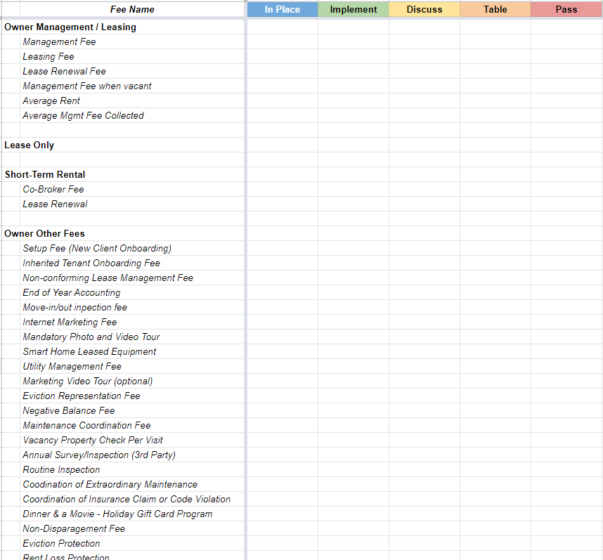
Download Now
Top 80
Value Add Services
betterwho.com/fee-implementation-list

