Slide 1
Organic Opportunities to Add to Your Bottomline
Presented by: Kathryn Carr, VP Brokerage
Property Management Inc.

Slide 2
Organic Opportunities to Add to Your Bottomline
Presented by: Kathryn Carr, VP Brokerage
Property Management Inc.

Slide 3
WHAT IF ?
Notes:
You developed the strongest revenue steam ever?

Slide 4
Run the Numbers
2022 AVERAGE SALE PRICE $ 403,000
AVERAGE COMISSION $ 10,760
AVERAGE REFERRAL $ 3,976
SO, WHAT IF…..

Slide 5
Run the Numbers
4 REFERRALS 1 EVERY QTR. $ 15,905
8 REFERRALS 2 EVERY QTR. $ 31,810
12 REFERRALS 1 EVERY MONTH $ 63,620
4 CLOSINGS 1 EVERY QTR. $ 43,040
8 CLOSINGS 2 EVERY QTR. $ 86,080
12 CLOSINGS 1 EVERY MONTH $ 129,210

Slide 6
HOW COULD THAT IMPACT YOUR BUSINESS ?
Notes:
Open question for the group
Provide for additional marketing
Build you own doors, units, or keys
Build a solid financial account for bad days and months
Hire additional staff

Slide 7
Leveraging the Organic Opportunities
Association Preferred Alliance 10 % turnover in Ownership
Short Term Rental Love the Experience Buy it or Invest
Residential Renters to Buyers
Investors Purchase and Liquidation
Commercial Renters to Buyers
Investors Purchase and Liquidation
Notes:
You can either brainstorm as a group or divide the class into small groups three would be great HOA, STR and Res. & Comm. Together

Slide 8
Notes:
Obtain your real estate license and we have a relationship with The CE Shop they offer Pre, Post Licensing courses along with continuing education
EVERY DAY WE OFFER A 30% discount code NEXTSTEP also a 40% discount for those related to anyone that is or has served in the US military
The CE Shop maintains a 93% pass rate and offers services in 48 different states

Slide 9
www.PMI.TheCEShop.com Save 40% when you enroll in Pre-Licensing courses with The CE Shop. It's a new year, and you deserve to have a fulfilling, enjoyable career. That's why we partner with The CE Shop, the leader of online professional education. There's never been a better time to begin your journey into real estate with the help of their award-winning curriculum written by industry experts. Use Discount Code: NARPM. Expires 10/20/2022

Slide 10
DETERMINE YOUR PATH
REFERRAL OR TRANSCTIONAL

Slide 11
Brainstorm PRO’S AND CON’S REFERRAL BUSINESS
PRO’S
CON’S

Slide 12
What did we find?
PRO’S
Does not distract from pillar growth
Captures revenue into the company
No need to join the Real Estate Board
Supports relationships with local REALTORS
Added service to your clients
Will lead to full real estate services when you are ready
Does not require you to create a full brokerage
CON’S
NONE

Slide 13
Brainstorm PRO’S AND CON’S TRANSACTIONAL BUSINESS
PRO’S
CON’S

Slide 14
What did we find?
PRO’S
Higher yield per transaction
Provides full real estate services to your clients
Allows for faster growth
Supports all pillars equality
You can hire an agent to lead the real estate side of your business to allow you to focus on pillar growth
CON’S
183 Steps in a real estate transaction
Takes away from building your property management business
Local agents could feel you are now competition
Additional expenses:
Local real estate board dues
Local MLS dues
Cost of commission to agents
Increase in E&O insurance

Slide 15
Build a Brokerage Business in Steps
Start up
Support pilar growth by capturing referral opportunities and adding to the bottom line.
Solo
Transition from a referral-based business to providing real estate services.
Growth
Growth by adding agents to support the development of the realty business.
Strategic
Complete brokerage services focus is on recruiting and retaining agent base while building production.

Slide 16
Steps to Build a Referral Network & System

Slide 17
Activate your license
There are three choices:
Place your license with a LFRO “Limited Function Referral Office”
Obtain a broker for your company and follow the steps to be compliant with your state rules and requirements
Place your license with an outside broker
Notes:
Placing your license with an LFRO is an easy path and doesn’t require hiring a broker or joining the local board of realtors and MLS; however, it does have a downside, as the ONLY thing you can do is work with referrals. YOU CAN NOT work directly with Buyers or Sellers
In most cases, obtaining a broker and building your PMI real estate business will come with a small cost to your company, as the broker will ask for a flat monthly fee and will also want a slice of the pie when you do any real estate business. THE PLUS SIDE, you are now building a single brand for your PMI company
Placing your license with an outside broker such as Keller Williams, Century 21, or a locally based company, the HUGE DOWNSIDE is now you are no longer leveraging your PMI company; now you have two masters, and consumers might not be as loyal or feel you only are serious about one or the other companies

Slide 18
Working with Realtors
Notes:
The key here it to define and build a referral team finding the agents you want o work with and here less is more.
So, what do I mean when I say less is more? If you try to give your referrals to 50 different agents, they will not see value in your relationship. If you only place 20 leads in a year 30 of those agents will never receive a lead. However, if you decide on 3 or 5 with the same number of leads now you have value as these agents will see true value in the relationship and respond faster and provide a higher level of service to your clients.

Slide 19
Vision your community and the agents that can best service it
Notes:
Take a few minutes and think about your local community
For example, I live here in Florida, and I would need agents with the following knowledge, golf, 55 and over communities, condos, and waterfront communities These are the agents that could best service my clients needs find agents that specialize in these areas. Try to avoid your friends that might do real estate part time, keep in mind you might want to bring one of these agents into your PMI company to lead your real estate business.

Slide 20
What Value Can you be to a Realtor
What are some of the ways we can bring them additional value to your referral team and stand out from their competition?
Keep in mind how can we:
Save Money
Make More Money
Same Time
Enjoy the Process

Slide 21
Start Talking Real Estate
What do I mean when I say talk real estate?
Notes:
The first Tuesday of every month we host a virtual session that reviews what is going on in real estate market on a national and regional level and discuss a hot topic such as the change in interest rates and changes that could be effecting your business

Slide 22
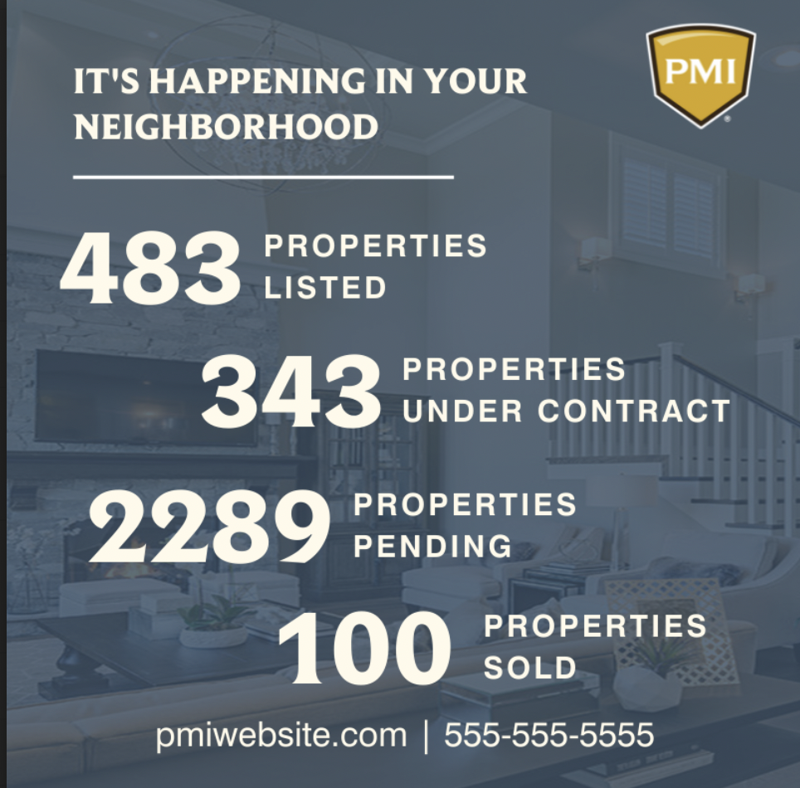
Start talking real estate on social media
Notes:
You can find more social media suggestions and templates on PMiWay under Realty. For example, October is how to sell a haunted house thyme with four different graphic and additional talking points.

Slide 23
Steps to Moving from Referral Base Business to a Transactional Based Business Working with Buyers and Sellers

Slide 24
#1 Being compliant Department of Regulations and your States Real Estate Commission.
NAR and your local real estate boards are here to help here to help you with this process and guide you through the process.
Example
Finding a Broker State departments
Join your local Board of REALTORS State and local Signage
Review your E&O policy guidelines...
and anything else as required by your local board and governments

Slide 25
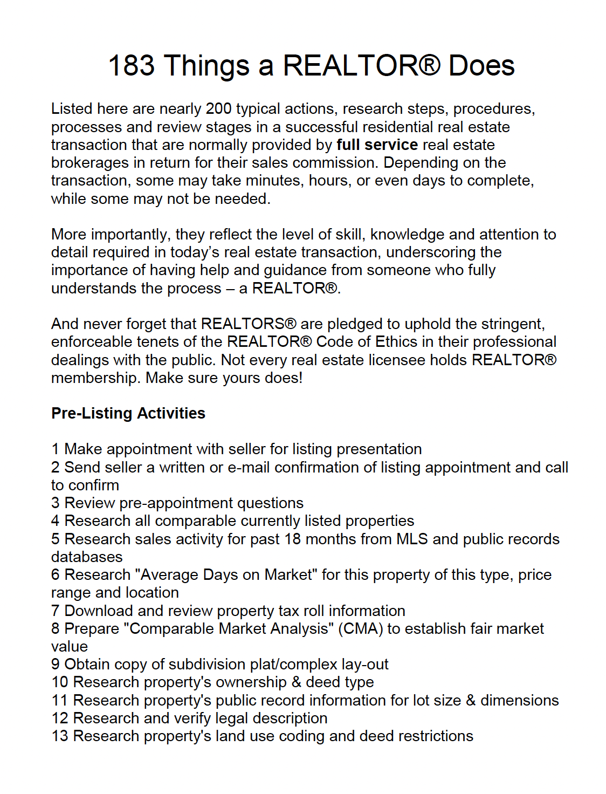
Understanding the Process
Consider hiring a transaction manager
Most work for several agents at one time
They get paid per deal 250 – 500
Leverage transaction software
Dotloop Brokermint
zipForms Skyslope

Slide 26
Building a Listing Based Business
Benefits in Property Management by building a listing-based business:
Listings are Buyer BAIT attracts more leads
Better time management
You are not the only one looking for a Buyer your MLS is
Getting paid twice

Slide 27
Steps to Hiring Agents and Building Market Share

Slide 28
Building Your Own Brokerage
Notes:
This is where we jump in with both feet by building a full brokerage division within your PMI Company helping to complete that consumer journey.
Defining your vision
Defining your competitive edge to your agents
Building a culture that attracts verses recruiting talent
Developing a competitive compensation program that is focused or these three key factors:
Recruitable
Retainable
Foremost Profitable

Slide 29
Building Your Own Brokerage
Recruiting Retention Compensation

Slide 30
Knowing your Competition
Do your research and learn the following:
Who is your competition?
What are people saying about them?
What is their commission program or programs?
What kind of agents do they attract?
Where do you find this information?
Google
Their websites
Ask agents
Check out SlideShare

Slide 31
Myth verses Perception
36% of REALTORS® were compensated under a fixed commission split (under 100%)
20% with a graduated commission split (increases with productivity)
18% with a capped commission split (rises to 100% after a predetermined threshold).
Notes:
When we think of agent compensation, we seem to hear those trendy words such as CAP and 100% however the reality just does not support the facts.
For example, KW has 188,121 agents worldwide and only 15.049 hit their cap of 21,000 that means 173,072 did not get the benefit of being on a cap program.

Slide 32
BRAINSTORM
What Builds Retention?
Culture
Your Competitive Edge
The Value You Bring
Compensation
Leadership

Slide 33
Explore different commission programs
Traditional
Cap
Fee Based
Blended

Slide 34
Kathryn Carr Kathryn@propertymanagementinc.com 772. 678.9302

