Slide 1


4 TRENDS
CHANGING OUR INDUSTRY
IN THE NEXT 5 YEARS
Examining The “OT”
in SWOT

Slide 2
Breakout
The 4 Trends Changing our Industry in the
Next 5 Years: Examining the “OT” in SWOT
Presented by: Scott P. Brady

Slide 3







    PERSONAL
      BA, UC Berkeley, Comparative Literature
      MBA, Cal State Fullerton
      Married 31 Years, 3 Adult Children
      My Newest “Why”: 2 Grandchildren (Beckett & Preston)
Who Am I?
    PROFESSIONAL
      Private Banking & Bank Marketing 1989-1997
      Real Estate Sales 1997-2022
      Residential Property Management 2012–2022
      Association Management 2020-2022
    CURRENT BUSINESES
      Progressive Property Management, Inc. (1,200 Doors)
      Progressive Association Management (3,500 Owners)
      Partners Real Estate Group/Progressive Realty (55 Agents)
      Brady Consulting Group – Ally Escrow, Inc.
    WHY I’M HERE
      Believe the Future is to “Monetize Everyone You Meet”
      Speaker at PMMCon, NARPM & CalNARPM
      Wrote ”The Profitable Property Manager” and
      “The ABCs of HOAs"
NARPM Annual Convention & Trade Show

Slide 4









OUR Businesses.
Progressive Property Management, Inc.
Progressive Association Management
Progressive Realty Group
Ally Escrow, Inc.
Brady Consulting Group
Association Management Services
Sierra Maintenance Services
Luxury Home Watch Services
Progressive Lending

Slide 5

NEW DOORS SOLVE ALMOST ALL PROBLEMS
SMIPOS + PILLARS + HYBRID PRICING + PROGRAMS + VIRTUAL PROPERTY MANAGEMENT + ASSOCIATION MANAGEMENT + EFFECTIVE MARKETING = GROWTH
994 Res
190 HOA
1,101 Res
527 HOA
1,181 Res
2,649 HOA
1,300 Res
4,000 HOA
1,500 Res
7,500 HOA
100% Organic Growth
Working On the Business (and Not In It)
Direct Mail Marketing
CalNARPM & NARPM
Virtual Property Management
Joint Ventures & State Expansion
Targeting SMIPOs & The 4 Pillars
Residential & Association Management
Virtual Agent Branches
Hybrid Pricing & Owner Programs

Slide 6




The 4 Trends:
04.
02.
The Real Estate Recession of 202?
03.
01.
Commission Compression
Housing as a Right
The Acceleration of Technology
NARPM Annual Convention & Trade Show

Slide 7

The Acceleration of Technology

Slide 8
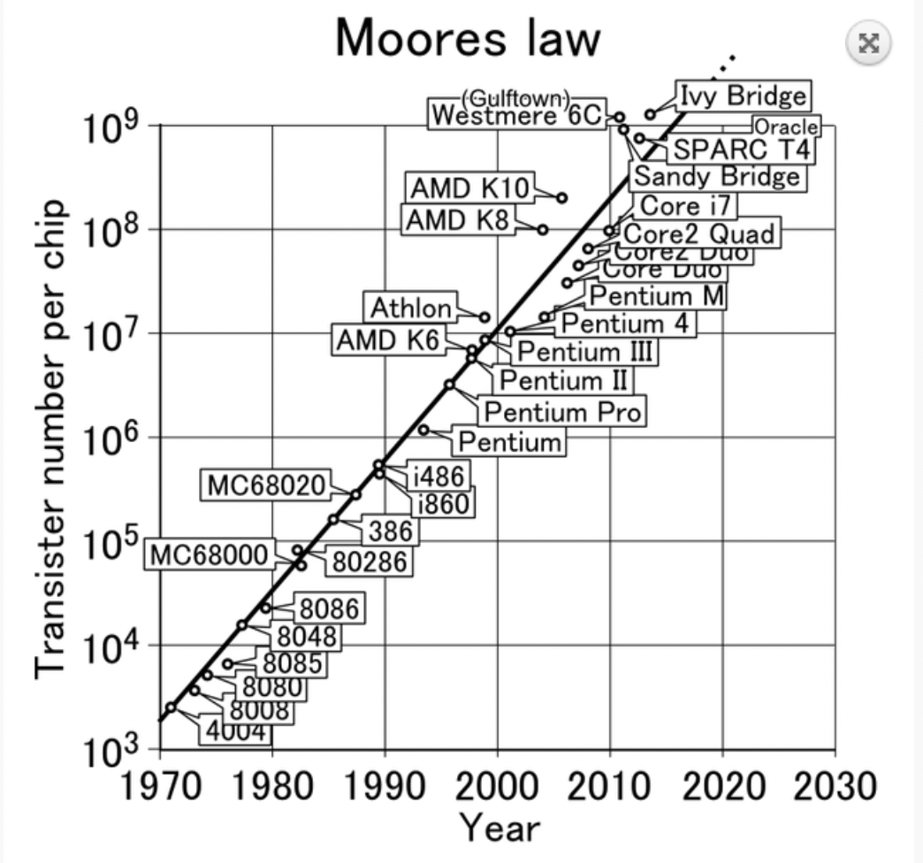

Moore’s Law.
Processor Speeds Double Every 2 Years

Slide 9
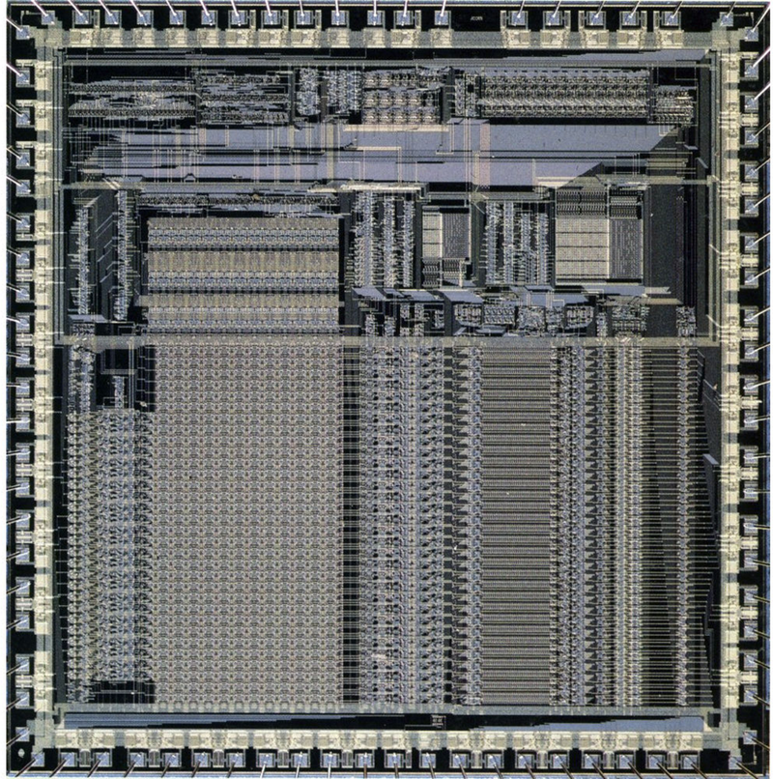
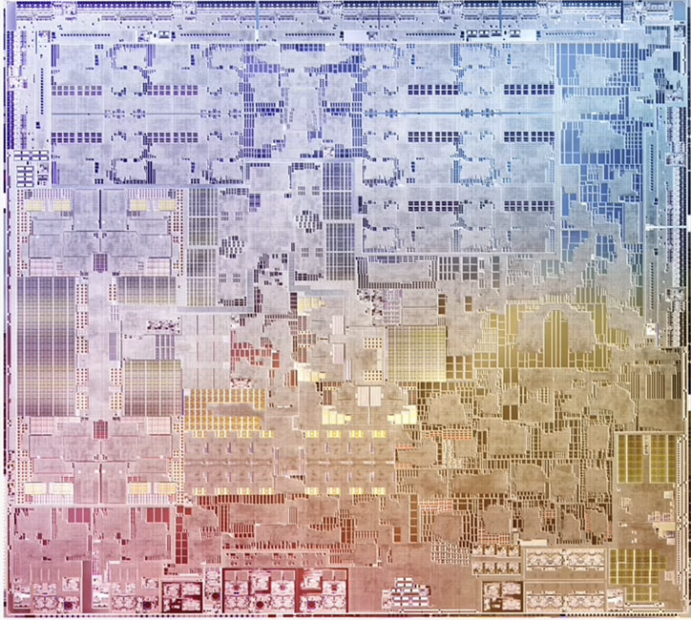
ARM1 Processor (1985)
50 Thousand Transistors
Apple M2 Processor (2022)
16-core ARM, 20 Billion Transistors
NARPM Annual Convention & Trade Show

Slide 10
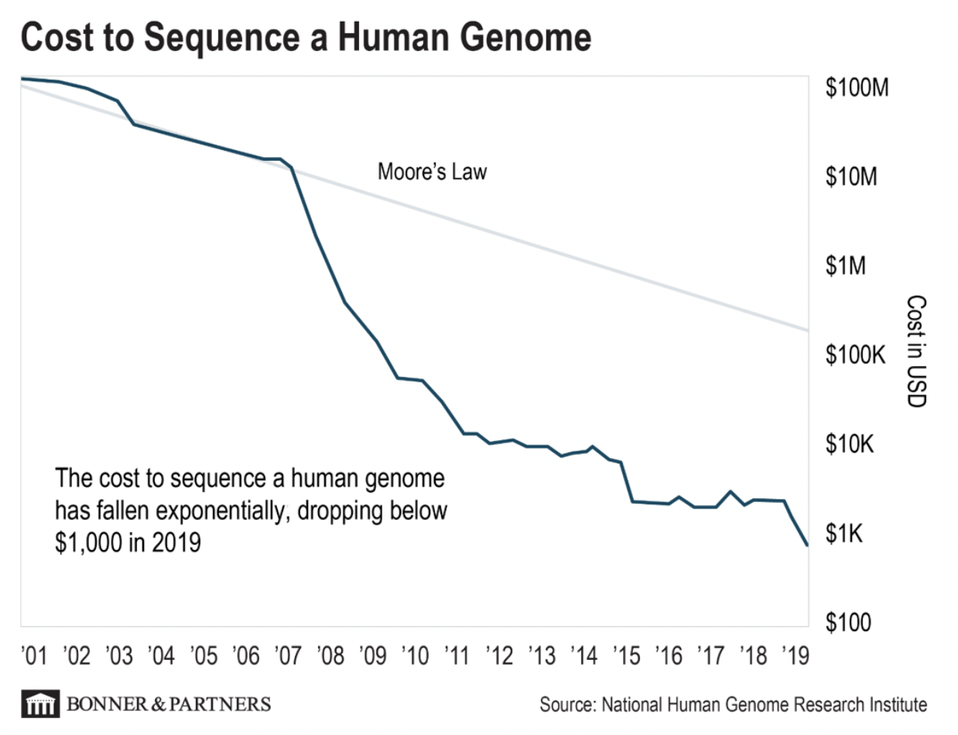
The Cost to Sequence a Human Gene genome
From $100,000,000 to
$1,000 in 20 Years

Slide 11


“THE ARC OF PRICE FOR ANY SERVICE BENDS RELENTLESSLY DOWN TO ZERO.”
Scott P. Brady
Price
$0
NARPM Annual Convention & Trade Show

Slide 12






EXAMPLES OF THE “LOSS LEADER” STRATEGY
NARPM Annual Convention & Trade Show

Slide 13

THE SCHWAB BUSINESS MODEL
In 1990, Trades Equaled 70% of Gross Revenue, in 2019, 5%
YEAR | TRADE FEE
1990 | $49.95
1995 | $29.95
2000 | $14.95
2005 | $12.95
2010 | $8.95
2015 | $7.95
2017 | $4.95
2019 | $0.00
1990, $25 Billion in Assets; in 2021, $660 Billion
.05% EFT Expense Ratio
$40 Billion in Cash
$5.4 Billion Net Income

Slide 14

What if You had to Breakeven on Price?

Slide 15

“Your Margin
is my Opportunity.”
~Jeff Bezos
NARPM Annual Convention & Trade Show

Slide 16

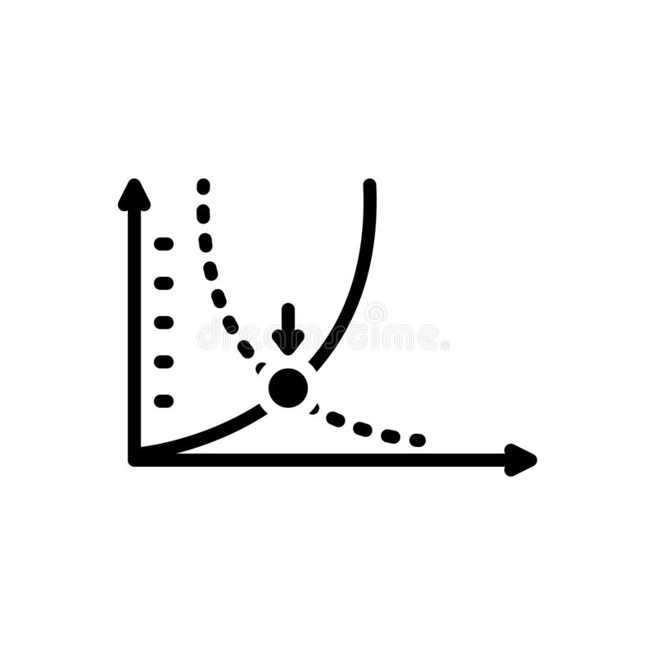
IN PROPERTY MANAGEMENT,
WE BREAKEVEN ON
THE OWNER’S MONTHLY MANAGEMENT FEE…
AND MAKE ALL OUR PROFIT ON LEASING,
OWNER & TENANT PROGRAMS AND FEES
NARPM Annual Convention & Trade Show

Slide 17

IN ASSOCIATION MANAGEMENT,
WE BREAKEVEN ON THE BASE MONTHLY MANAGEMENT FEE…
AND MAKE ALL OUR PROFIT ON
ESCROWS, COLLECTIONS, CREDITS & REIMBURSABLES
NARPM Annual Convention & Trade Show

Slide 18


VOIP (Voice Over Internet Protocol)
& PROPERTY MANAGEMENT:
1995 - Intel and Microsoft Standardize Software
2007 - Manufacturers Proliferate Asia, Specifically the Philippines
2015 - Philippines the Call Center Capital of the World
2020 - Over 1,000 Business Process Outsourcing Companies (BPO)
NARPM Annual Convention & Trade Show

Slide 19
Outsourcing
Operations
Accounting
Remote Workers (VAs)
Tenant Issues
Phone Calls
Maintenance Coordination
Compliance
NARPM Annual Convention & Trade Show

Slide 20
A LOT OF CHANGES IN THE BUSINESS
2013 – First “Broker-Owner” Conference
1987 – NARPM Founded
2015 – VA’s Gain Widespread Use
1992 – First Modern REIT
2016 – Mynd and VC Backed Companies
2006 – Appfolio
2017 – Property Management Mastermind Podcast
2010 – PMW – Property Manager Websites
2010 – Seacoast Commerce Bank “Dedicated Management Banking”
2017 – Petscreening.com
2018 – Resident Benefit Packages
2011 – Rently Self-Showings
2019 – Diffi.rent Artificial Intelligence
2012 – Filter Easy/Second Nature
2012 – Fourandhalf “Dedicated Management Marketing”
2020 - Profit Maximization & Program Implementation
2022 – “Virtual” Association Management

Slide 21




DELEGATING
Inspections
Leasing
Pet Screening
Anything That Can Be Done for Less
Marketing
Accounting
HR

Slide 22





Calls
    Maintenance Coordination
Showing
Automating
Computers Don’t Eat, Sleep or Complain
  Lease Approvals
    Accounts Payables
NARPM Annual Convention & Trade Show

Slide 23

Commission Compression

Slide 24

NAR
DOJ
Buyer Agent Compensation
Notes:
I’ve spoken to people who have a negative view of tracking metrics. But data is data. We coach our clients all the time to utilize data. Like driving a car with no dashboard. Or trying to lose weight without looking at the scale.
Our job is to share uncomfortable truths with our clients. We should embrace it in our lives. Does not mean be an asshole.

Slide 25

The Pressing Issues
Agents Steer Buyers from Low Commission Properties
Every Buyer’s Agent Paid the Same No Matter the Competence
Buyers Should Pay their Agents,
Not Sellers
Agents Don’t Work for “Free”
NARPM Annual Convention & Trade Show

Slide 26

SAWBILL STRATEGIES vs. NAR (et al)
Fee paid to Buyer’s Broker inflated.
2 CLASS ACTION LAWSUITS
MOERHL vs. NAR (et al)
Seller suing because payment to Buyer’s Agent inflates cost to seller.
NARPM Annual Convention & Trade Show

Slide 27


NO COURTS REQUIRED
Department of Justice
Federal Trade Commission
NARPM Annual Convention & Trade Show

Slide 28


New Entrants
IBuyers
1% of Market Now
    Open Door
    Offers, Inc.
    Redfin
    Seller’s Advantage
    Expected to be 10% by 2030
    If Buyer’s Pay Commission, More Feasible
NARPM Annual Convention & Trade Show

Slide 29

New Commission Models
  100% Split
    $300 to $600 a Transaction
    65% Profit Drop for Traditional Brokerage
01.
02.
ExP KW HomeSmart Fathom JPAR United
03.
  Side
    Help Top Brokers Create a Brokerage

Slide 30

THE HIGHEST COMMISSION RATES
IN THE WORLD
COUNTRY | AVERAGE SELLER COMMISSION (%)
United States | 4.92
Germany | 4.50
Belgium | 3.00
Australia | 2.50
Netherlands | 1.75
Singapore | 1.75
United Kingdom | 1.75

Slide 31
  Buyer Compensation Now Seen by Buyers
POSSIBLE (PROBABLE) OUTCOMES
Buyer’s Agent Will Need to Secure a Buyer’s Broker Agreement
    Buyer Agent’s Commission Removed from the MLS
    Buyer Many Need to Pay Buyer’s Agent Compensation
    Dual Agency May be Prohibited

Slide 32

Seller Determines Compensation to Buyer’s Agent
Compensation to Buyer’s Agent Not Shown in MLS
Compensation to Buyer’s Agent (if any) Stated in Purchase Agreement
Compensation Can Be Negotiated During the Offer and Counteroffers
Effective October 3, 2022

Slide 33
Seller Decides Not to Offer Compensation to Buyer’s Agent
Buyer’s Agent Includes Commission in the Offer
WHAT WOULD BE THE
IMPACT ON SALES?
Seller Counters Commission Out of Contract
Buyer Asks for Credit to Pay Their Agent
Seller Denies Credit and Buyer Must Pay for Their Agent Out of Pocket
Something That Was A Given (Commission Offered in MLS) Now Negotiated Between Buyer & Seller (See Termite Clearance in CA)

Slide 34


04
Buyer Goes Directly to Listing Agent?
05
Buyer Willing to Pay $20,000 to an Agent
on a $800,000 Purchase?
01
.5% of the Purchase Price?
02
$100 an Hour?
What Would A Buyer Pay An Agent To Represent Them On A Purchase?
03
$5,000 Flat Fee?

Slide 35

WITHOUT A BUYER’S
BROKER AGREEMENT,
YOU MAY WORK FOR FREE

Slide 36

50% of Total Commissions are Buyer Commissions
Most New Agents Work with Buyers
50% of Agents Do Not Close a Transaction Annually
Brokerages Charge Lower Splits to Buying Agents
02
03
01
04
WHAT WOULD BE THE IMPACT ON AGENT COUNT?
NARPM Annual Convention & Trade Show

Slide 37

A Devastating Impact….
If All Occur
NARPM Annual Convention & Trade Show

Slide 38
BETWEEN A REAL ESTATE RECESSION AND
THE LOOMING CHANGE IN BUYER COMPENSATION…
Agent Count Decreases 20% to 35%
Commission Income Drops 40% to 50%
WHAT WOULD BE THE
IMPACT ON BROKERAGES?
Brokerage Profits Drop 30% to 40%
Teams Gain Power
Top Listing Agents Gain Power & Leverage
NARPM Annual Convention & Trade Show

Slide 39





Agents Start Dabbling in Property Management
THE IMPACT ON PROPERTY MANAGEMENT?
All Management Companies Offer
Real Estate Services
Stable Management Companies Thrive in Real Estate
The Realtor - Property Manager - Community Model Gains Traction
Management Companies Add Additional Services: HOA Management & Real Estate

Slide 40

THE COMING UNITED
STATES RENTER
COUNTRY

Slide 41


The Tipping Point
NARPM Annual Convention & Trade Show

Slide 42


ELECTEDS CHOOSING TO STAY ELECTED
Annual Inspections
No Criminal History Screening
No Retaliation
Housing Authorities
Jury Trial for Evictions
Just Cause Eviction
Relocation Expense
Rent Control
Legal Representation Paid by Owner
EASY
P
O
L
I
T
I
C
A
L
L
Y
HARD

Slide 43
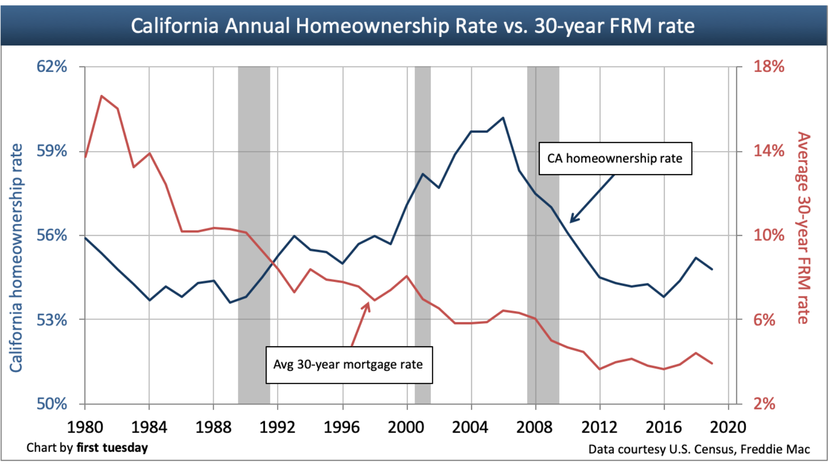
EVEN WITH LOW RATES, OWNERSHIP WAS DROPPING
Historically, Ownership Goes Down When Rates Go Up. Not This Time.

Slide 44
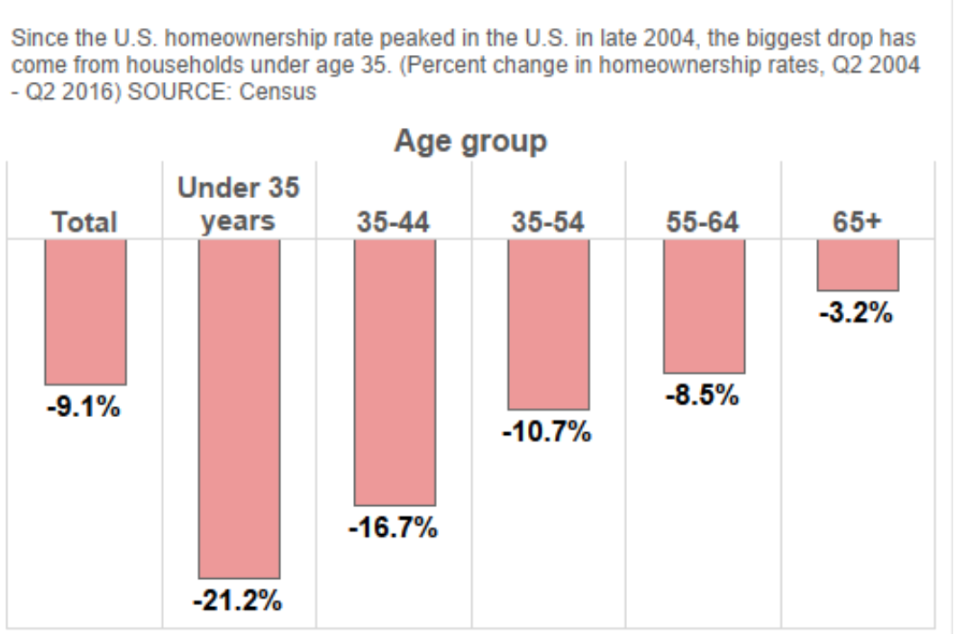
YOUTH EMBRACE RENTING
Since the Great Recession, only those over 65 buying homes at the same pace.

Slide 45
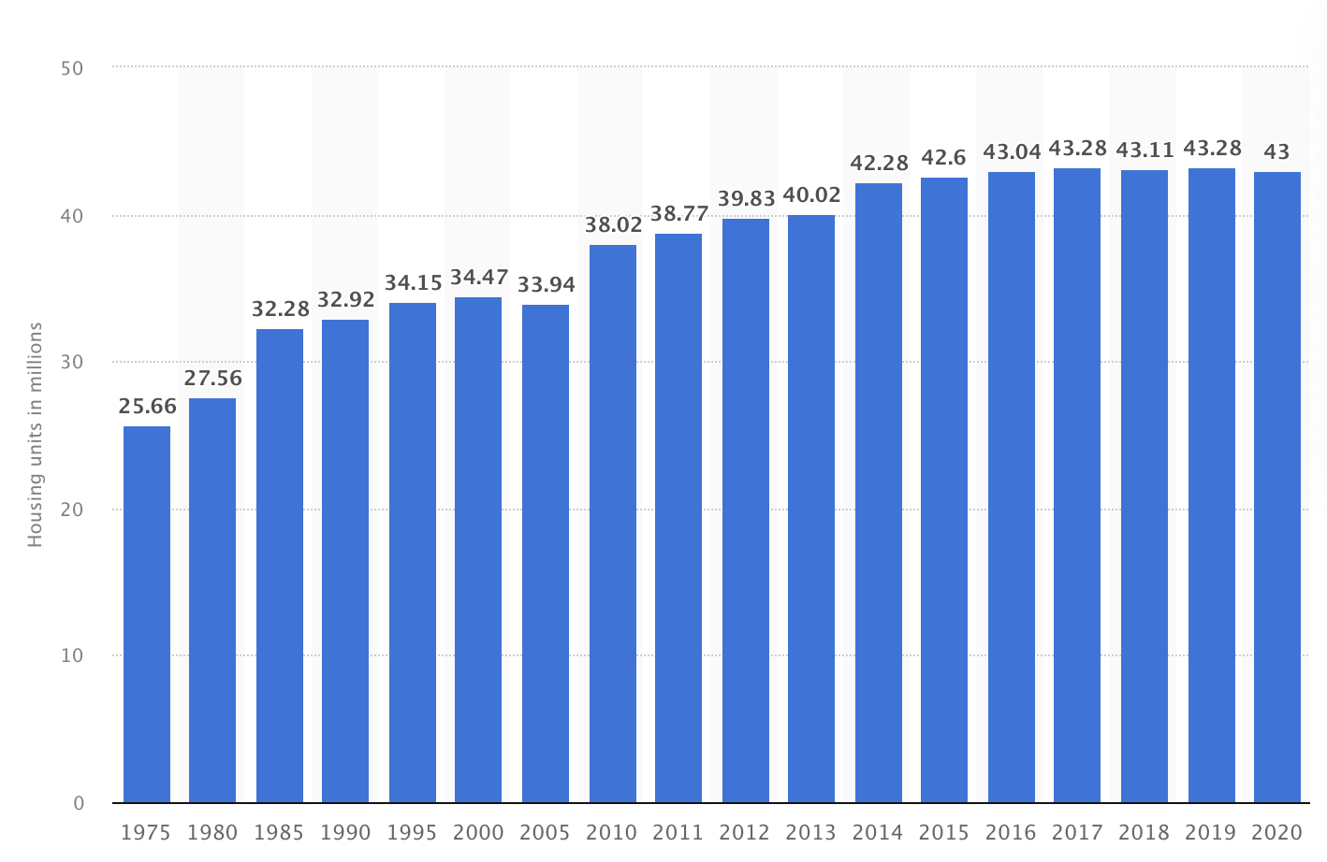
THE NUMBER OF RENTER OCCUPIED HOUSING UNITS IN THE UNITED STATES FROM 1975 TO 2020
5 MILLION MORE RENTER HOUSEHOLDS
IN 10 YEARS

Slide 46
People Rent, When It Is Cheaper to Rent Than to Buy
Top 3 States
Bottom 4 States

Slide 47


THE TENANT PROTECTION CONUNDRUM
If They Can’t Raise Rents,
Remove the Tenant and the Owner Must Pay for All Repairs: Why Buy?
NARPM Annual Convention & Trade Show

Slide 48

FROM OWNERS TO RENTERS
Currently 55% of All Households are Owners
Could be 50% in 10 years
Currently 70% of Owners Self-Manage
In Australia, Where Tenants are a Protected Class,
Only 30% Self-Manage

Slide 49

SOME OF THE NATIONAL RENTER TRENDS
No Limit on Section 8 Monthly Voucher
Mandatory Section 8 Acceptance
No Criminal History in Consideration
Date of Birth Eliminated for Consideration
Elimination of Eviction History
Fair Housing, Fair About What?
NARPM Annual Convention & Trade Show
Notes:
I’ve spoken to people who have a negative view of tracking metrics. But data is data. We coach our clients all the time to utilize data. Like driving a car with no dashboard. Or trying to lose weight without looking at the scale.
Our job is to share uncomfortable truths with our clients. We should embrace it in our lives. Does not mean be an asshole.

Slide 50

THE UNITED STATES OF AUSTRALIA
SMIPOS GO FROM FROM 70% to 50%
NARPM Annual Convention & Trade Show

Slide 51

The Real Estate Recession of 2022
(Lasting Through 2024)

Slide 52
RECENT HISTORY OF RECESSIONS
47 Recessions Since 1790
  Energy Crisis
  Iranian Revolution
  Inflation Jumped
  Interest Rates Climbed to 18%
  Home Prices Fell
  September 11 Attacks
  The Dot Com Bubble Burst
  Short and Shallow Recession
  Home Prices Fell Slightly
The Coronavirus Comeback
1973
To
1975
1981
To
1982
1990
To
1991
2001
To
2002
2007
To
2009
2020
To
2022
  OPEC Crisis
  Stock Market Crash
  Quadrupling of Oil Prices
  Home Prices Fell
  1990 Oil Price Shock
  Inflation Increased
  Fed Raised Rates
  Home Prices Fell
  The Great Recession
  Mortgage Crisis
  Bank Crisis ($700 billion bailout)
  Stock Market Steep Drop
  Massive Government Stimulus ($787 billion)
  Housing Prices Crashed (up to 50% in some areas)
NARPM Annual Convention & Trade Show

Slide 53

The Cause
01
Inflation at 5 to 9%
02
30 Fixed Rate Historically 2% Above Inflation Rate
03
Home Sales Decline 10% to 30%
04
Prices Decline 5% to 15%

Slide 54
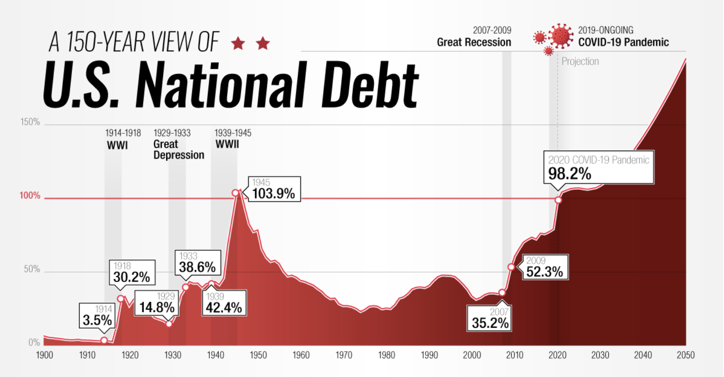
DEBT SERVICE LEVELS NOT SEEN SINCE WW2
Notes:
I’ve spoken to people who have a negative view of tracking metrics. But data is data. We coach our clients all the time to utilize data. Like driving a car with no dashboard. Or trying to lose weight without looking at the scale.
Our job is to share uncomfortable truths with our clients. We should embrace it in our lives. Does not mean be an asshole.

Slide 55
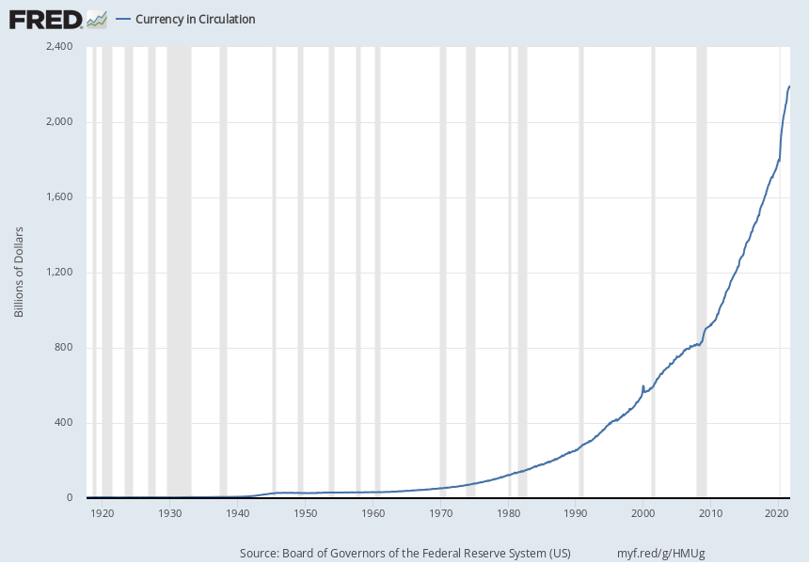
40% of the Money Ever Printed, Printed in 2020
Notes:
I’ve spoken to people who have a negative view of tracking metrics. But data is data. We coach our clients all the time to utilize data. Like driving a car with no dashboard. Or trying to lose weight without looking at the scale.
Our job is to share uncomfortable truths with our clients. We should embrace it in our lives. Does not mean be an asshole.

Slide 56
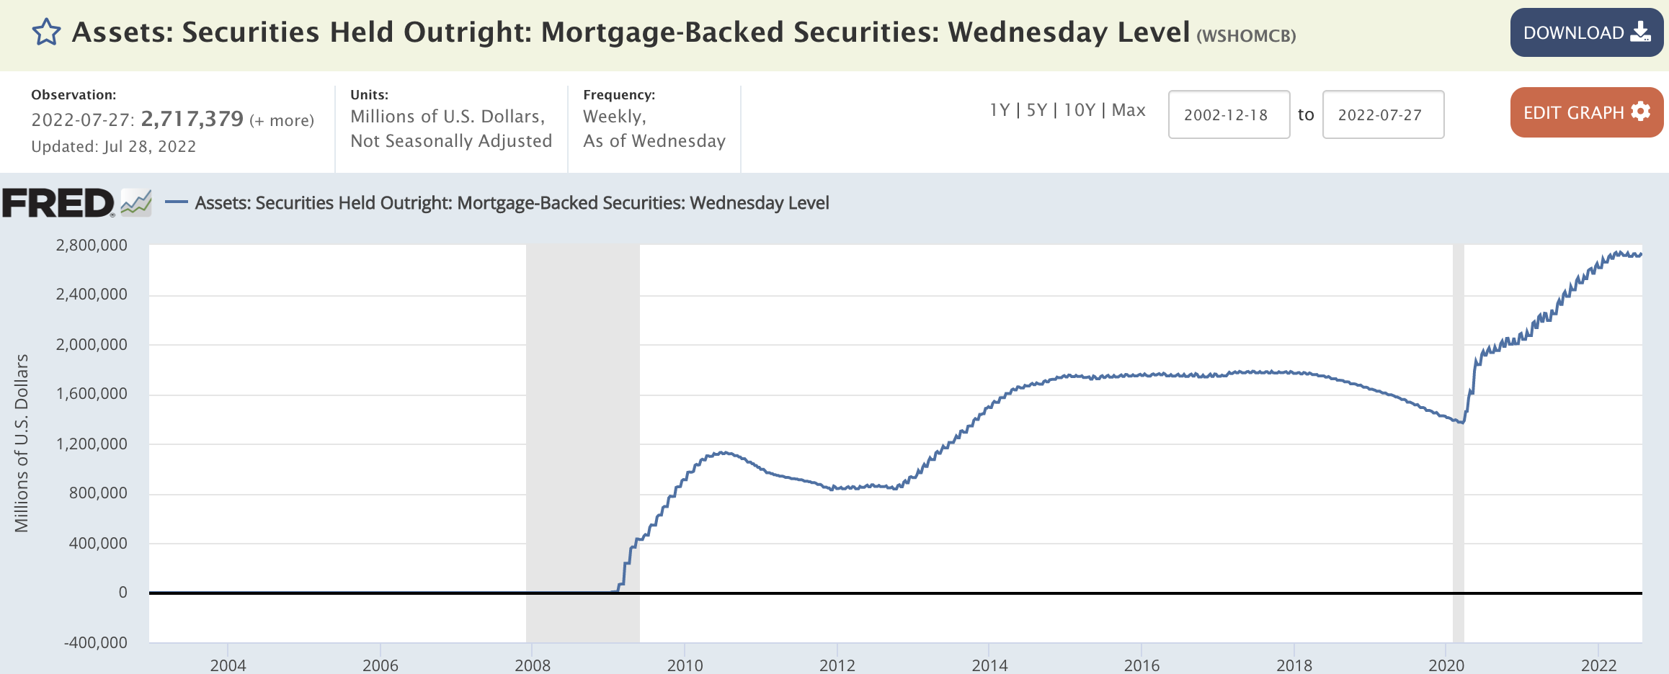
24% of All Mortgages Owned by Uncle Sam
Mortgage Backed Securities Owned by the Fed: $2.8 Trillion
Total Outstanding Mortgage Debt: $11.7 Trillion
Expected Loan Originations in 2023: $2.2 Trillion
Notes:
I’ve spoken to people who have a negative view of tracking metrics. But data is data. We coach our clients all the time to utilize data. Like driving a car with no dashboard. Or trying to lose weight without looking at the scale.
Our job is to share uncomfortable truths with our clients. We should embrace it in our lives. Does not mean be an asshole.

Slide 57
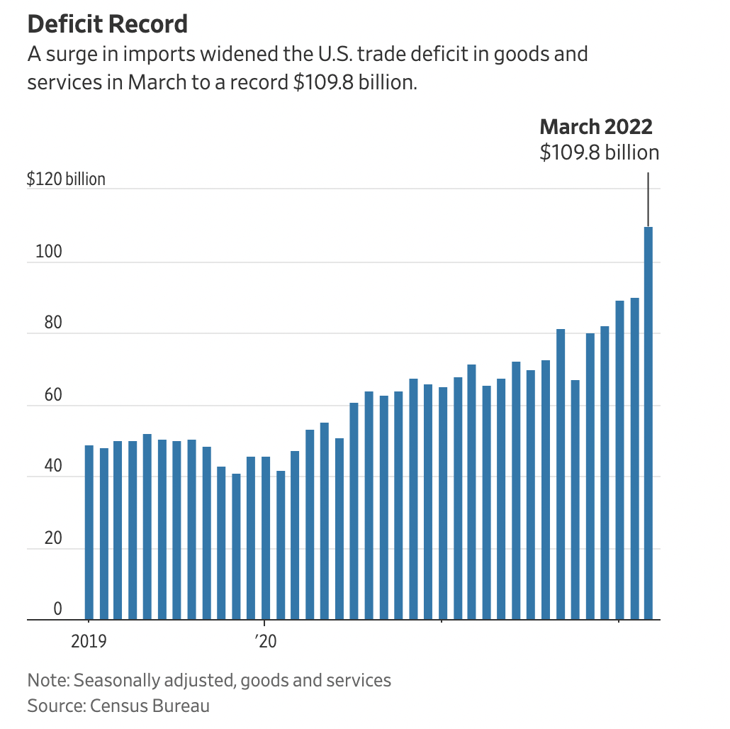
The Only Thing We Make is Money
Notes:
I’ve spoken to people who have a negative view of tracking metrics. But data is data. We coach our clients all the time to utilize data. Like driving a car with no dashboard. Or trying to lose weight without looking at the scale.
Our job is to share uncomfortable truths with our clients. We should embrace it in our lives. Does not mean be an asshole.

Slide 58
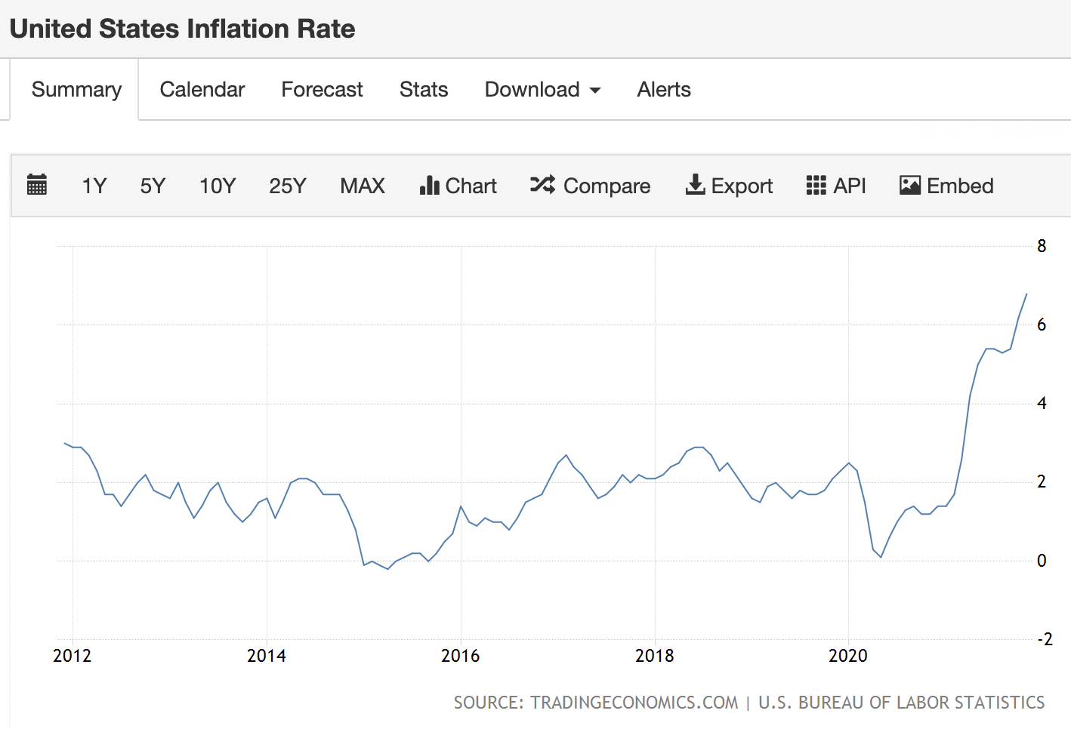
The Escalating Rate of Inflation
NARPM Annual Convention & Trade Show
Notes:
I’ve spoken to people who have a negative view of tracking metrics. But data is data. We coach our clients all the time to utilize data. Like driving a car with no dashboard. Or trying to lose weight without looking at the scale.
Our job is to share uncomfortable truths with our clients. We should embrace it in our lives. Does not mean be an asshole.

Slide 59
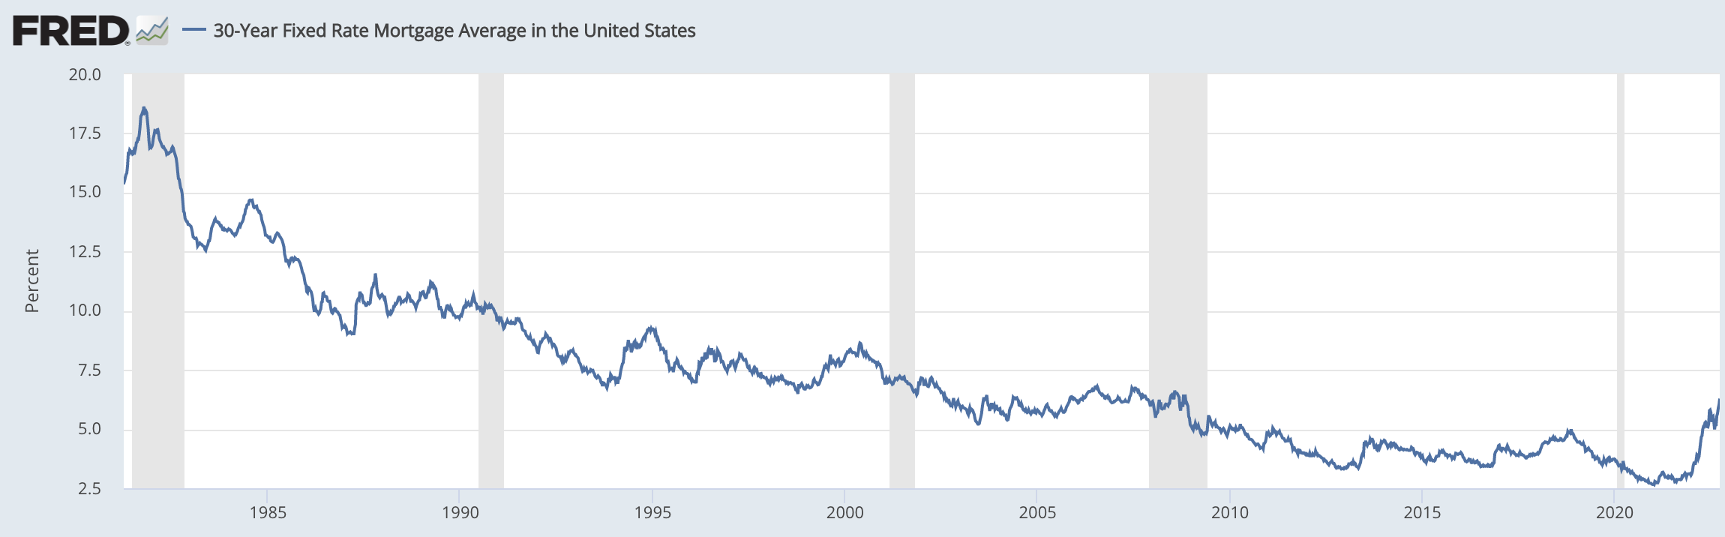
30 Years of Lower(ing) Rates
Notes:
I’ve spoken to people who have a negative view of tracking metrics. But data is data. We coach our clients all the time to utilize data. Like driving a car with no dashboard. Or trying to lose weight without looking at the scale.
Our job is to share uncomfortable truths with our clients. We should embrace it in our lives. Does not mean be an asshole.

Slide 60
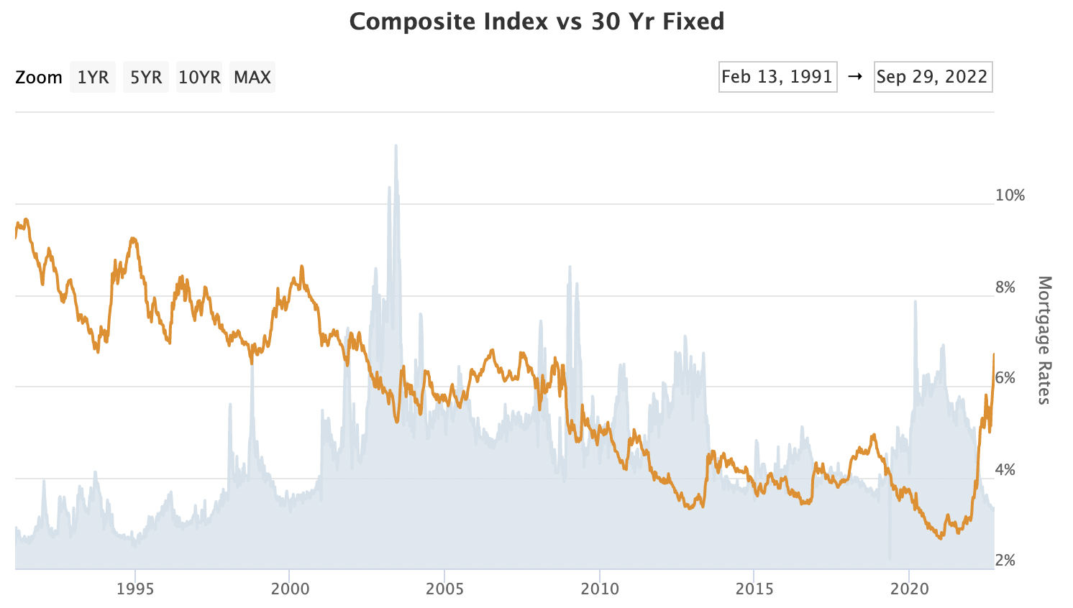
Will the Last Mortgage Banker Leaving the Office…
Notes:
I’ve spoken to people who have a negative view of tracking metrics. But data is data. We coach our clients all the time to utilize data. Like driving a car with no dashboard. Or trying to lose weight without looking at the scale.
Our job is to share uncomfortable truths with our clients. We should embrace it in our lives. Does not mean be an asshole.

Slide 61
THE REAL PAIN OF PAYMENT SHOCK
Variables | July 2021 | July 2022 | Increase
Average Sales Price | $442,680 | $465,000 | 14.2%
20% Down Payment | $88,536 | $93,000 | $4,464
Loan Amount | $354,144 | $372,000 | $17,856
Interest Rate | 3.26% | 6.25% | 91.7%
Payment | $2,643 | $4,115 | $1,472
TOTAL 1 YEAR INCREASE IN PAYMENT FOR A LAS VEGAS SINGLE FAMILY HOME |  |  | 55.7%
Notes:
I’ve spoken to people who have a negative view of tracking metrics. But data is data. We coach our clients all the time to utilize data. Like driving a car with no dashboard. Or trying to lose weight without looking at the scale.
Our job is to share uncomfortable truths with our clients. We should embrace it in our lives. Does not mean be an asshole.

Slide 62
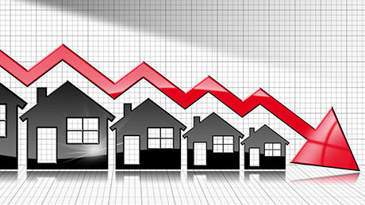
The Effect
A 4-Year Slow Home Price Decline
  Buyers Try to Time the Market
  Sellers Begrudgingly Lower Prices
  Do You Want to Stay, or Do You Want to Sell?
Anyone Remember
1991 to 1995?

Slide 63

WHAT GOES UP, MUST COME DOWN

Slide 64

IT’S OUR TIME TO SHINE

Slide 65
Rather than selling at a discount, sellers rent
Tenants stumble and stop paying
01.
04.
PROPERTY MANAGEMENT COMPANIES LOVE RECESSIONS
It takes longer to find a suitable tenant
With a low rate mortgage, a rental cash flows
02.
05.
Investors jump in and buy at a discount
Rent prices soften
03.
06.
NARPM Annual Convention & Trade Show

Slide 66



Embrace the Chaos

Slide 67


Slide 68


Commission Compression Makes Our Business More Appealing

Slide 69

The Renter State Makes Self-Managing More Difficult Creating More Doors

Slide 70

The Next Real Estate Recession Creates More Doors to Manage

Slide 71


Technology Acceleration
Makes Us More Profitable

Slide 72


WHAT’S A COMPANY TO DO?
Refine Your Success Propositions
Increase Per Door Income
Effective Marketing Makes “Sales” Unnecessary
Position Yourself as the Tenant Protection Expert
Embrace the “Aggregation of Marginal Gains”
Explore Ancillary Income Streams

Slide 73

WHAT WE ARE DOING AT PROGRESSIVE….
Expanding to North Los Angeles
Looking for AITD (All Inclusive Trust Deed) Deals
Aggressively Targeting HOAs (20 to 200 Owners)
Association JVs with Real Estate Companies
Considering a “Flat Fee Buyer Brokerage”
Adding Hard Money Loans for HOA Owners

Slide 74


“At the Heart of Capitalism is Creative Destruction.”
Joseph A. Schumpeter
NARPM Annual Convention & Trade Show

Slide 75

“You may have to forget the past in order to succeed in the future.”
Young Hutchison

Slide 76



“When you change the way you look at your business, your business can truly change.”
Scott P. Brady
Pricing
Programs
Growth Strategies
AddMoreDoors.com

