Slide 1
Speakers Workshop
The Founder and The Force Multiplier
Presented by:
DD Lee
Skyline Properties Group, A PURE Property Management Company
Lisa Wooten
Vision Realty & Management

Slide 2
DD Lee - Founder
Founded Skyline in 2004, sold to PURE at the end of 2021
Current team has 11 people
Amanda Trott is my Force Multiplier
Founded Skyline Community Management in 2011
Other businesses:
Cleaning Company
Turnkey Company
Utilities Billing Management Company
Airbnb Management Company
RV Rental
An international dating business

Slide 3
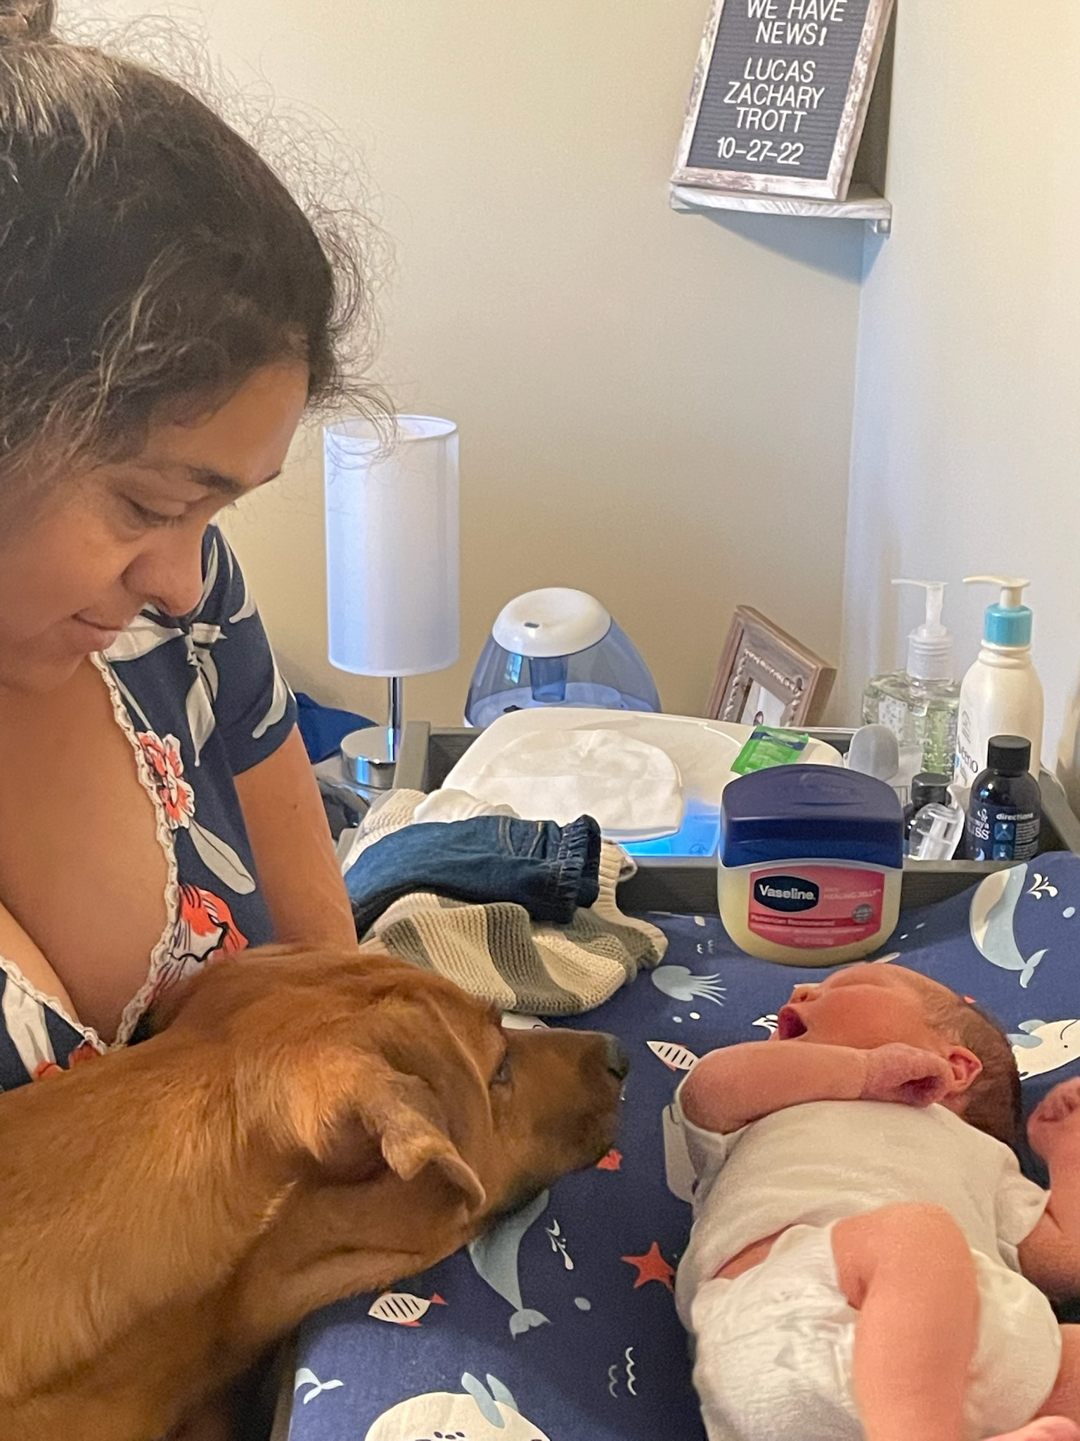
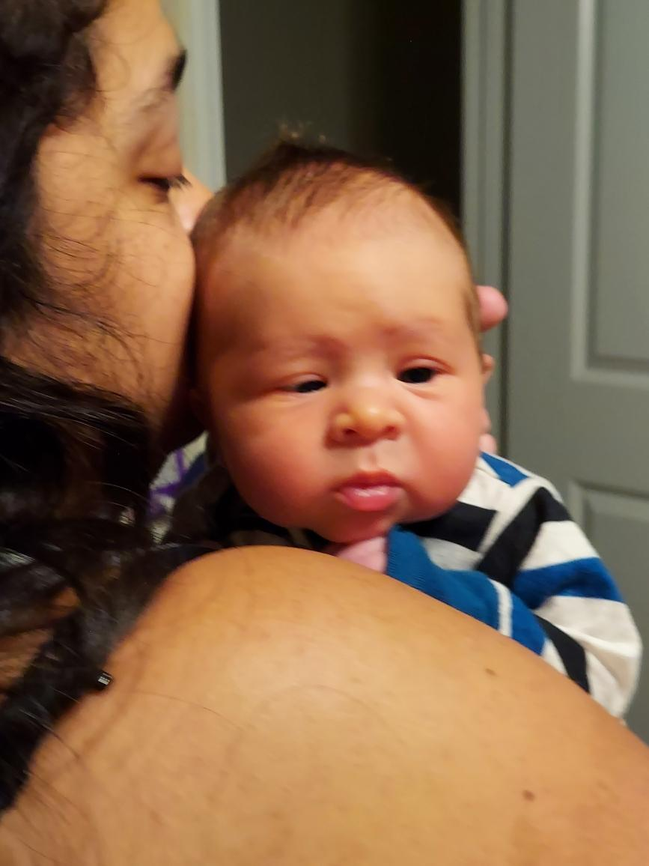
Amanda Trott - Force Multiplier

Slide 4
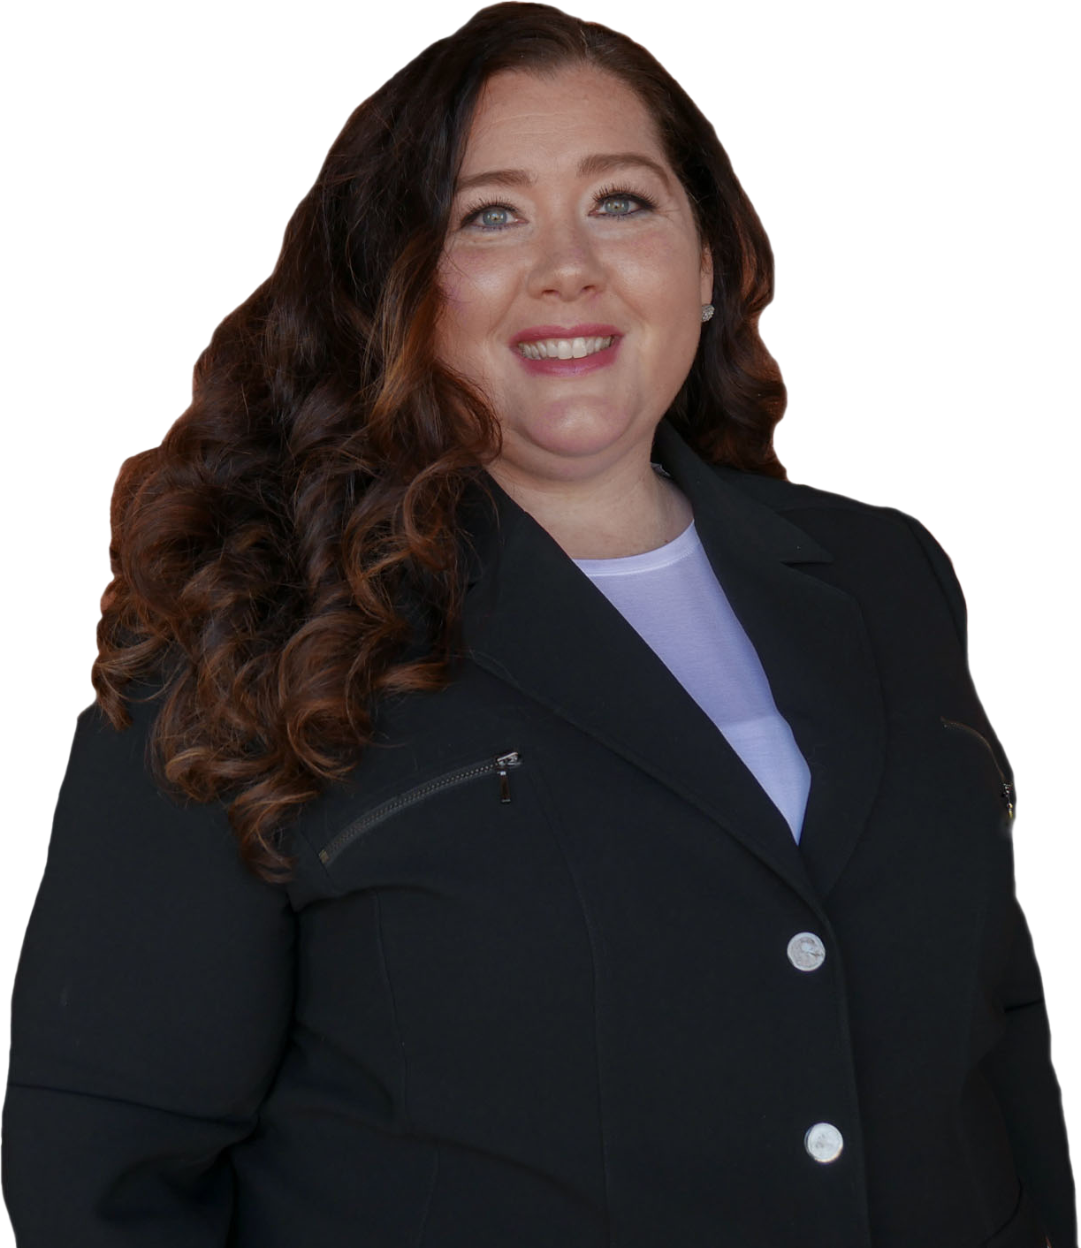
Lisa Wooten - Force Multiplier
Lisa joined Vision 9 years ago
Current team has 11 people
Force multiplier for Adam Hinman with Vision Realty & Management
Acquisition, rehab, SFR, commercial and multifamily portfolio management.
Lisa has worked side by side with Adam to grow the number of doors from 250 to over 600
Notes:
Lisa - tell story of what you did before Adam and how did Adam find you

Slide 5
In Other Words…
FORCE MULTIPLIER:
FOUNDER:
Visionary
Entrepreneur
Leader
CEO
Director of a Division
Personal Assistant
Admin Assistant
Executive Assistance
Right Hand
Operations Manager
Chief of Staff
Director of Operations
Notes:
DD: Ask for audience survey after this slide

Slide 6
Who are Founders
Notes:
DD - why do I need a force multiplier

Slide 7
Who are Force Multipliers
Notes:
Lisa - nurturing, detail oriented, organized - high liters
Lisa - why do i need a founder

Slide 8
THE BEGINNING OF
STRATEGIC RELATIONSHIP
80/20
Alignment of goals and expectations
Check-in Frequently
Build trust and cultivate loyalty
Inner circle
Lead up
Notes:
DD - define the 80/20
DD - goals - it doesn’t matter if I have 10 goals, if, Amanda only likes 3 of them, only 3 are getting accomplished

Slide 9
RESPONSIBILITIES OF THE FOUNDER - 20%
Seek business opportunities and growth
Strategize and overall planning
Spread your vision - make it viral
Provide focus, clarity, and direction for the team
Remove road blocks
Work on yourself - increase your leadership lid
Notes:
DD - At some point you are going to find yourself out of a job (no longer doing accounting, coordinating maintenance, making sales calls) - you want this because it means you have successfully surrounded yourself with talent who could do all the work instead of you. So what do you do then? identify your 20% and get rid of the 80%
Focus/Clarity - it’s not enough to just have a vision, show them how to get there. Provide extreme clarity and focus - break down the vision into weekly, monthly, quarterly goals, and annual goals. Give example of reaching 300 doors - marketing, BDM, customer service, google reviews. Make sure team understands and have them ask questions. If your team gets off track, remind them and help them refocus
Remove road blocks - give them tools, schedule 15 minute daily huddles, give them answers so they are not held up waiting for you.
Work on yourself - All of the above would not be possible if you don’t work on yourself professionally and personally. You want to always work on increasing your leadership lid or capacity. You cannot be an effective leader and serve if your tank is empty. Do what you need to to have mental clarity or That includes - read, meditate, exercise, attend conferences. Make your world big so that your team sees you as a vehicle for success
if it’s not on this list, get rid of it and delegate - you should not be managing your calendar or submitting expense reports or even booking your own travel

Slide 10
RESPONSIBILITIES OF THE FORCE MULTIPLIER 80%
Focuses more on the now
Driven by the demands of the Day
Manages the day to day operations
Maximize the Founders reach
Maximize the Founders time by keeping the top 20% of your job at the forefront of your mind at all times
Notes:
Lisa - share excitement about new ideas and then reality sinks in after 24 hours
examples of what you do for the business on a day to day

Slide 11
What does the Founder need from the Force Multiplier?
Confidence and trust that things will get done without me there
Clear and direct communication
Honesty
Accountability
Reality Check
Notes:
story about me and Amanda

Slide 12
What does the Force Multiplier need from the Founder?
Trust me enough to let go
Be accountable to your words and actions.
Clear, concise, consistent communication
Respect
Support
Notes:
Lisa - talk about how it made you feel when Adam gave you a company card and spoke about you to peers

Slide 13
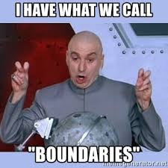
WHEN THINGS DON’T GO WELL…
Notes:
Lisa - Sticky note for 8 years that says “You were right I was wrong”
DD - convo with Amanda about doing too much for others

Slide 14
ACHIEVE MORE TOGETHER
How to find and hire an executive assistant?
Are you working with the right strategic partner?
Keep growing
Notes:
DD - How I hired Amanda
DD - VAs vs. Local
we become family

Slide 15
THE NEXT CHAPTER….
Amanda/DD
Lisa/Adam

Slide 17
CONTACT INFORMATIONS
DD’s contact info:
dlee@purepm.co
Lisa’s contact into:
lwooten@visionwestgeorgia.com

